Slide 1
Social Story
Coronavirus
Covid19

Slide 2
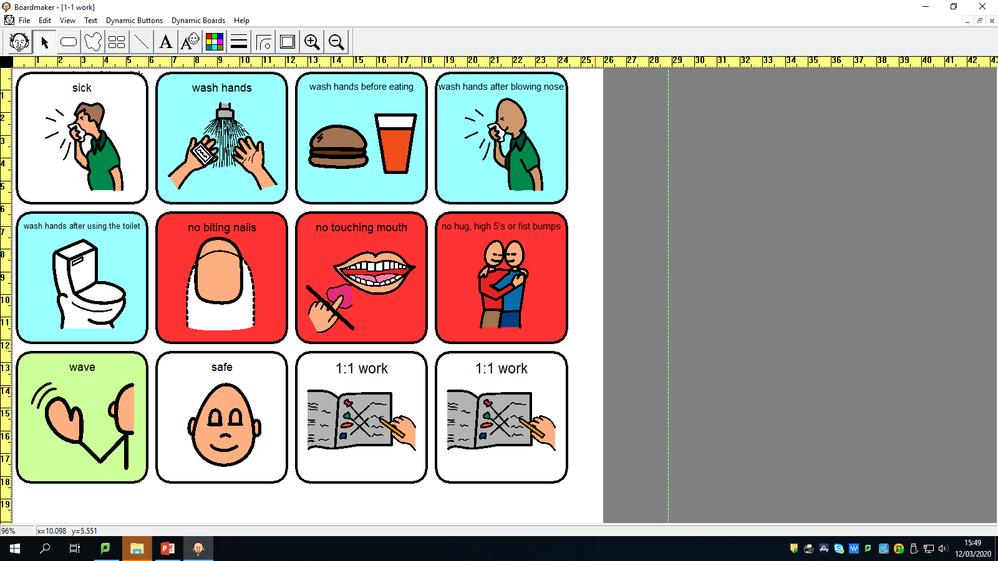
Coronavirus can be called “Covid19”.
Coronavirus is a new type of flu.
A flu will make you feel sick, but it is ok, you will feel better again.

Slide 3
I can keep safe from Coronavirus by washing my hands with soap and water.
I will wash my hands before I eat my food.
I will wash my hands after I sneeze, blow my nose or touch my mouth.
I will wash my hands after I go to the toilet.
I will be safe with my lovely clean hands.

Slide 4
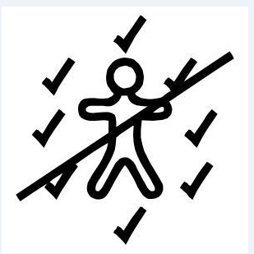

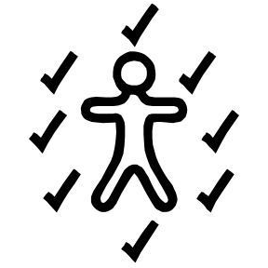

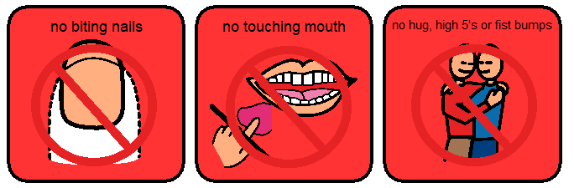
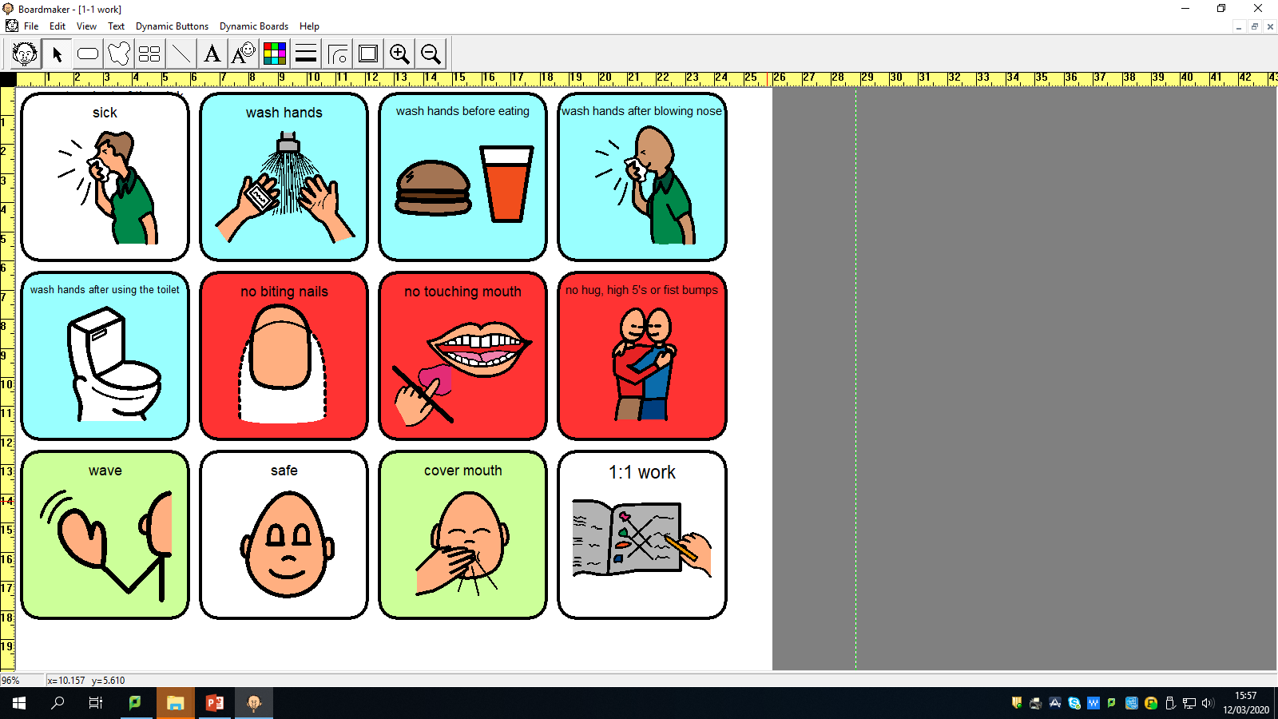
I will not bite my nails or put my hands in my mouth.
I will cover my mouth when I cough or sneeze.
If I am not feeling well, I will tell a grown-up.
I will not give my friends or staff high 5’s, hugs or fist bumps until everyone is feeling better.
I can do other things to be friendly, like give them a wave, an elbow bump or a dab!
Unhealthy choices
Healthy choices

Slide 5


My school might need to close for a while- everyone will stay at home instead.
It will be closed to let everyone get better.
A grown-up will let me know when I can go back to school.

Slide 6
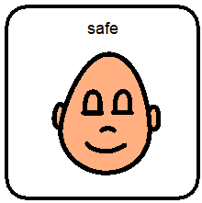
Just like other types of flu, coronavirus will go away soon.
I don’t need to feel worried, but if I do I can talk to an adult.
I will keep safe! Hurray!

