Slide 1
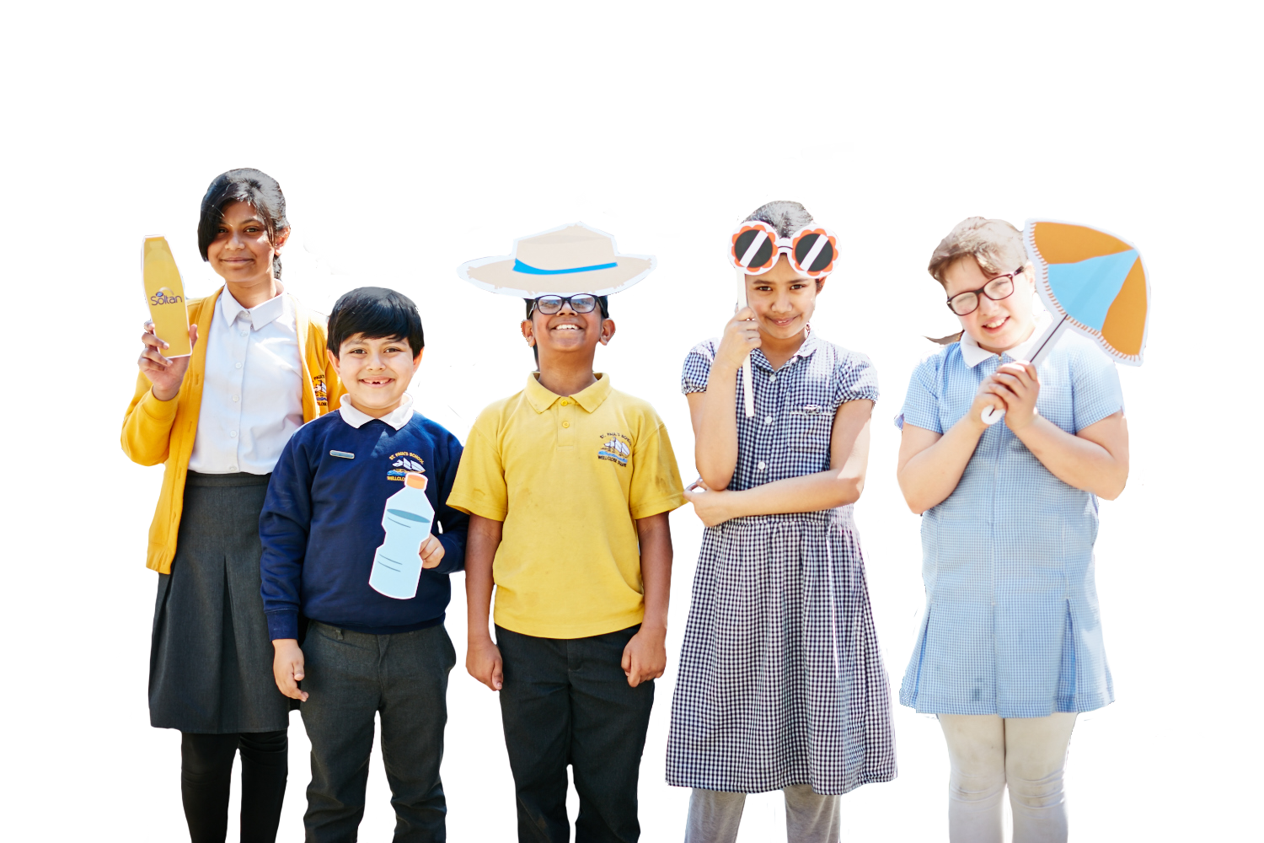


Sun Ready
Poster Project

Slide 2
To parents and guardians
The Sun Ready Poster Project helps children to learn about the effect of the sun’s UV rays and how to protect themselves against sun damage.
Children are then empowered to spread the word by creating a poster to remind themselves, and others, to stay safe in the sun. Display your poster in a window or in your garden to help remind yourself and your family to stay sun safe!
Using this presentation
Use this resource with your child. Slide notes contain further information to help you explain the concepts and ideas to your child.
Italicised notes indicate where there is differentiation between age groups.
Curriculum links
PSHE Core theme 1 – Health and Wellbeing
how to manage risks to physical health and wellbeing
how to make informed choices about health and wellbeing
Literacy
discussing words and phrases that capture the reader’s interest and imagination
discussing writing similar to that which they are planning to write, in order to understand and learn from its structure, vocabulary and grammar

Slide 3
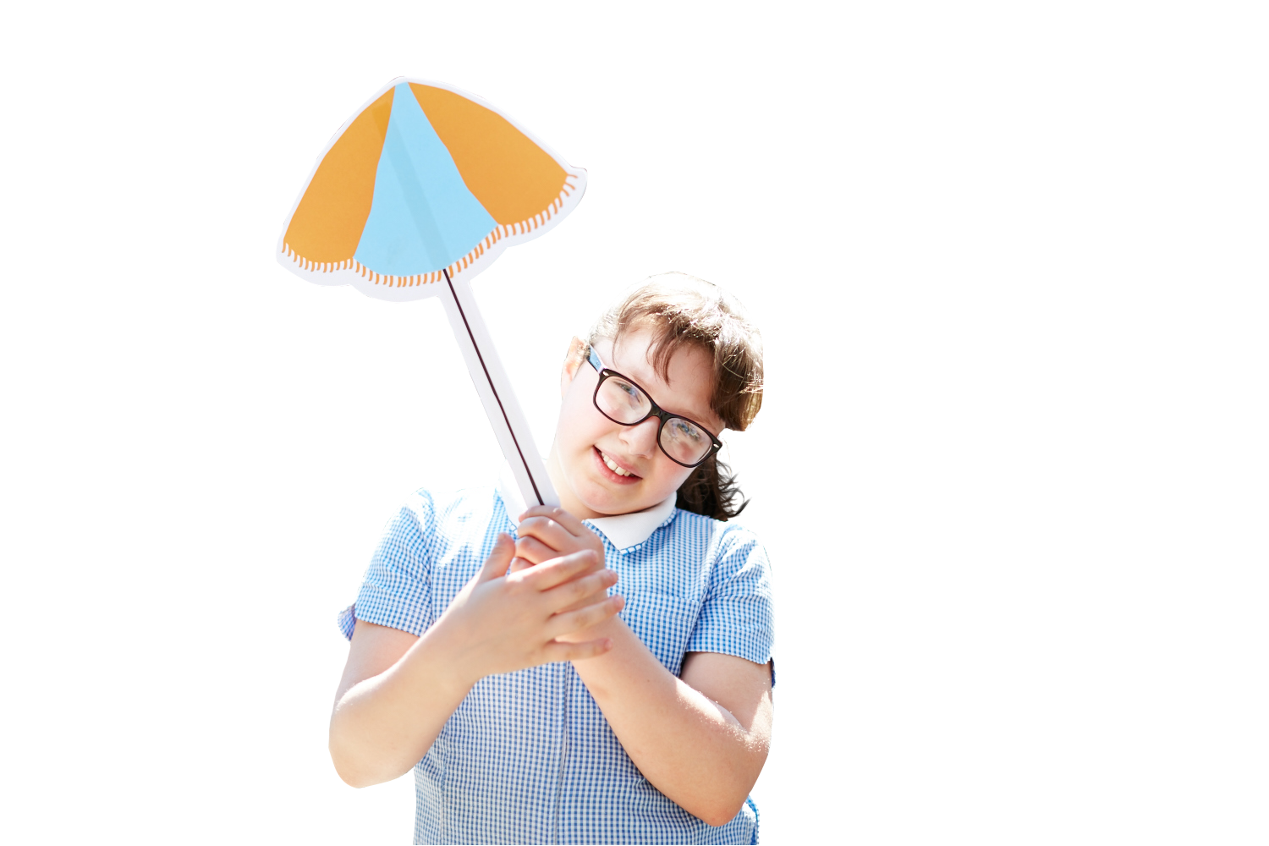
Learning objectives
Through this resource, children will have
the opportunity to learn:
That the sun gives off UV rays that can be harmful
Some of the risks associated with sun exposure
How to protect themselves from sun damage

Slide 4
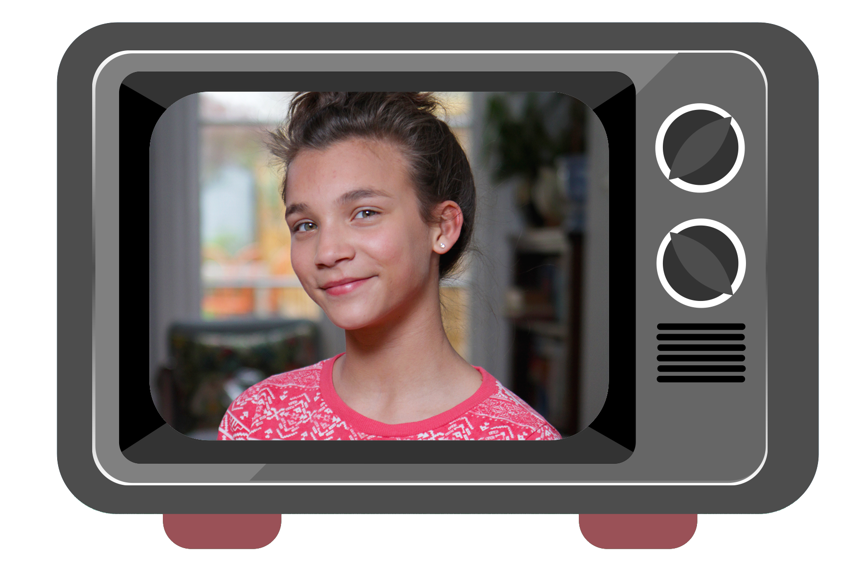

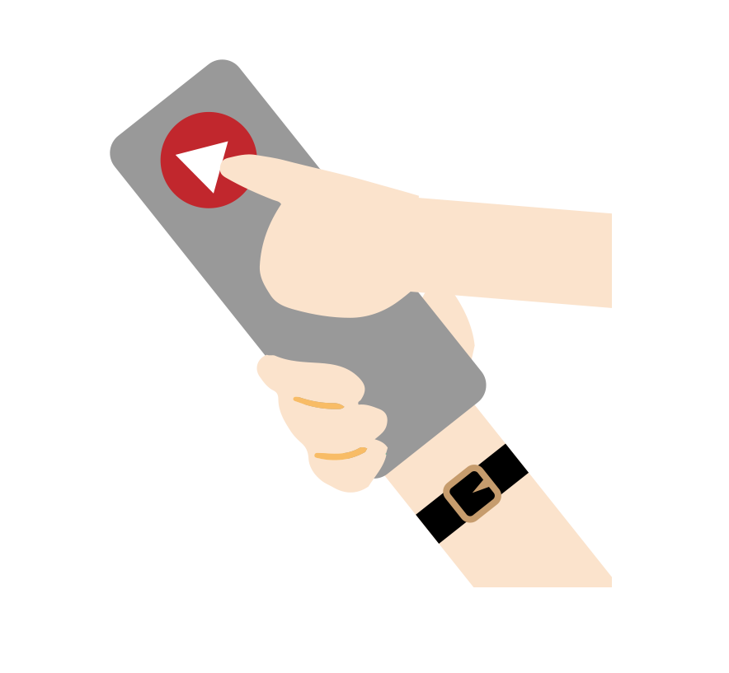



Tanai’s Story
Notes:
Introduce the video:
This is the story of a girl who loves football, but missed the biggest match of the season because of her sun burn.
Video: https://www.soltansunready.com/for-schools/Soltan-Sun-Ready-Tanai-story

Slide 5
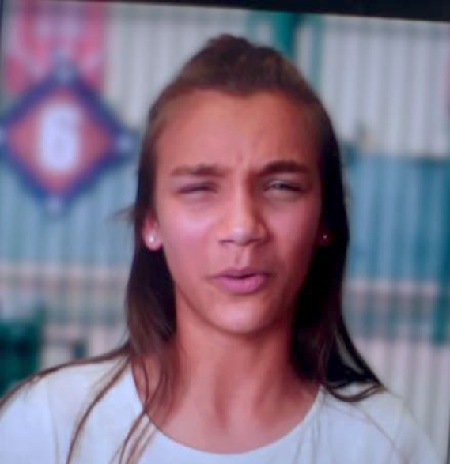
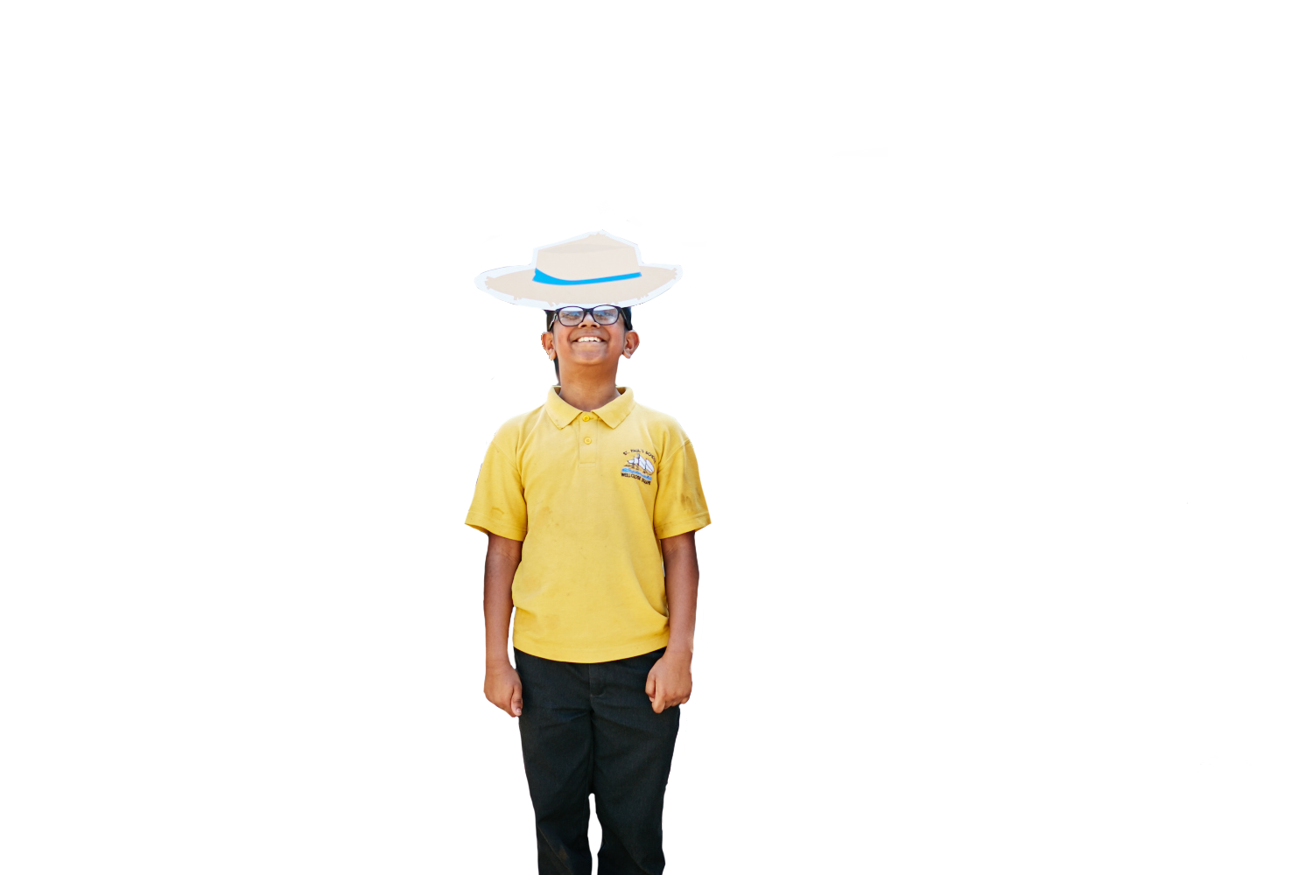
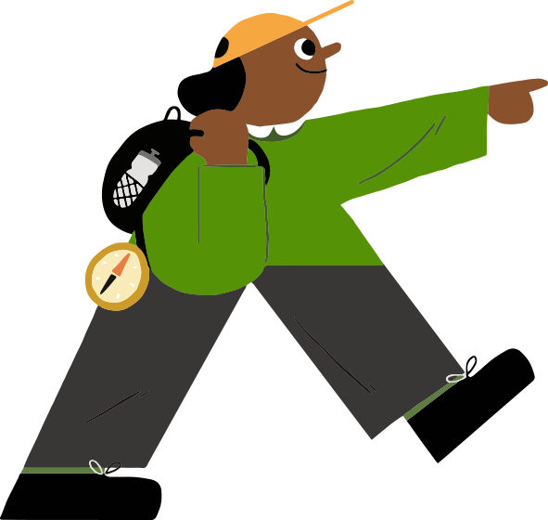



Sun burn can
damage your skin
Notes:
Ask your child to summarise what happened to Tanai:
Tania went to see her football team play, along with her friend
It was a very hot day
Tanai wore a sleeveless top and shorts
She had to queue for a long time to get her tickets and got sun burnt
The sun burn hurt so much that Tanai missed the match
Her mum told her that sun burn can damage your skin
Tanai had to stay inside for a week. Her skin was very red and sore
Questions:
Do you think that Tanai regretted getting sun burn? Why?
Can you think of anything she could have done to avoid getting sun burn?

Slide 6
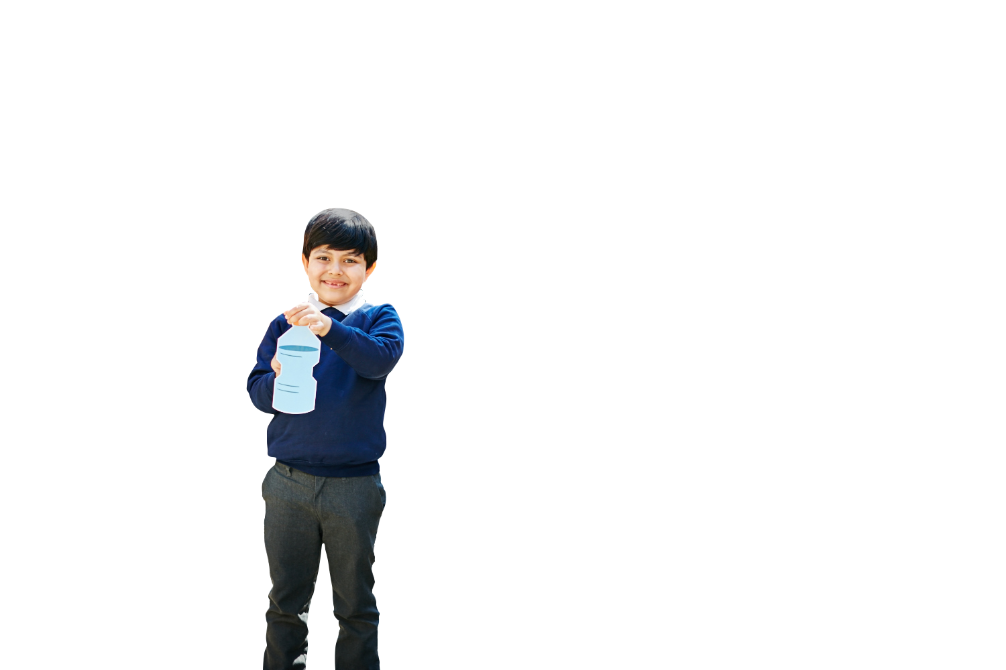
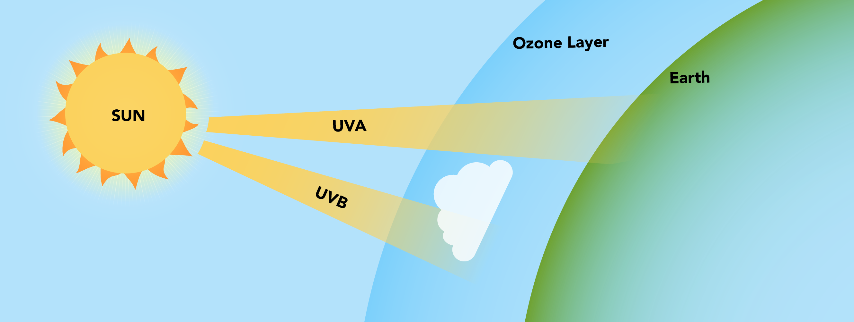
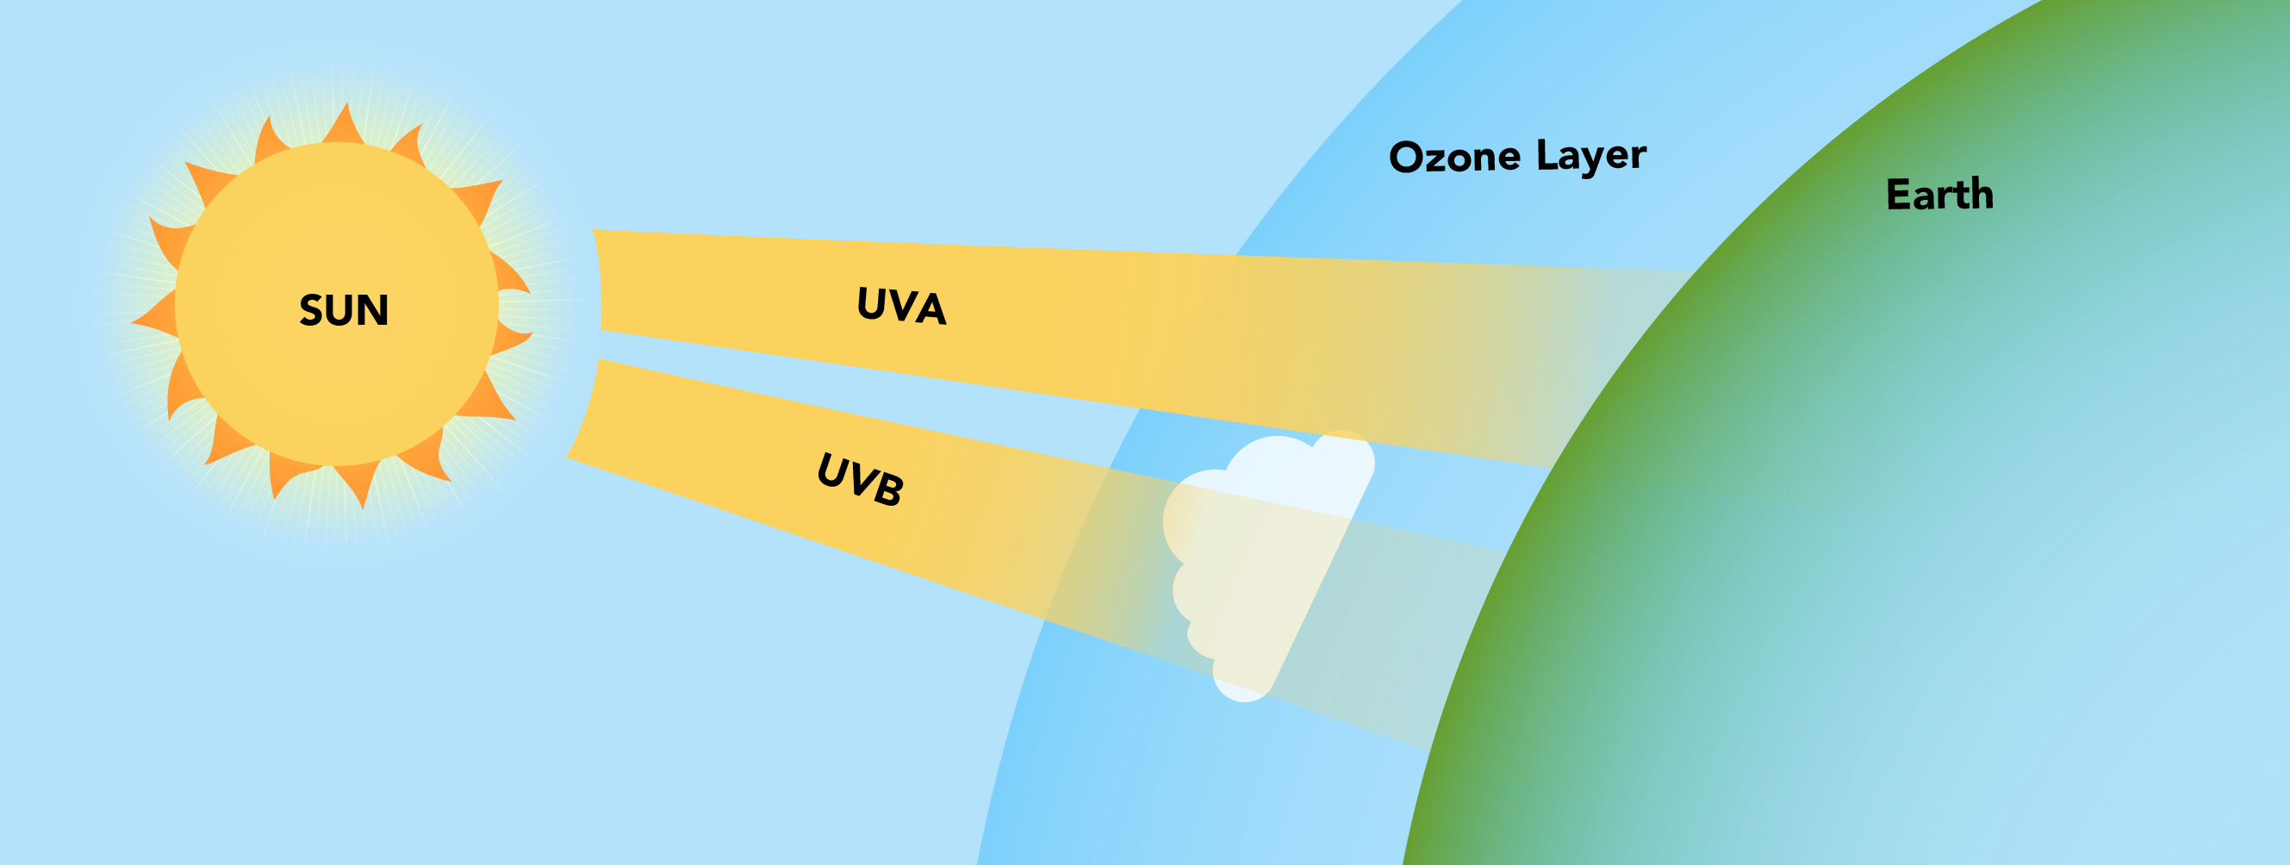
The sun’s UV rays
The sun gives off invisible rays.
These are called ultraviolet (or UV) rays.
Some UV rays are stopped by the ozone layer, but UVA and UVB rays can reach us on Earth.
These rays can cause sun burn and damage our skin.
Notes:
Explain what UV rays are:
The sun gives off light and heat, but it also gives off something we can’t see: invisible UV rays.
UV stands for ultraviolet.
UV rays have very high energy and can reach us all the way down on Earth.

Slide 7
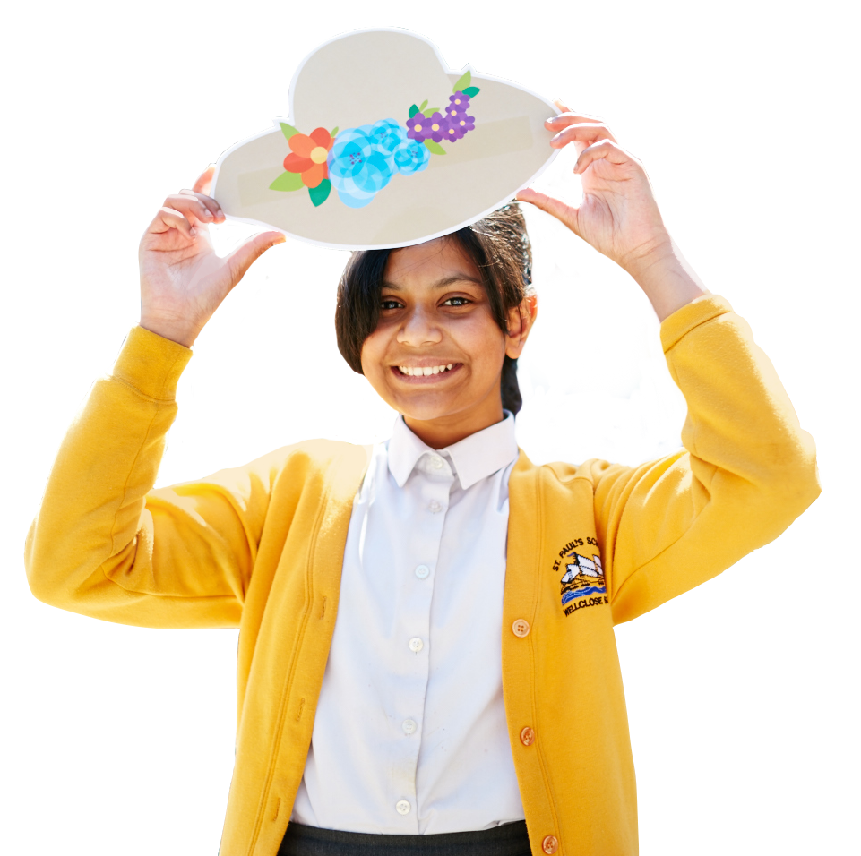
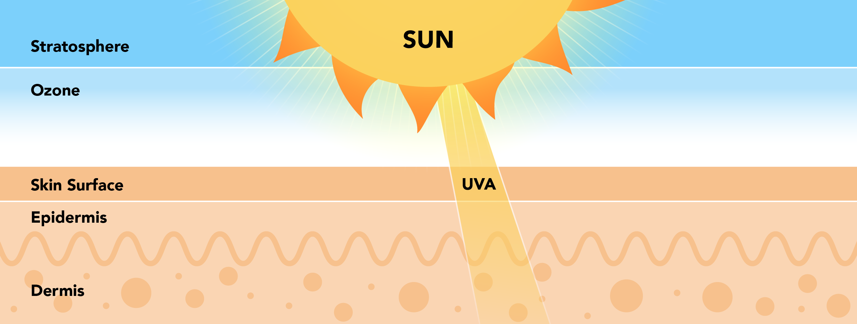
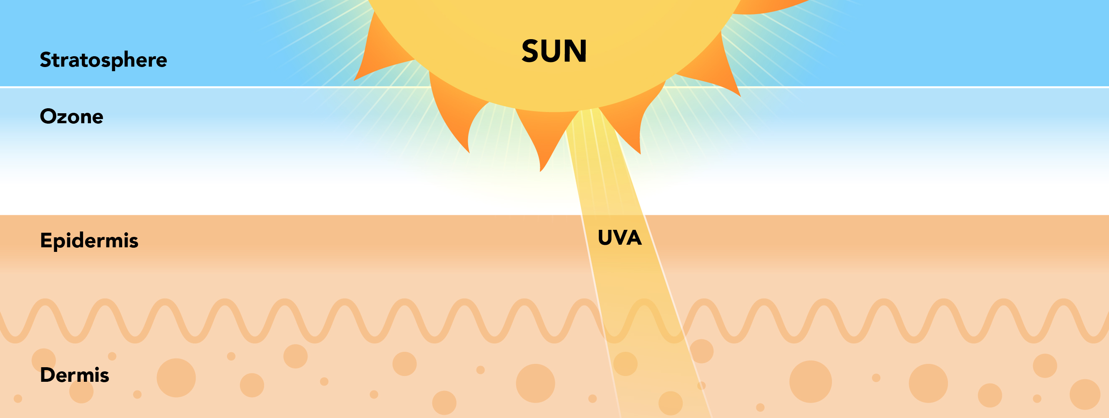
UVA rays
What are they?
The most common type of UV rays
Rays that can go very deep into your skin
Rays that can reach you even on overcast days or through windows
What do they do?
Damage eyes
Damage skin and cause dark spots
This damage can be permanent,
a bit like a tattoo you can’t remove!
Notes:
Basic information (4-7):
Explain that UVA rays can go very far down into your skin. Even though you might not be able to see it, UVA rays can cause damage.
Further information (7-11):
Most of the UV rays that reach Earth are UVA rays. They are less intense than UVB rays, but can penetrate more deeply into the skin.
The epidermis is the outer layer of the skin.
The dermis is the layer beneath the epidermis, which contains structures like nerve endings, sweat glands and blood capillaries.

Slide 8
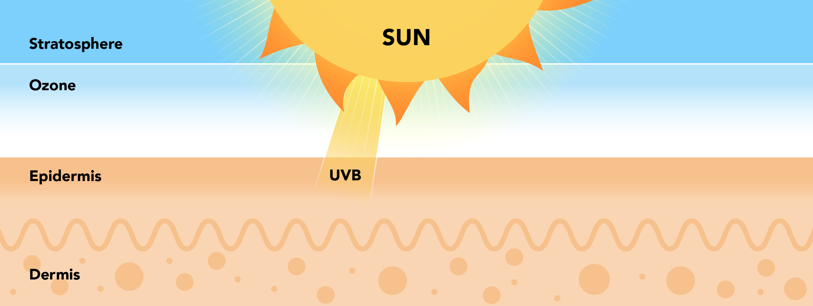
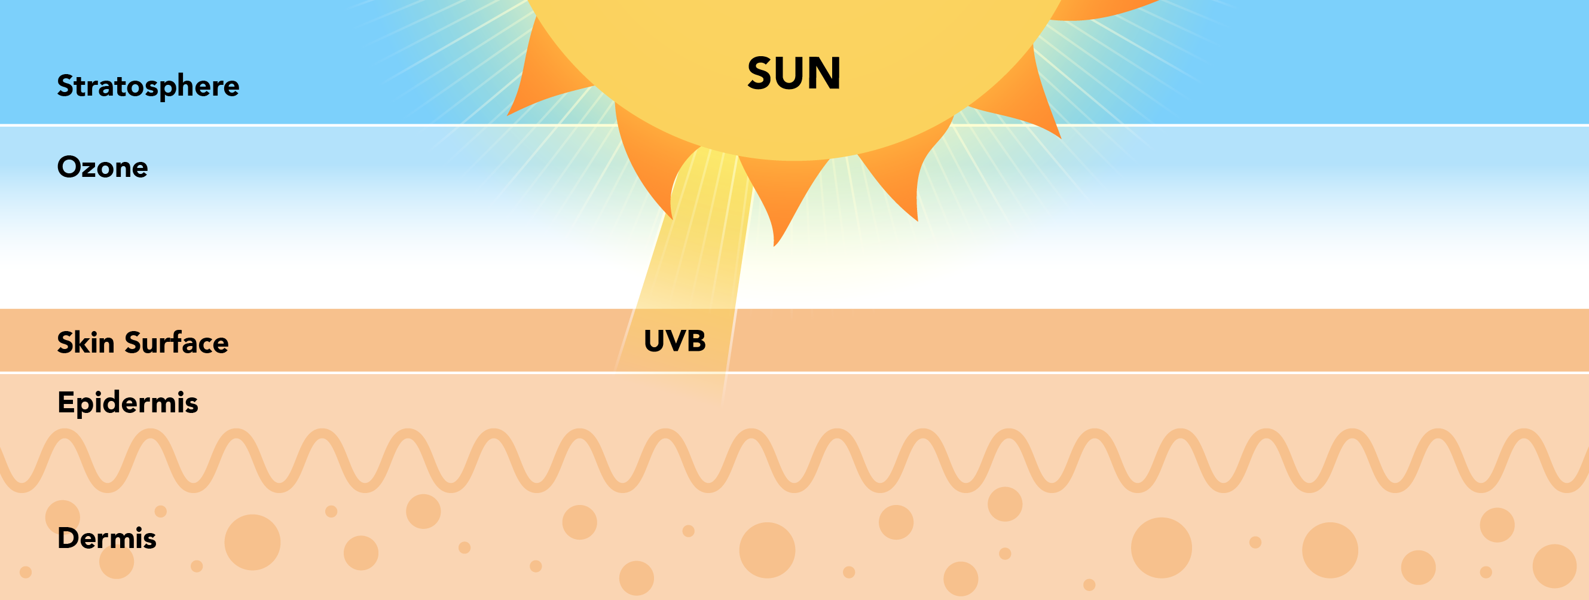
UVB rays
What are they?
Less common type of UV rays
Rays that mostly affect the surface of your skin
Very strong and powerful rays
What do they do?
Cause sun burn
This can make your skin red and really sore!
Notes:
Basic information (4-7):
Explain that UVB rays can be very strong and cause sun burn. Even after a sun burn heals and goes away, the sun damage from UVB rays can be permanent.
Further information (7-11):
UVB rays are less common on Earth because most of them get absorbed by the ozone layer. They don’t penetrate the skin as deeply as UVA rays, but they still cause damage and are the main cause of sun burns.

Slide 9
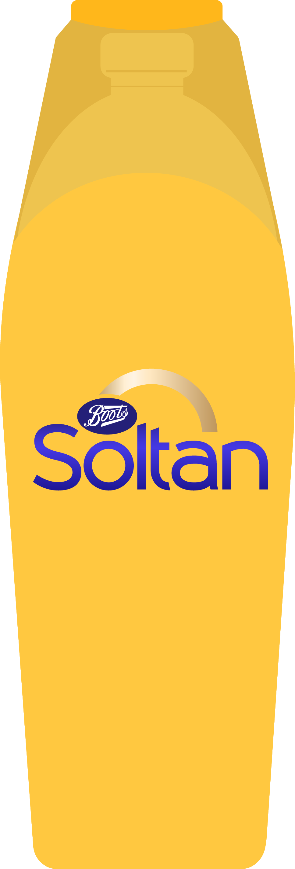


Sun protection
Look for sun protection with:
Five star UVA protection
A high SPF (at least 30)
Notes:
The SPF number tells us how much protection a sun protection product gives you against UVB rays. For the best protection, choose SPF 30 or higher.
The star rating shows how well the product protects against UVA rays. A five star rating means it offers the best protection.

Slide 10

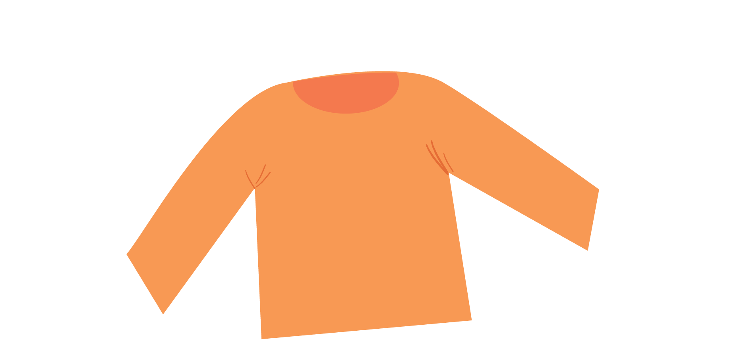

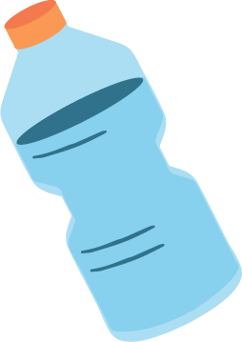
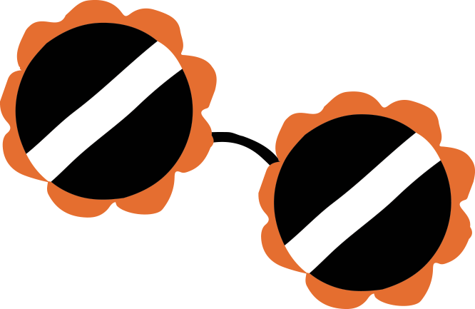
We need to be Sun Ready
Click to find out about our Five Top Tips for staying sun safe!
Seek some
shade between 11-3.
Five star UVA rated sun protection (with at least
SPF 30).
Cover up your skin.
Drink plenty of water.
Wear sunglasses to protect your eyes.
Notes:
Explain how each object helps us to be sun ready:
- Five star rated sun protection with a high SPF (at least 30): protects our skin from both UVA and UVB rays.
- Hat and top: keeps the sun off our head, face and body.
- Sunglasses: protect our eyes from the sun.
- Water: keeps us hydrated.
- Sun shade: keeps UV rays off us. It is especially important to stay out of the sun from 11-3, as this is when the sun’s rays are strongest.

Slide 11
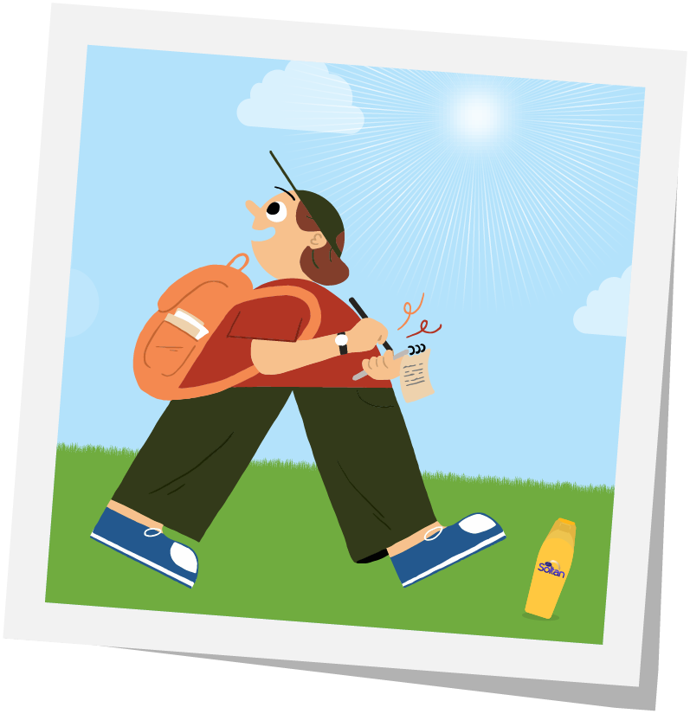
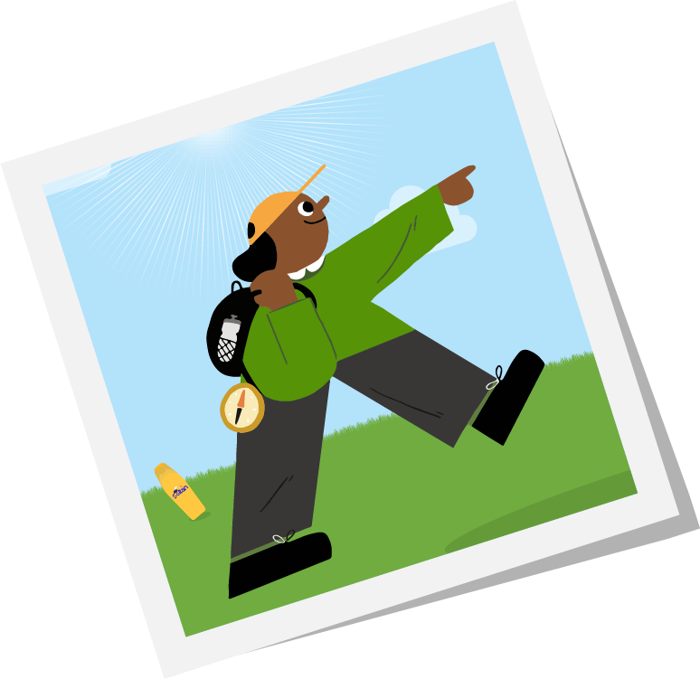
Quiz time!
Let’s find out if you’re Sun Ready!
Choose your quiz
4–7 year olds
7–11 year olds
Notes:
Use the buttons to skip to your chosen quiz. If preferred, you can delete the slides that you don’t want to use.

Slide 12

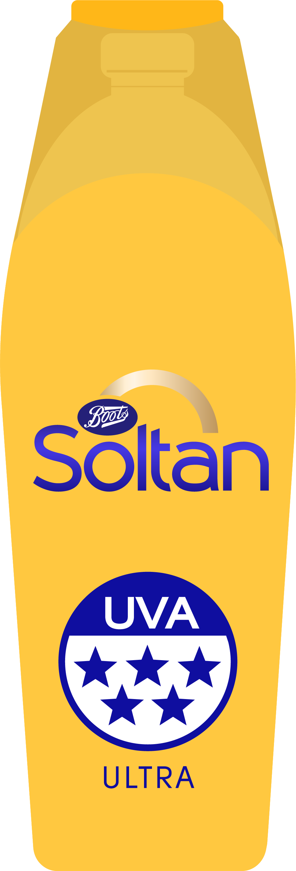
Question 1 / 5
True or False?
The sun makes rays
called UVA and UVB.
True
False
The sun makes UVA and UVB rays. These can cause sun burn and other damage to your skin. Look out for a sun protection that has a high SPF and a five star UVA rating
to protect against both types.
Next
Notes:
Answer: True
The sun makes ultraviolet rays called UVA and UVB.

Slide 13
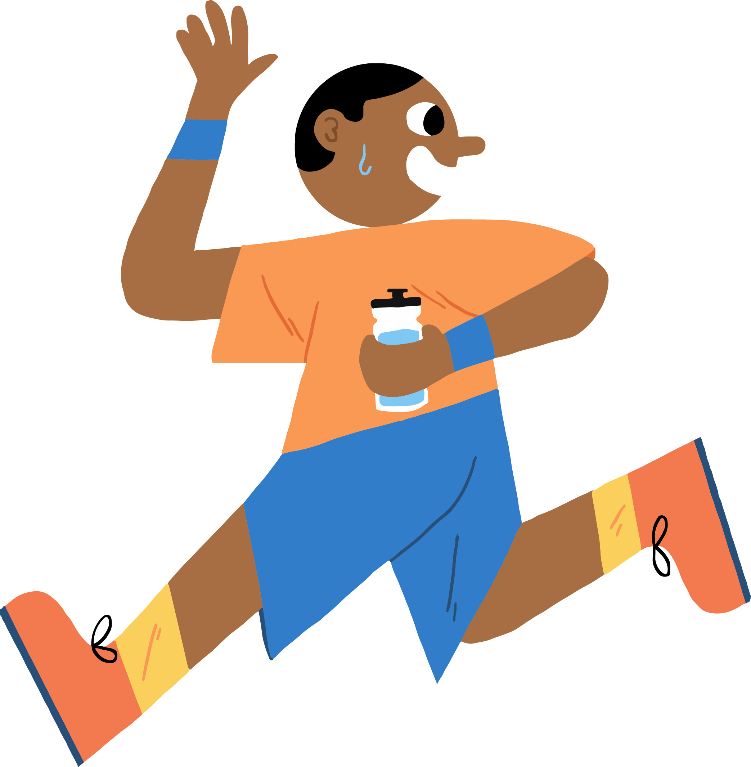
Oops, try again!
Back to question

Slide 14
Question 2 / 5
True or False?
Too much sun can
give you a sun burn.
True
Too much sun can cause sun burn, making your skin red and sore. Sun burn is easy to see, but it’s not the only kind of damage that the sun can cause. It can also damage your eyes, cause dark spots on your skin or lead to damaged skin in the future.
False
Next
Notes:
Answer: True
The sun can cause sun burn, as well as other damage that you can’t always see.

Slide 15
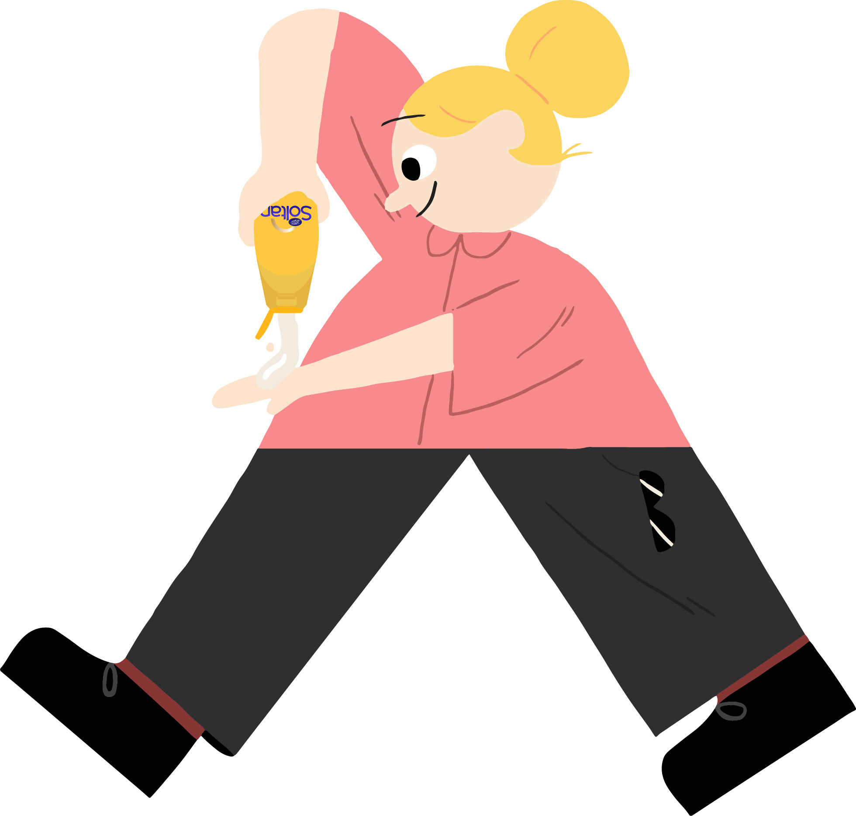
Oops, try again!
Back to question

Slide 16
Question 3 / 5
True or False?
Sun damage is
never permanent.
True
False
Even if you can’t see it right away, some sun damage can be permanent! That’s why it’s important to protect yourself from harmful rays.
Next
Notes:
Answer: False
Even if you can’t see it right away, some sun damage can be permanent!

Slide 17
Oops, try again!
Back to question

Slide 18
Question 4 / 5
True or False?
It’s important to look for a high
SPF (at least 30) and a five star
UVA rating when choosing sun protection.
True
False
A five star UVA rating on sun protection means that it gives the maximum protection against UVA rays. Also use sun protection products with SPF 30 or higher.
Next
Notes:
Answer: True
A five star rating on sun protection is the maximum level of protection against UVA rays. SPF 30 or higher is recommended to best protect against UVB rays.

Slide 19
Oops, try again!
Back to question

Slide 20

Question 5 / 5
Which of these can help you
stay safe and get sun ready?
Read each idea and decide if it
helps keep you sun safe.
Finish quiz
Wear a hat and clothes that cover your skin
Use five star UVA rated sun protection
(and at least
SPF 30)
Wear sunglasses to protect your eyes
Eat oranges
Drink water when it’s
hot out
Seek some shade during the hottest times of day
Stand very
still and
don’t move
Notes:
Answers:
a. Wear a hat and clothes that cover your skin. (Choose light materials so you don’t get too hot.)
b. Wear sunglasses to protect your eyes
d. Drink water when it’s hot out. (This is especially important if you’re doing physical activity.)
e. Stay in the shade during the hottest times of day. (The hottest times are between 11 and 3.)
g. Use five star UVA rated sun protection (and at least SPF 30). Check the label on your sun protection to make sure it has the five star UVA rating and a high SPF.

Slide 21
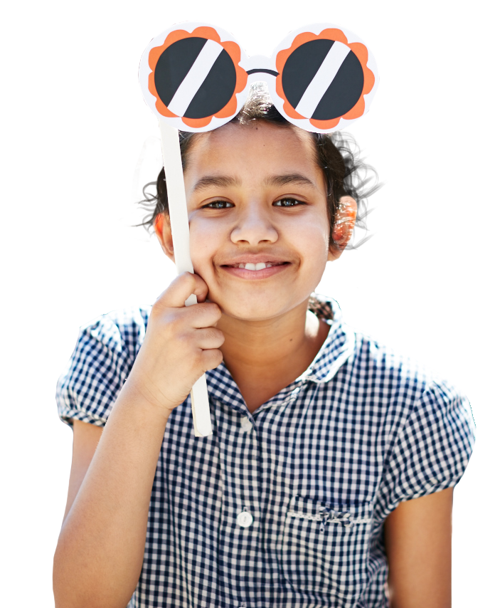
Question 1 / 5
What are the rays
that the sun gives off?
UVA
and UVB
QRS
and TUV
Type 1
and
Type 2
The sun gives off UVA and UVB rays. These can cause sun burn and other damage to your skin. It’s important to use sun protection that protects against both.
Next
Notes:
Answer:
UVA and UVB
These rays can cause sun burn and other kinds of damage.

Slide 22
Oops, try again!
Back to question

Slide 23
Question 2 / 5
Which rays can
penetrate deeper
into your skin?
UVA rays
UVA rays can go deeper into your skin and cause damage in the future, even if you can’t see it right away. UVB rays don’t go as deep, but can cause sun burn and other skin damage.
UVB rays
Next
Notes:
Answer: 1. UVA rays
These rays can go deeper into our skin and can cause long-term skin damage.

Slide 24
Oops, try again!
Back to question

Slide 25
Question 3 / 5
Which one is NOT true
about the sun’s rays?
They can
cause
permanent
damage to
your skin.
They can
damage your eyes
They can make you grow taller
The sun’s rays can’t make you grow taller, but they can cause permanent damage to your skin and your eyes. That’s why it’s important to protect yourself from
harmful rays.
Next
Notes:
Answer:
c. They can make you grow taller.
The sun can’t help you grown taller, but it can cause permanent skin damage and hurt your eyes.

Slide 26
Oops, try again!
Back to question

Slide 27
Question 4 / 5
Select all the things
you should look for in sun protection.
SPF 30 or higher
Five star
UVA rating
3 star
UVA rating
A five star UVA rating on sun protection means that it gives the maximum protection against UVA rays. Use protection products with SPF 30 or higher to protect against UVB rays.
Next
Notes:
Answers:
a. SPF 30 or higher
b. Five star UVA rating
These things show you that a sun protection product offers the best protection.

Slide 28
Oops, try again!
Back to question

Slide 29
Question 5 / 5
Which of these can help you
stay safe and get sun ready?
Read each idea and decide if
it helps keep you sun safe.
Finish quiz
Wear a hat and clothes that cover your skin
Use five star rated sun protection
(and at least
SPF 30)
Wear sunglasses to protect your eyes
Stay near a pool
Drink water when it’s
hot out
Stay in
the shade during the hottest times of day
Stand very still while in the sun
Notes:
Answers:
a. Wear a hat and clothes that cover your skin. (Choose light materials so you don’t get too hot.)
b. Wear sunglasses to protect your eyes
d. Drink water when it’s hot out. (This is especially important if you’re doing physical activity.)
e. Stay in the shade during the hottest times of day. (The hottest times are between 11 and 3.)
g. Use five star rated sun protection (and at least SPF 30). Check the label on your sun protection to make sure it has the five star rating and a high SPF.

Slide 30

Congratulations!
You’re a Sun Ready expert!
Now that you know all about being sun ready, take part in the Sun Ready Poster Project!
Get creative and encourage your family to stay safe and get sun ready.

Slide 31
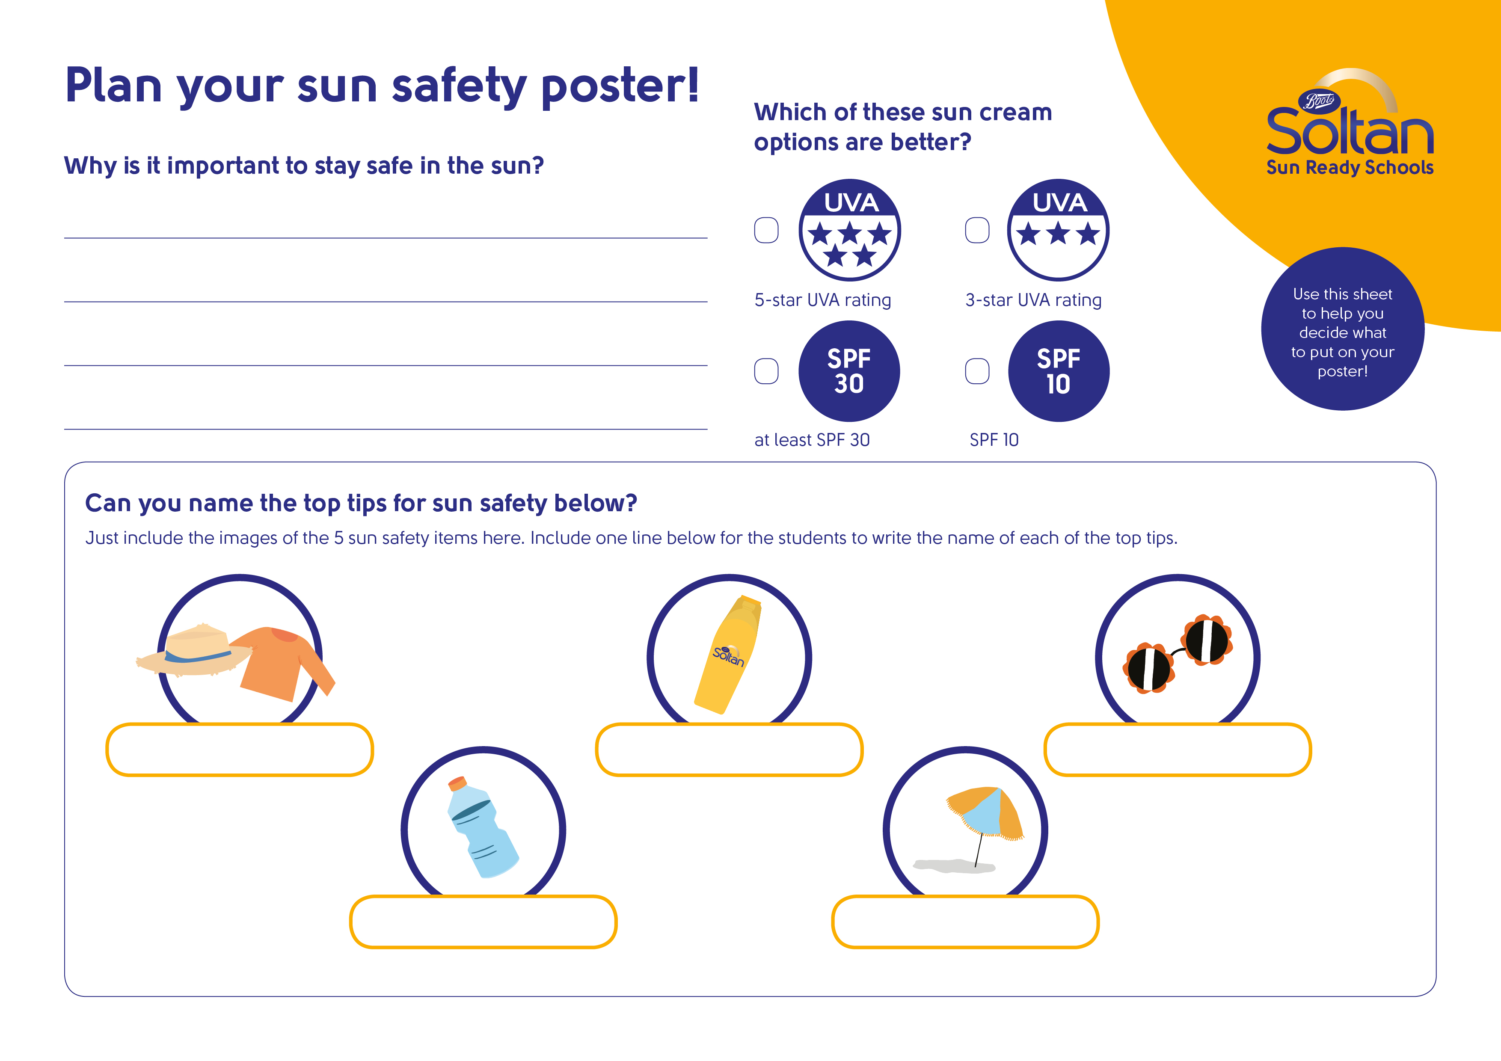
Let’s create a sun safety poster!
Notes:
This activity should only be attempted by children aged between 4 and 7 years old. The activity for older children starts on slide 33.
Explain to the children that their task is to create a poster that encourages their family to be sun safe and explains how they can do this.
If necessary, recap some of the main points of this lesson using these questions:
Why is sun safety important?
What can you do to be sun safe?

Slide 32



Make a poster
Notes:
This activity is for children aged between 4 and 7 years old. The activity for older children starts on slide 33.
Key points:
Make sure the poster displays at least one way that people can stay sun safe – the images on screen will help children to remember how to stay sun safe.
Encourage children to use a range of colours in their poster to make it stand out.

Slide 33
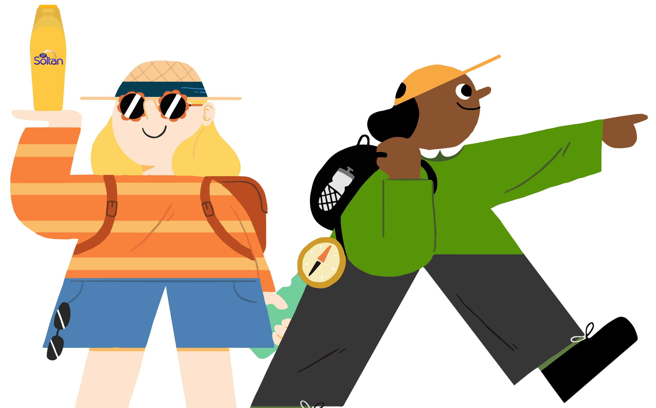
Let’s create a Sun
Ready poster!
Notes:
This activity is for children aged between 7 and 11 years old. The activity for younger children starts on slide 31.
Start by asking your child what an poster is. Do they have any ideas?
A poster is a set of images designed to make people do or be aware of something, e.g. buy a product, take part in an activity or start behaving differently.
Can your child think of any examples of posters?

Slide 34
Planning your poster
Who is your audience?
What are your key messages
What is your slogan?
Notes:
This activity should only be attempted by children aged between 7 and 11 years old. The activity for younger children starts on slide 31.
Planning your poster
Explain that, before starting work on their poster, it’s important to plan.
Before your child starts working on their poster, use the notes below to help them plan out their work.
Audience
Posters work best when you have a clear idea of your audience. Why do you think that is?
You can tailor your messages to what your audience will be interested in or need to know most, choose a design style that will appeal to them, and put your poster in a place where it will be seen.
Ask your child to decide who their poster will target, for example:
younger children
children their age
parents
teachers
Key messages
Do you know what a key message is?
The most important information that they want to get across to their audience – it’s what they want their audience to know or do – it should be short, snappy and easy to remember.
Key messages for this poster are likely to include the following:
Wear a hat
Cover up
Use sun protection
Stay in the shade
Wear sunglasses
Drink plenty of water
Make sure that your child understands that different formats can work better for different audiences or in different places. As their poster is going to take place in their local community, a poster works well. It can be placed on lamp posts or in shop windows, and images and slogans can be used to make the poster engaging.
Slogans
Most successful posters have a slogan, which helps to make the message in the poster stick in people’s minds. Slogans are short, memorable sentences that relate to your poster and encourage people to act in a certain way.
Can your child think of any famous slogans?
Ask your child what they think makes a good poster.
Explain that they will need to think of their own slogan and add it to their poster.

Slide 35
Make a poster
Notes:
This activity should only be attempted by children aged between 7 and 11 years old. The activity for younger children starts on slide 31.
Key points:
Make sure that your poster provides information to people about how to stay sun safe. It should focus on at least one method of staying sun safe. Be sure to use your research to back up your points by using facts and statistics.
Make sure that your poster is engaging. You might decide that it should be colourful, simple, striking or bright – whatever you decide to do, it needs to be something that will encourage people to be sun safe.
Make sure to include a slogan that will stick in people’s brains and keep them thinking about sun safety.

Slide 36
The Soltan Sun Ready Website
Examples of posters made by other children can be found on the Soltan Sun Ready website’s gallery page.
Explore the website to find more sun safety information and fun activity ideas!
Notes:
Go to the Soltan Sun Ready website’s Families page for more ideas to keep your children entertained and sun safe this summer: https://soltansunready.com/for-families

