Slide 1
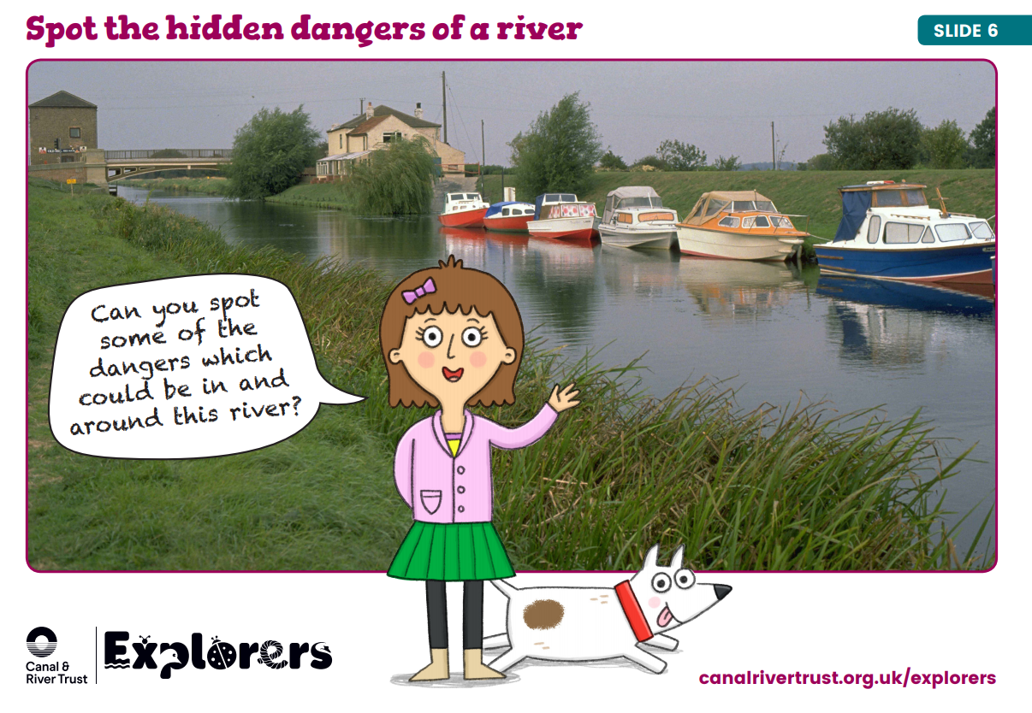

Slide 2
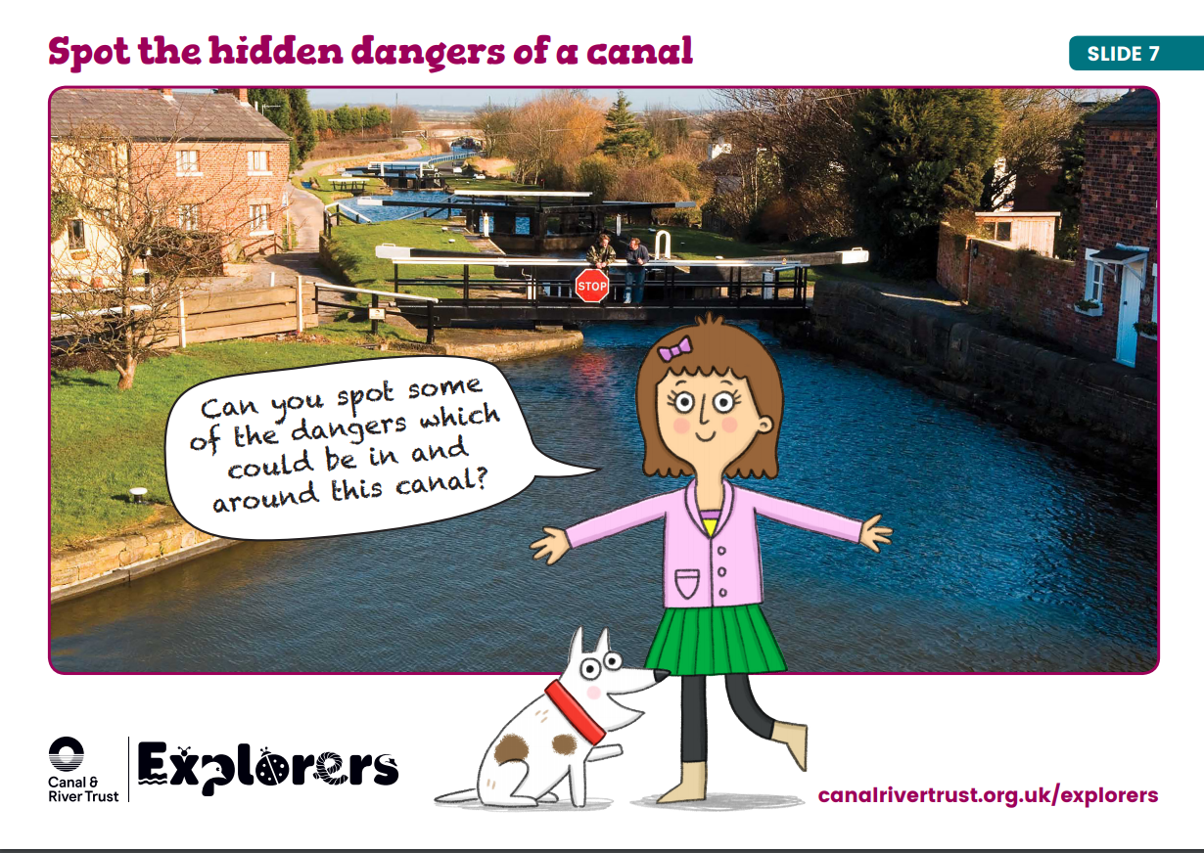

Slide 3
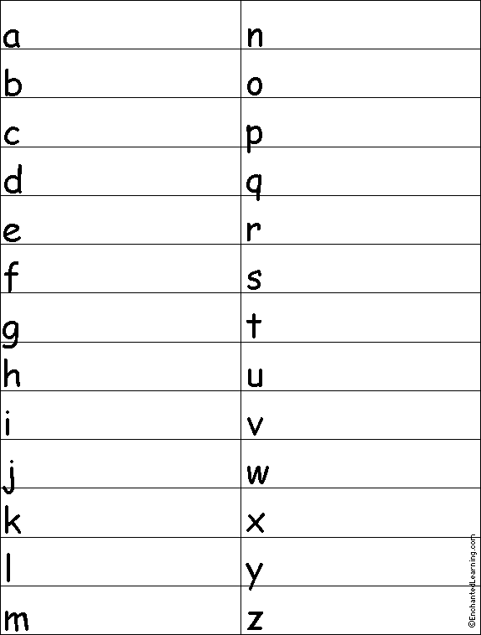

Slide 4
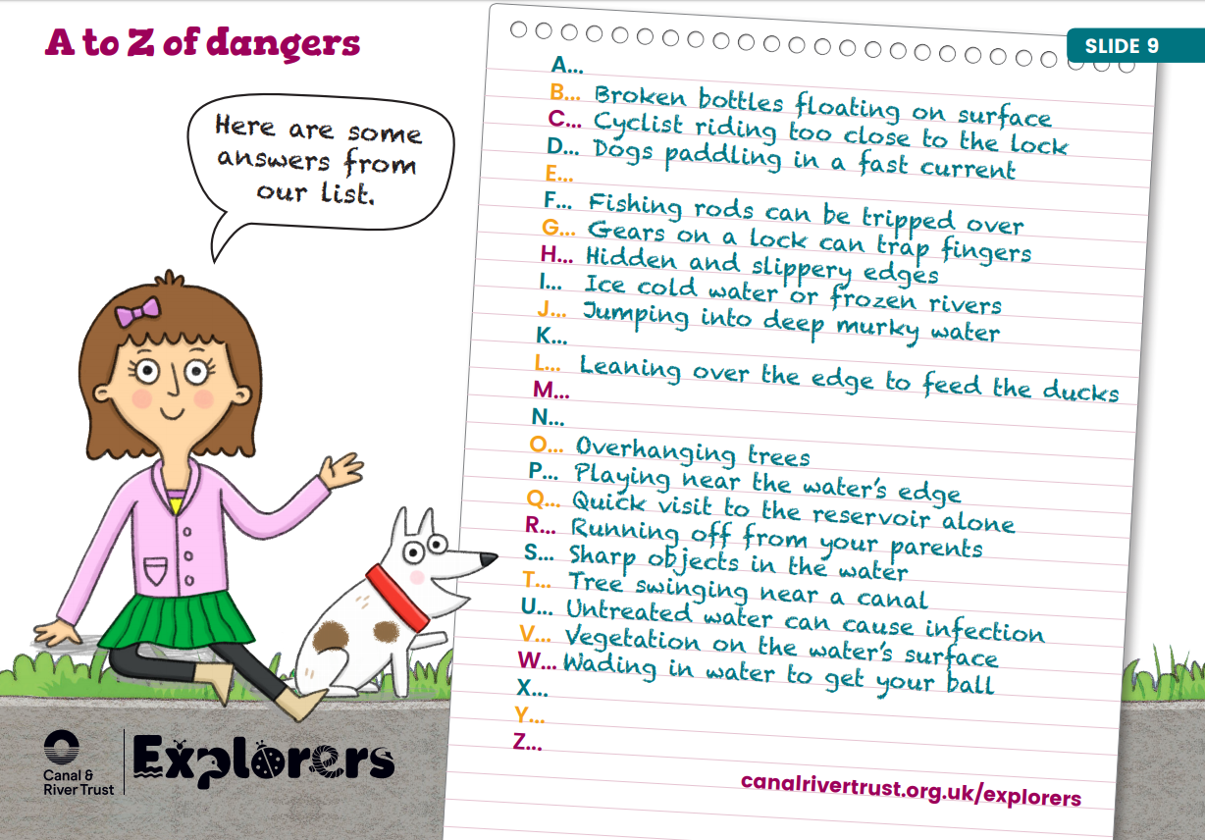

Slide 5
Task:
Write a water safety poem…You can choose any style of poem.
Here is an example of a verse that I have written that has included lots of poetic techniques…alliteration, onomatopoeia, similes, rhyming. (You do not need to use ALL of these).
Drip, drop. The water seems so peaceful and still
You can’t see how deep it is, well… not until…
Crashing, crazy currents can sweep you away
It doesn’t matter if you can swim or how good or bad a day
Be careful near the water as it’s not as safe as meets the eye
Enjoy the water carefully and life will be as sweet as apple pie!

