Slide 1
What is a line of symmetry?

Slide 2
Symmetry
If a shape can be folded exactly in half, then we say that shape has got line symmetry.

Slide 3
One line of symmetry.
A

Slide 4
Two lines of symmetry.
H

Slide 5
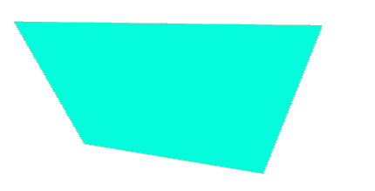
No lines of symmetry.
Z

Slide 6
Even more lines of symmetry!

Slide 7
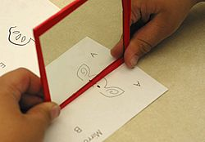
Mirror Symmetry
If you put a mirror along the line of symmetry, the shape looks the same as without the mirror.

Slide 8







There are lines of symmetry all around us!

