Slide 2
Where Is Japan?
Japan is in the continent of Asia.

Slide 3
Where Is Tokyo?
Japan is made up of 6852 islands. The main island is called Honshu and this is where Tokyo is located.
Tokyo

Slide 4
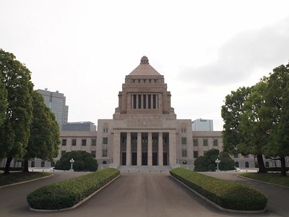
All About Tokyo
Tokyo is the capital city of Japan. A capital city is where the government of a country meets.
The Japanese government meet in the National Diet Building in Tokyo.
Talk About It
“National Diet Building (JAPAN)” by Junpei Abe is licensed under CC BY 2.0
  Do you know the names of any other capital cities?

Slide 5
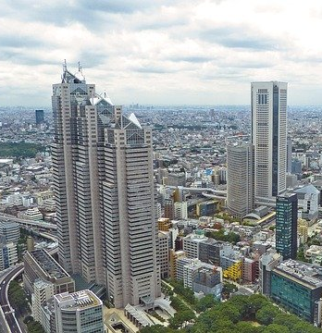
All About Tokyo
Tokyo has a population of almost nine million people, making it the biggest city in Japan.
The currency of Japan is the yen.
Shinjuku Station in Tokyo is the world’s busiest train station.
As in the rest of Japan, Shinto and Buddhism are the main religions in Tokyo.

Slide 6
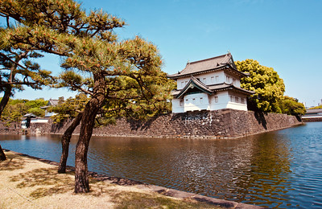
Imperial Family
The Imperial Palace is the home of the Imperial family. The Emperor of Japan is the head of the Imperial Family. Currently, this is Emperor Naruhito. Much like Queen Elizabeth II, Emperor Naruhito is a constitutional monarch, which means he has limited power over
the government.
“Imperial Palace” by Natalie Maguire is licensed under CC BY 2.0

Slide 7
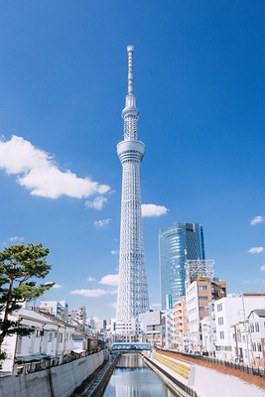
Tokyo Skytree
The Tokyo Skytree is the tallest structure in Japan. It is 634 metres high, which makes it the world’s tallest tower. It is a broadcasting tower for television and radio.
“TOKYO SKYTREE” by hans-Johnson is licensed under CC BY 2.0

Slide 8
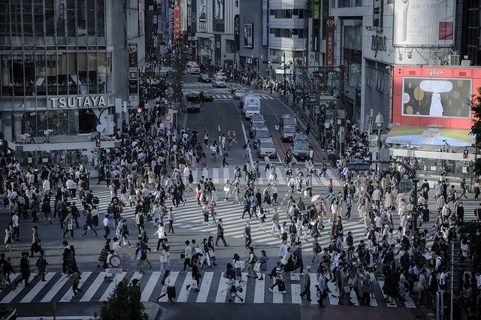
Shibuya Crossing
The Shibuya Crossing is possibly the world’s busiest road crossing. At busy times, as many as 2500 people cross the road at the same time.

Slide 9
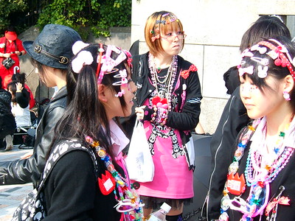
Harajuku District
This area of Tokyo is known for its fashion. Young people like to gather in the area and it has many clothes shops with the latest Japanese trends.
“Harajuku girls” by LHOON is licensed under CC BY 2.0

Slide 10
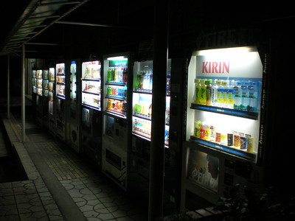
Vending Machines
It is said that in Tokyo, you are never further than 12 metres away from a vending machine. In Tokyo, you can buy many different things from vending machines including burgers and clothes!
Talk About It
“Japanese drink vending machines” by Joe Allen is licensed under CC BY 2.0
  If you could have a vending machine in school, what would you want it to sell?

Slide 11
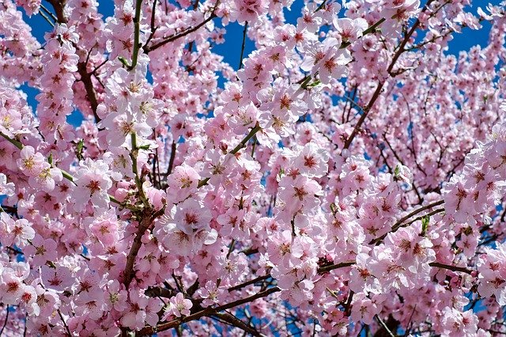
Hanami
Every year, Japan has a cherry blossom season that starts in March or April. The blossoms last for around two weeks. Tourists travel to enjoy Hanami, which is Japanese for ‘flower viewing’.

Slide 12
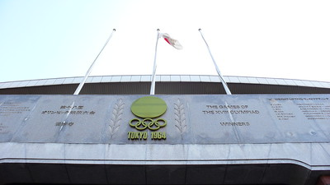
Tokyo 2020
In 2020, Tokyo are hosting the Olympic Games. The Games will start on the 24th of July and will end on the 9th of August.
The New National Stadium will host the opening and closing ceremonies. This was also one of the venues for the 1964 Olympics and the 2019 Rugby World Cup.
Did You Know?
Tokyo was meant to host the 1940 Olympics but they were cancelled due to the Second World
War.
“Olympic 1964” by shuets udono is licensed under CC BY 2.0

