Slide 1
Maths at Walford Primary School
Parents’ Workshop
Wednesday 1st March.2017
Notes:
A4 sheets of paper
pencils
coloured paper cups (two different colours)
cubes
counters
proportional equipment, such as straws, Numicon, base ten equipment

Slide 2
Our aims this afternoon are to:
Explain how maths will be taught throughout the school.
Explain why the children will not always be in ability groups.
Explain how the textbooks will be used in class.
Explain how the part-whole model works.
Explain how the bar model works.
Show you how you can help your child at home.

Slide 3
Why Change Approach?
Singapore is consistently ranked in the top three spots in international tests such as TIMSS and PISA.
The new curriculum is a mastery curriculum with an emphasis on deep conceptual understanding and problem solving.
The spiral curriculum systematically develops skills and concepts.
The programme is build around the C-P-A approach.
There is an emphasis on the development of intellectual competence, such as the ability to visualise.
Notes:
Explain that in the TIMSS and PISA tests, Singapore is consistently in the top three places for maths in the world rankings. You may wish to give a bit of background on each international test:
TIMSS (Trends in International Maths and Science Study): this test assesses the maths and science knowledge and skills of 9–10 year-olds and 13–14 year-olds around the world.
PISA (Programme for International Student Assessment): this test assesses the maths, science and reading skills of 15-year-olds from schools worldwide.
The approach looks at deep conceptual understanding, and ensures that children really understand concepts rather than rushing through content. It is important to stress to parents throughout that this is a mastery curriculum, and moving children on quickly to larger numbers or decimals does not necessarily mean that they are ‘better’ at maths.
The CPA approach which you will look at on the next slide means that regardless of age or stage of development, children will work with concrete apparatus first. The more able children find it difficult to explain and may have some gaps in understanding, while the less able children are supported and have time to make connections.
Explain to parents that mathematical language is key to the approach, and there is a strong emphasis on being able to explain your understanding, both to other children and to the teacher.

Slide 4

The C-P-A Approach
Concrete:
resources such as cubes, counters and shapes
Pictorial:
pictures, drawings
Abstract:
numbers and symbols
1
4
3
Notes:
Before any of the CPA stages appear on the slide, ask parents to show you the number 3 using anything they have to hand. Some may write the number 3 on paper, some may gather three objects from the table top, and some may show three fingers.
Explain that the numeral ‘3’ is abstract and does not exist. The materials on the table are real physical objects – we call these ‘concrete’. Regardless of age and stage, all children will work in the concrete representation when meeting a new concept, and they will be expected to explain their thinking using physical objects.
Children then work towards understanding pictorial representations for the concrete apparatus they have been using: this might be a picture of a Numicon shape or some base ten equipment. Show parents your school’s resources as you talk about them, and ensure that concrete apparatus is available for them to look at and use. In the first instance, it is important that the children’s experiences of place value and number is with proportional resources, such as bundles of straws, Numicon and base ten. Examples of non-proportional resources include place value counters and an abacus.
The CPA approach is not a linear model, but is instead one which moves forwards and backwards revisiting each representation. This helps the child make connections between the three representations and deepen their understanding.

Slide 5
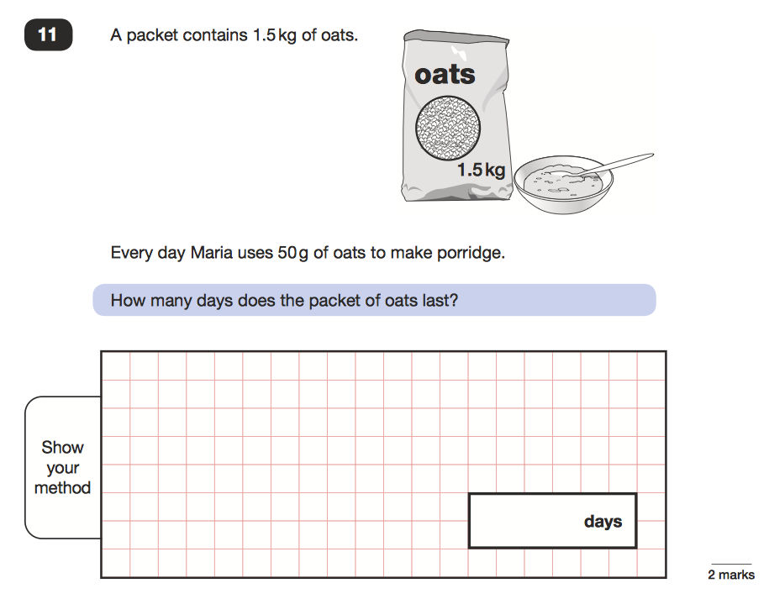
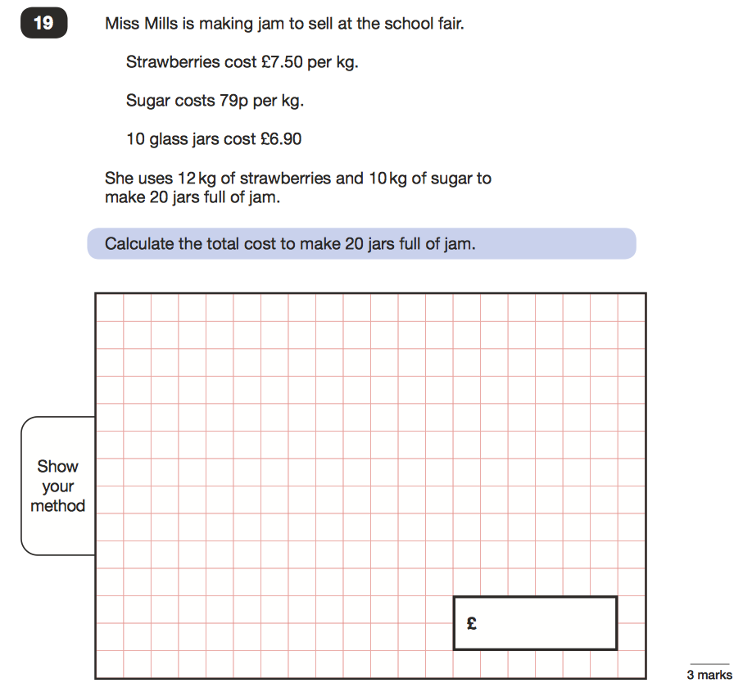
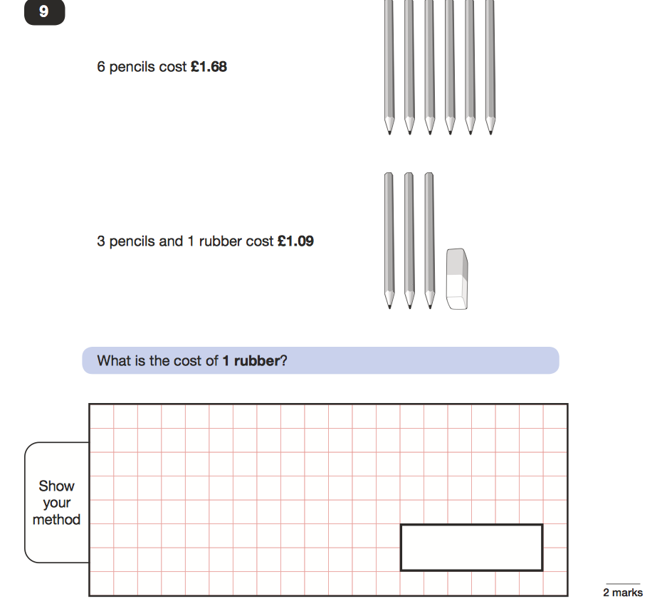
End of Key Stage Examples

Slide 6
Textbooks
Notes:
Presenter notes:
Ask parents “Who used a maths textbook when they were at school?” and take some feedback. Show parents the textbooks and explain that children will be using a blend of approaches in their maths lessons including direct teaching with the whole class, working with resources and exploring concepts using the Pupil Textbooks, and group and individual work using the Practice Book and Assessment Book.
You may want to show parents an example of a section from any of the Pupil Textbooks you are familiar with, for example perceptual variation, place value or calculation. If possible, have parents sharing one copy of the Pupil Textbook between two as you show them the example.

Slide 7
A ‘Mastery’ Curriculum
Key features:
The curriculum is highly-structured, based on a spiral approach to learning and learning theories.
Each maths area or topic is covered in depth for the year group once, and is not repeated within the same year.
Children are not grouped or put into ability sets.
Notes:
Explain to parents that in the past, schools have covered the whole of the maths curriculum in a term, with repeated visits to each of the topics in the spring and summer. Working in this way meant that the curriculum was hurried, and a lot of children (and teachers) felt that they had only just got going with a topic or area when they had to stop and change.
A mastery curriculum does not work in this way. Each area is covered at a suitable level once in the year.

Slide 8
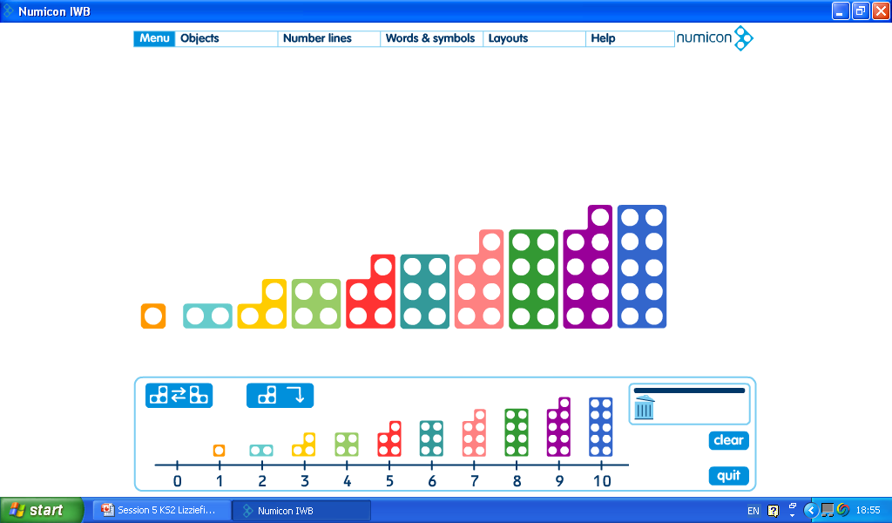
The Beginning
Knowing everything there is to know about a number.
What do you know about 7?
It is an odd number.
It is a quarter of 28.
It is made up of a 3 and a 4.
It is two more than 5.
It is made up of a 3 twos and a one.
It is half of 14.
It is three fewer than 10.
It is a single digit number.
It is double three and a half.
It is a prime number.
It comes after 6 and before 8.
It is fewer than 10.
Notes:
Encourage parents to think about a best friend. You don’t always see them everyday but you know everything there is to know about them - so when you do meet up with them, you can pick up where you left off. It is exactly the same with number.
Reassure parents that although children aren’t put into sets or ability groups in a mastery curriculum, they are expected to think more deeply. For example in Year 1 children work for a long time mastering everything they need to know about a number. They concentrate on numbers to 10 for a while then extend to 20. However, they need to know everything there is to know about ten.
This slide shows just a Numicon 7 shape. Ask parents what they know about 7. Take feedback, then progress the PowerPoint to show some of the many different ways they can describe 7. Explain that if they want to help their children, exploring and talking about numbers is an excellent way to help them. Older children may be looking at larger numbers, or numbers with one, two or three decimal places.
Write 5 + 3 = ___ - 1 on the board. Ask, what makes this a challenging question? Give a few moments for the parents to look at it and take feedback. Be prepared to discuss equivalence, for example 4 + 6 = 7 + 3, or that 10 = 2 + 8. Select your own numbers, and if you use Numicon at school you could have a pan balance nearby to demonstrate.

Slide 9
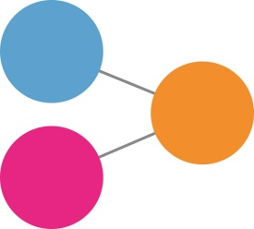
The Part-Whole Model
Here is the part-whole model used as a pictorial representation. It works on the principle that if you know two values out of three in a calculation, you can calculate the missing value using addition or subtraction.

Slide 10
The Part-Whole Model
6
6 and 4 more makes ?
The two parts (6 and 4) combine
to make the whole (10).
?
4

Slide 11
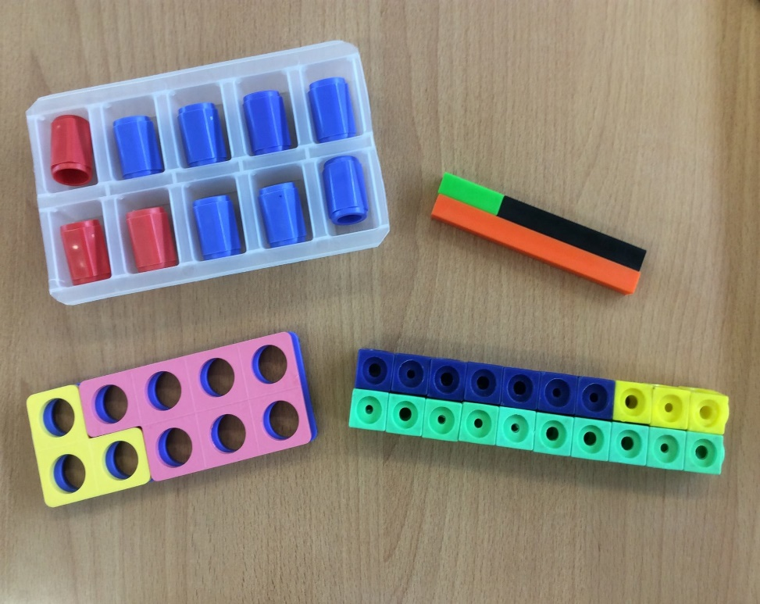
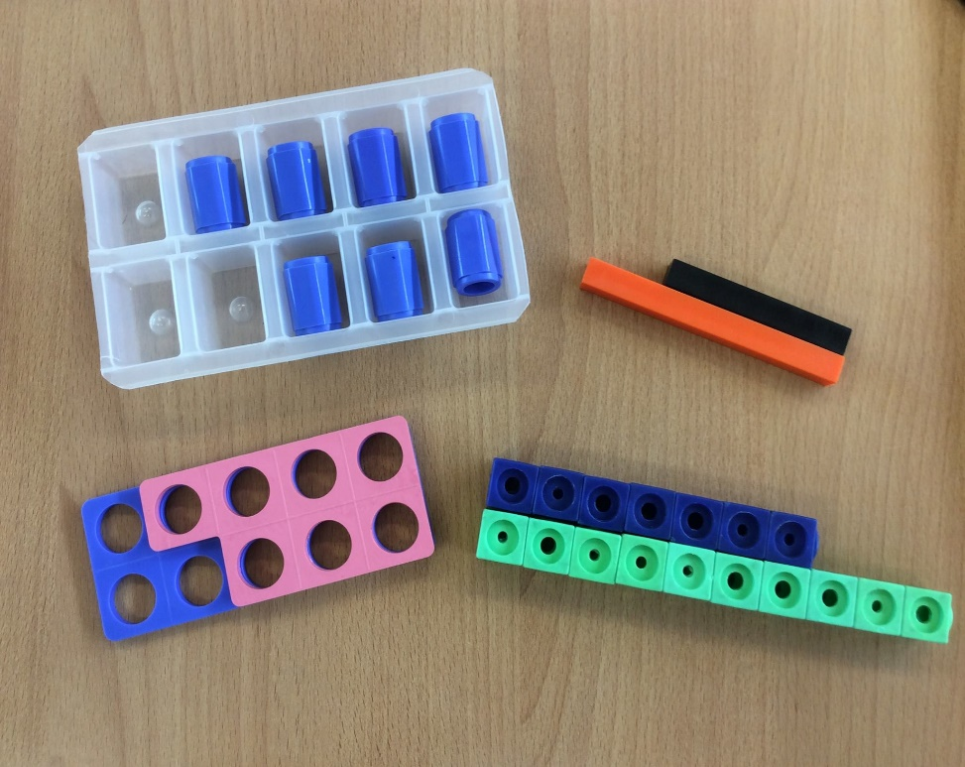
The Part-Whole Model
Notes:
This is a model showing how the part-whole model can be shown using equipment.
Take 10 cubes and perform the calculation 10 – 3 = 7.
Say: “Here is 10, I will take away 3” then discard the 3, so you no longer have it.
Explain that you have the answer but no idea what you had taken away or the starting number.
The model on the right clearly shows ten ice-cube slots but only seven of them are occupied after three have been removed.
We can clearly see
what we started with
how much has been removed
what is left.

Slide 12
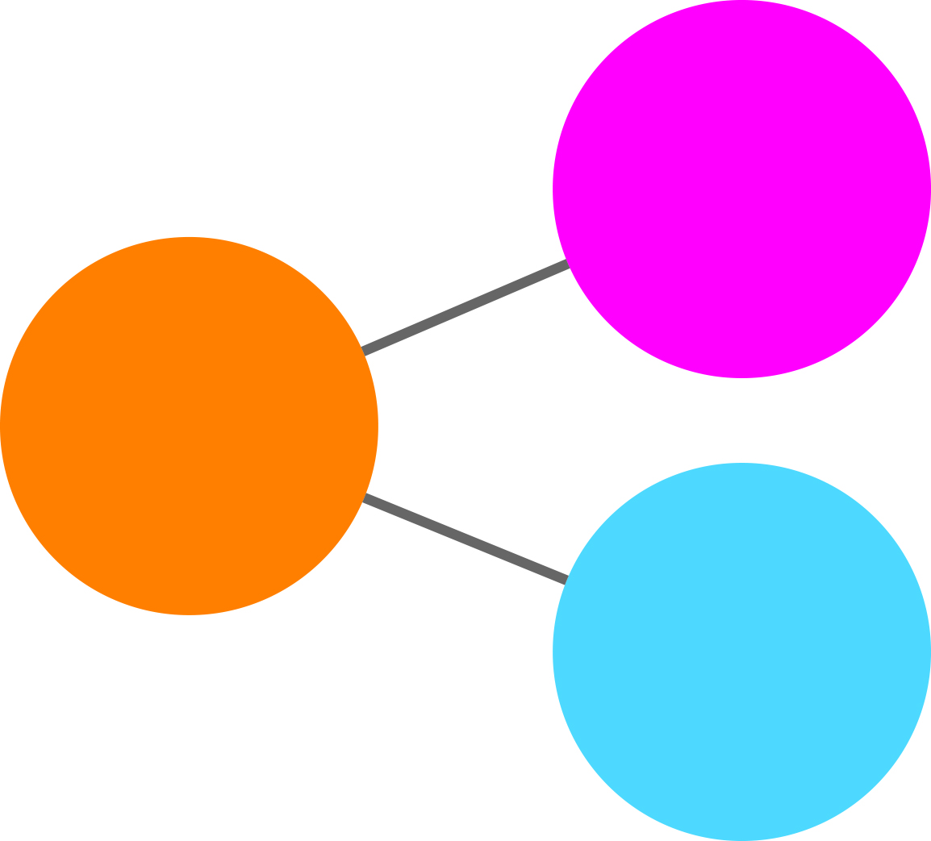


The Part-Whole Model
The part-whole model can be orientated differently, and is used for addition and subtraction problems.

Slide 13
The Part-Whole Model
An unknown number and 4 makes 10.
This leads to a missing box calculation:
+ 4 = 10
In other words, algebra.
?
10
4
The National Curriculum requires that children know their number families for
all the operations, for example:
6 + 4 = 10 3 × 7 = 21
4 + 6 = 10 7 × 3 = 21
10 – 6 = 4 21 ÷ 7 = 3
10 – 4 = 6 21 ÷ 3 = 7
Notes:
Introduce the model illustration as an addition and subtraction model. Explain that if you know any two out of three parts, you can work out the missing part. Explain that this is essentially algebra, in that it deals with unknown numbers.
Talk about links to the National Curriculum, and how it helps the children to learn their number families. Point out that this model is for addition and subtraction, but the National Curriculum looks at knowing number relationships for multiplication and division as well.

Slide 14

The Part-Whole Model
The part-whole model can involve more than two parts.
Here is an example from a Year 6 geometry lesson:
?
Notes:
Explain to parents that this is an example of how the part-whole model helps older children solve geometry problems. Encourage them to suggest which numbers go in each circle in the part-whole model.
The part-whole model is taught in Inspire Maths 1 and 2, and referred to in Inspire Maths 3 and 4. Children will not come across it in Inspire Maths 5 and 6, as the expectation is that it is already embedded in their thinking.
Children working with Inspire Maths for the first time in upper-KS2 will need to be taught the part-whole model. This is an area parents can support their children with.

Slide 15
Activities and Games
There are 7 cubes under the cups. You can only lift one cup up. Can you work out how many cubes are under the second cup?

Slide 16
There are 5 cubes under this cup. There are 7 cubes altogether. 7 – 5 = 2. I know that there are 2 cubes under the other cup.

Slide 17
I solved the problem with a subtraction. 7 – 5 = 2
I can check my answer with an addition.
5 + 2 = 7 or 2 + 5 = 7
Notes:
This slide provides an example of how the activity can be extended using secure knowledge of the part-whole model and reasoning skills. This gives depth and breadth for those children who have already grasped two parts making a whole without extending the total number of cubes being used.

Slide 18
Now try this activity again taking turns to hide the cubes. Use different totals.

Slide 19
I have 3 cups and 10 cubes. I’ve hidden the same number of cubes under both blue cups and a different number under the red cup. You can only lift one cup.
Can you work out what is hiding under the other 2
cups without lifting them?

Slide 20
If I lift this cup, what
maths do I need to solve
the problem?

Slide 21
If I lift this cup, what
maths do I need to solve
the problem?

Slide 22
If I lift this cup, what
maths do I need to solve
the problem?

Slide 23
I have four cups and ten cubes. I’ve hidden the same number of cubes under both blue cups and a different number under the red cups. The number of cubes hidden under the red cups is the same. You can only lift one cup. Can you work out what is hiding under the other cups without lifting them?

Slide 24
If I lift this cup, what
maths do I need to solve
the problem?

Slide 25
If I lift this cup, what
maths do I need to solve
the problem?

Slide 26
If I lift this cup, what
maths do I need to solve
the problem?

Slide 27
If I lift this cup, what
maths do I need to solve
the problem?

Slide 28
I have 5 cups. The total number of cubes I’ve used is 25. There is the same number of cubes under each cup. How many cubes are under each cup?

Slide 29
What maths do you need to solve this problem?
What number facts do you already know?

Slide 31
Bar Modelling
“Instead of relying on superficial and unreliable clues like key words, the simple visual diagrams help children understand why the appropriate operations make sense.”
Beckmann 2014
“When children have experience and exposure to many concrete materials, they are able to develop the ability to visualise”
Ban Har 2016
“Bar models are a tool to help children visualise stories”
Ban Har 2016
“Model drawing trains children to think analytically, providing an important transition between the concrete and the abstract.”
Forsten 2014
“Although bar models will not always help children carry out required calculations, they are clearly designed to help children decide which operations to use.”
Beckmann 2014

Slide 32
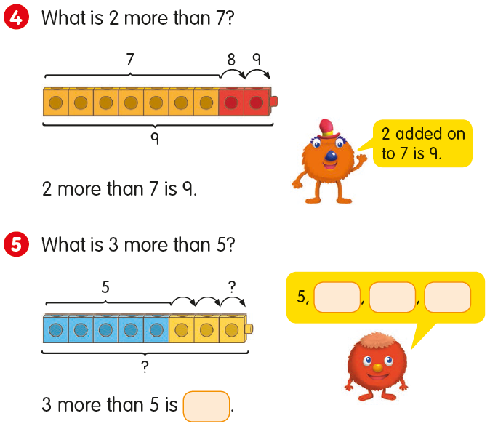
Introducing the Bar Model
Notes:
Point out the parts of the model, shown in different colours and bracketed.

Slide 33
Introducing the Bar Model
Omar bakes 10 biscuits.
Ruby bakes 12 biscuits.
How many biscuits do they bake altogether?
10
12
?
They bake 22 biscuits altogether.
Notes:
Talk the parents through the question, draw out that the children are asked to answer in a full sentence once they have solved the problem. This takes them back to the context of the word problem.
Also note, the numbers used in this question are much easier than would normally be used in word problems at this level. This means that children can solve it mentally and are instead concentrating on the new model.

Slide 34
Introducing the Bar Model
Hardeep buys large eggs and small eggs.
Altogether he buys 20 eggs
There are 7 small eggs.
How many large eggs are there?
7
?
20
There are 13 large eggs.
Notes:
This shows another kind of bar model

Slide 35
Millie has a new fish tank.
She wants to put 21 fish in it.
Millie’s mum gives her 15 fish.
She uses her pocket money to buy the rest.
How many fish does she buy?
305 children go to the park on Saturday.
278 more children go to the park on Sunday than on Saturday.
How many children go to the park on Sunday?

Slide 36
Developing the Bar Model
Peter puts 5 bread rolls into each packet.
He has 4 packets.
How many bread rolls does he put into the 4 packets altogether?
5
5
5
5
?
There are 20 bread rolls altogether.

Slide 37
Developing the Bar Model
Hardeep buys 12 pears.
He puts an equal number of pears into 3 boxes.
How many pears are there in each box?
?
?
?
12
There are 4 pears in each box.
Notes:
This is an example of how a bar model can be used for a division calculation. Before completing this problem, explain to the parents that the children have by this stage had a lot of practice putting objects into equal groups. Ask parents to each take 12 cubes.
Can they put the cubes into:
2 equal groups?
6 equal groups?
3 equal groups?
12 equal groups?
4 equal groups?

Slide 38
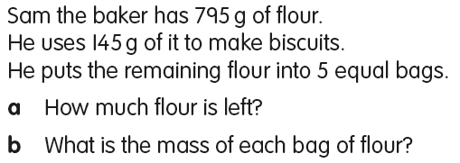
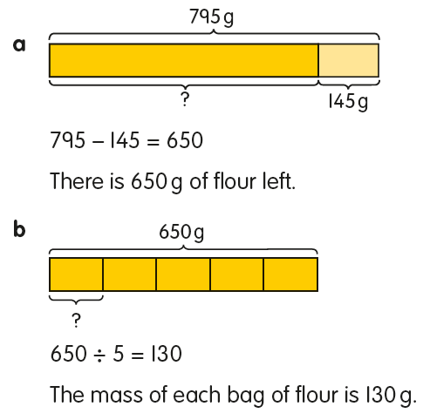
Developing the Bar Model

Slide 39
Developing the Bar Model

Slide 40
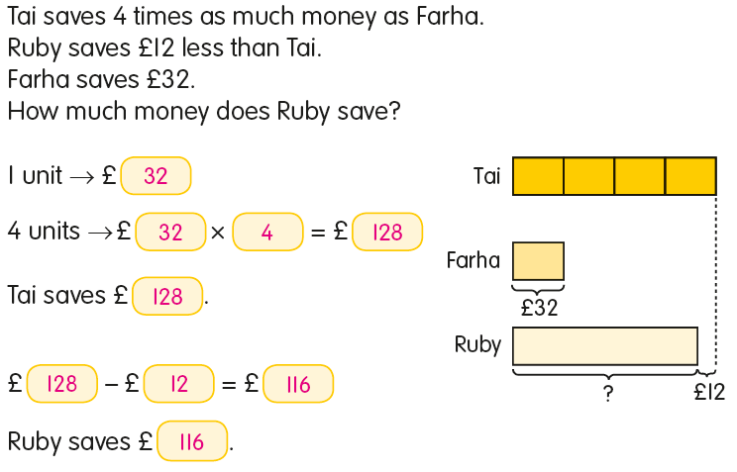
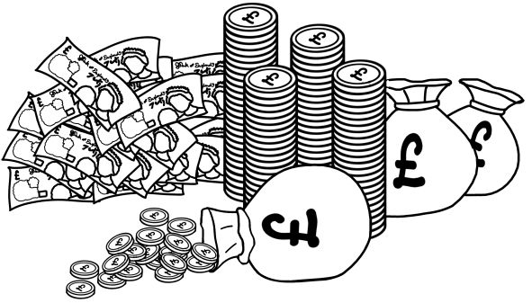
Further Word Problems
Notes:
Encourage parents to think about the skills they have gained by solving the previous problems with the bar model. How does this help?
Y3

Slide 42
Further Word Problems
William has 95p
He has 20p less than his brother
How much money do William and his brother have altogether?
95p + 20p = 115p
William’s brother has 115p
William’s brother has £1.15
William has 95p
William and his brother have
210p altogether.
William and his brother have
£2.10 altogether.
95p
20p
?

Slide 43
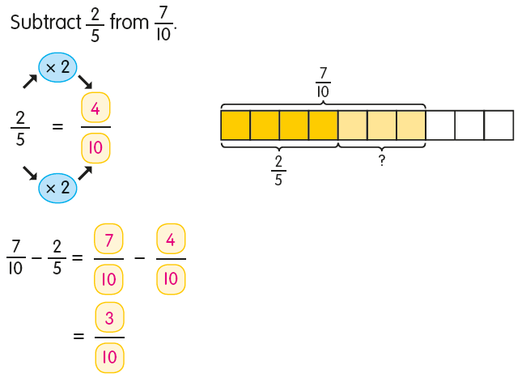
Bar Models and Fractions
Notes:
Explain that bar models help children learn how to subtract fractions using models and the equivalent fractions method.

Slide 44
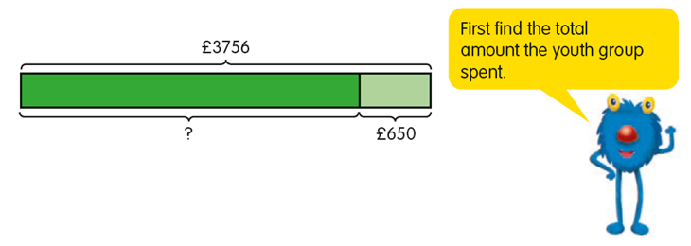
Further Multi-Step Word Problems
A youth group had £3756 for a camping trip.
They saved £650 and spent the rest on 12 tents and some food for the trip.
The tents cost £205 each.
How much did they spend on food?
Notes:
This is the final bar modelling example of the evening and taken from Inspire Maths 4A.
Explain to parents that they will need multiple bars to solve this. Work through the slides, and explain each step to parents as you go.

Slide 45
A youth group had £3756 for a camping trip.
They saved £650 and spent the rest on 12 tents and some food for the trip.
The tents cost £205 each.
How much did they spend on food?
3756 – 650 = 3106
They spent £3106 altogether.

Slide 46
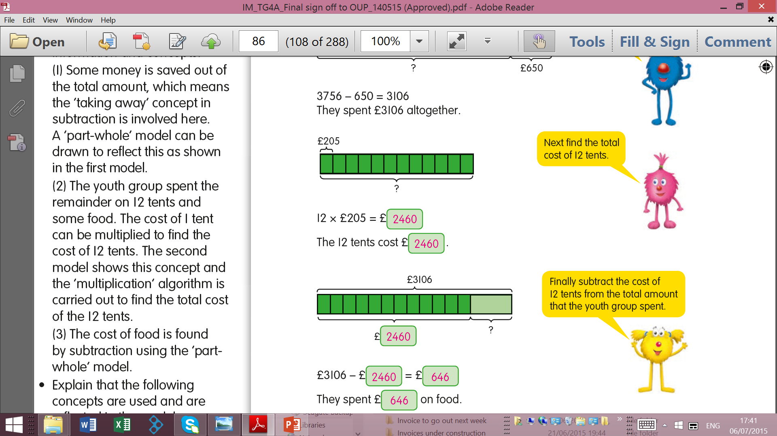
A youth group had £3756 for a camping trip. They saved £650 and spent the rest on 12 tents and some food for the trip.
The tents cost £205 each. How much did they spend on food?

Slide 47
A youth group had £3756 for a camping trip. They saved £650 and spent the rest on 12 tents and some food for the trip.
The tents cost £205 each. How much did they spend on food?

Slide 48
How Can I Help My Child?
You can help your child by finding and talking about maths in everyday situations. For example, a shopping trip is rich in mathematical opportunities, such as:
spending money, calculating change and working out which offers give the best value for money.
empty packaging can provide your child will immediate access to 3D shapes and nets.
using packets and tins as a source of mathematical information to discuss, such as mass and volume.
using items often sold in pairs, fours and sixes (such as drinks or yogurts) to talk about multiples or times tables.

Slide 49
How Can I Help My Child?
You can also help your child in a number of other ways:
Encourage a secure knowledge of number, by asking questions which help them explain what comes before or after a given number, or how the number is made, for example tens and ones.
Encourage them to draw pictures and models such as part-whole and bar models to answer questions.
Support them with home activities, and encourage them to answer questions in full sentences.
If you are unsure about any concepts, please ask your child’s teacher to explain how it is taught and how you can support
your child.

Slide 50
Exemplar Language Changes…
We are working on modifying our language to avoid fixed mindset messages and encourage growth mindset.
The following language changes would be a great starting point…
That’s brilliant, becomes:
That’s interesting, what made you think in that way?
You’re a genius, becomes:
Tell me about it - how did you decide what to do?
Don’t worry, I couldn’t do it either, becomes:
I’m sure if we look at it together, we can work out a solution.
That’s too hard, becomes:
Challenges are good because you know your brain is having to work hard.
We are not that type of family, becomes:
If you keep trying, I think you’ll be able to do it.
I can’t, becomes:
I can’t yet.
I can’t do it, becomes:
What strategy could I try next?

