Slide 1

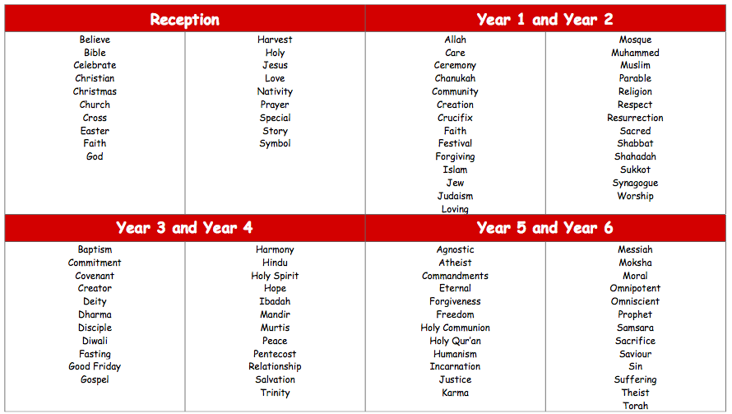
Walford Nursery and Primary School
RE Key Vocabulary

