Slide 1
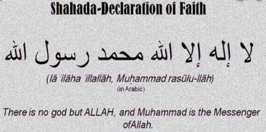
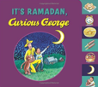
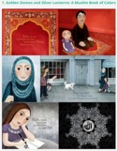
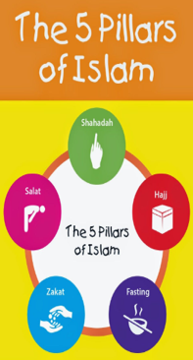
Being a Muslim: KS1 Knowledge Mat (1.6 Y2)
Subject Specific Vocabulary |  |  | Exciting Books
Muslim | A person who follows the religion of Islam.
Allah | The Arabic term for “God.”
Muhammad (Peace be upon him/PBUH) | The final prophet to whom Muslims believe God revealed the Qur’an.
 |  | Sticky Knowledge- Who is a Muslim and how do they live?
Shahada | A statement of faith that all Muslims recite. The first of the 5 Pillars. | The Shahadah is very important for Muslims. It is recited (said) by Muslims to declare (show) that they are committed to Allah.
Messenger | Someone who delivers a message. | Muslims believe that there is only one God referred to as Tawhid. Muhammad (Peace Be Upon Him/PBUH) is his messenger.
Tawhid | Arabic for “declaring one god”. Muslims believe that there is only one God. | Muslims learn a lot from the Prophet Muhammad (PBUH) through stories such as the ‘Tiny Ants’ (care for all of Allah’s creation and ‘The Prophet Muhammad and the black stone’ (being wise).
Qur’an | The Holy Book of Islam. | Muslims have 99 names for Allah, such as ‘All Compassionate, The Pure One and the Source of Peace’.
Prophet | A person Muslims believe was chosen by God to teach people about Allah’s message. | Muhammad received the Holy Qur’an on the ‘Night of Power’. Muslims treat the Qur’an with the upmost respect by wrapping it up.

Slide 2
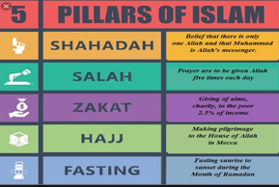
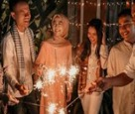
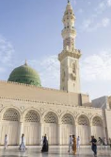
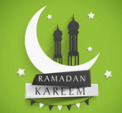
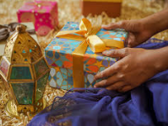
Being a Muslim: LKS2 Knowledge Mat (L2.9 Y3)
Subject Specific Vocabulary |  | Muslims
Ibadah | Muslim worship. |  | Mosque
Salah/ salat | The name for the ritual prayer that Muslims perform five times each day while facing Mecca.
Rak’ah | A series of movements carried out when Muslims recite their prayers (salah).
Mecca | An ancient city, in western Saudi Arabia. It is the holiest of Muslim cities. | Sticky Knowledge – How do festivals and worship show what matters to a Muslim? (Links to 1.6)
Mosque | Muslim place of worship with at least one minaret, a tall, slender tower with balconies, used for calling the faithful to prayer. | Surah 1 (Chapter 1) of the Qur’an is a summary of the Qur’an and its seven verses are often recited by Muslims when they pray.
 |  | Muslims believe that there is only one God referred to as Tawhid. Muhammad (Peace Be Upon Him/PBUH) is his messenger.
Ramadan | Ninth month of the Muslim year, during which strict fasting is observed from dawn to sunset. | Salah/salat is the second pillar of Islam. Muslims pray in a mosque as well as at home. They pray because God has told them to. Prayer takes place five times a day and follow a series of movements when doing so. Carrying out this is highly spiritual and allows Muslims all around the world to connect.
Eid-ul-Fitr | Is also known as the "Festival of Breaking the Fast", is a religious holiday celebrated by Muslims worldwide that marks the end of Ramadan,
 |  | Sawm (fasting) is the fourth pillar. Muslims must fast during Ramadan which is the ninth month of the Islamic calendar. Muslims fast during daylight hours only. There are lots of reasons why they fast, such as learning self-discipline and appreciating God’s gifts.
Laylat-ul-Qadr | Is also known as the “Night of Power” when it is believed the first verses of the Quran were revealed to the Islamic prophet Muhammad (PBUH).
Muslims celebrating Eid-ul-Fitr

Slide 3
Being a Muslim: UKS2 Knowledge Mat (U2.8 Y5)
Five Pillars | The five basic ritual or devotional duties of Sunni Muslims, namely: Shahada a declaration of faith in God; salat, five daily prayers; sawm, fasting; zakat, almsgiving; and hajj, pilgrimage to Mecca. | Sticky Knowledge – What does it mean to be a Muslim in Britain today? (Links to 1.6 and L2.9)
 |  | The Five Pillars of Islam are the five obligations that every Muslim must satisfy in order to live a good and responsible life according to Islam. Shahadah (belief in ONE God and his Prophet); salat (daily prayer); sawm (fasting); zakah (almsgiving); and hajj (pilgrimage).
Hajj | A Muslim pilgrimage to Mecca, which takes place in the last month of the year and which all Muslims are expected to make at least once during their lifetime if they can afford to do so. It is one of the Five Pillars of Islam. | Eid-ul-Fitr - It is celebrated on the 1st day of the month of Shawwal. On this day, Muslims are encouraged to dress in their best clothes and attend a special Eid prayer at their mosque. Before the prayer begins, Muslims make an alms payment (the Zakat al Fitr) in the form of food or its cash equivalent. This food and/or money is then distributed to the poor. After the special religious service, the focus turns to gift-giving. Children are given many gifts. Women get gifts from their loved ones.
Hadith | A statement, action or approval attributed to the Prophet of Islam, Muhammad (PBUH). | There are different Muslim groups – Sunni, Shi’a and Sufi. The Sunni and Shi’a agree on the main principals of Islam but differ with other aspects such as historical experiences. Sufi Muslims are emphatic that Islamic knowledge should be learned from teachers and not exclusively from books.
Eid-ul-Fitr | Is also known as the "Festival of Breaking the Fast", is a religious holiday celebrated by Muslims worldwide that marks the end of Ramadan, | In the Qur’an there are many powerful stories such as the Prophet’s Night Journey (Surah 17). Some stories in the Qur’an seem to be shared with other religions such as Christian and Jewish people. We find the story of God telling Abraham to sacrifice his son in both the Qur’an and the Bible.
Tawhid | Arabic for “declaring one god”. Muslims believe that there is only one God. | There are over 1,500 mosques in the UK. A typical mosque also includes a minaret, a dome and a place to wash before prayers. Each feature has its own significance. Architecture is one of the greatest Islamic art forms. Mosques are highly decorated and colour is a key feature. This level of decoration is reserved for the inside only.
Qur’an (Koran) | The Islamic sacred book, believed to be the word of God as dictated to Muhammad by the archangel Gabriel in 610. It was written down in Arabic.

Slide 4
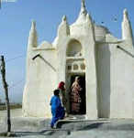
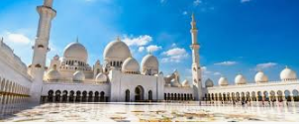
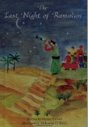
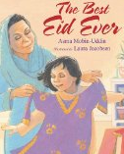
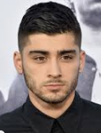
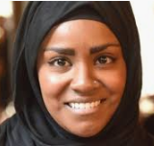
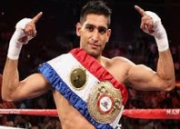
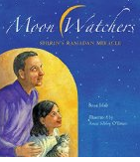
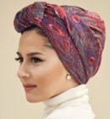
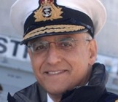
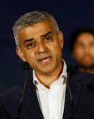
Being a Muslim: UKS2 Knowledge Mat (U2.8 Y5)
Exciting Books |  | Mosques
 | Famous UK Muslims

Slide 5
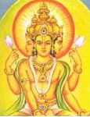

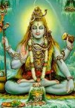
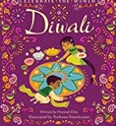

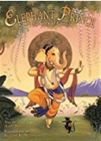
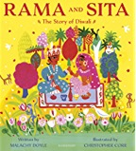

Being a Hindu: LKS2 Knowledge Mat (L2.7 Y4)
Subject Specific Vocabulary |  | Bt | Exciting Books
Hinduism | A religion that believes in many gods.
Aum | The symbol used to represent Hinduism.
Brahman | Hindu God, the ultimate being. Hindus believe that there is a part of Brahman in everything.
 |  | Sticky Knowledge – What do Hindus believe God is like?
Deities | Supernatural beings that are worshipped.
 |  | Hinduism is over 4,000 years old, making it one of the world's oldest religions. It is made up of a variety of different religious beliefs and practices. It originated near the Indus River in India. The name 'Hindu' comes from the word Indus. Hindus believe that religion is more about what you do than what you believe; that there is an universal god – Brahman and there is a part of Brahman in everyone.
Brahma, Vishnu and Shiva | Brahma is the creator; Vishnu is the preserver and Shiva is the destroyer.
Rama and Sita | Rama is a good man who is married to a princess, Sita.
Diwali | A Hindu festival that usually falls in October/November. | Aum is made up of 3 sounds: ‘A’, ‘U’ and ‘M’. Many Hindus believe that it was the very first sound out of which the universe was created.
Ramayana | An ancient sanskrit (a language of India) story about Rama. | Diwali means rows of lighted lamps. It is a festival of lights and it is celebrated with joy. During this festival, people light up their houses and shops. They worship Lord Ganesh for good welfare and prosperity and Goddess Lakshmi for wealth and wisdom.
Atman | Inner soul or self.
Brahma Vishnu Shiva
Aum

Slide 6
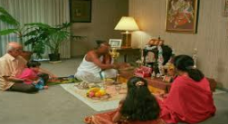
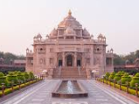
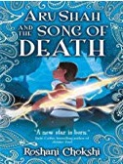
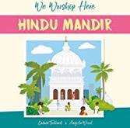
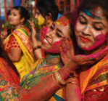
Being a Hindu: LKS2 Knowledge Mat (L2.8 Y4)
Subject Specific Vocabulary |  |  | Exciting books
Hinduism | A European word for describing a wide religious tradition
Sanatan Dharma | Eternal way; this is a complete way of life, not just beliefs.
Murtis | Family shrine | Sticky Knowledge – What does it mean to be a Hindu in Britain today? (links to L2.7)
Mandir | Hindu temple
 |  | Most Hindus worship (puja) every day at home and have a shrine there. A shrine can be anything from a room, a small altar or simply pictures or statues. Family members often worship together. At the shrine, Hindus make offerings to a murti.
Dharma | A Hindus holy way of life.
Bhagavad Gita | Hindu holy text
 |  | Holi – this festival marks the arrival of spring and also celebrates fertility, colour, love, and the triumph of good over evil.
Holi | Hindu festival of colours
 |  | Hindus have many traditions and customs such as daily prayer, they greet each other with the word ‘Namaste’, they show respect to their elders by taking care of them in their old age and they sing hymns/songs.
Puja | Daily prayer/worship
 |  | Light symbollises Brahman and represents the gods in heaven.
A Mandir
Hindus celebrating puja at home
Hindus celebrating Holi

Slide 7
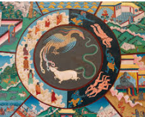



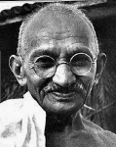
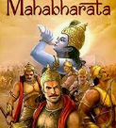
Being a Hindu: UKS2 Knowledge Mat (U2.7 Y6)
Subject Specific Vocabulary
Dharma | A Hindu’s religious and moral duty.
Samsara | The cycle of birth, death and rebirth that Hindus believe in.
Karma | The cycle of what happens to a person is a result of their own actions.
Punusharthas | Four aims of life that Hindus believe in | Sticky Knowledge – Why do Hindus want to be good? (links to L2.7 and L2.8)
 |  | Hinduism is a diverse religion so it difficult to say that all Hindus believe in… However, the beliefs in d’harma, karm, sansara and moksha are commonly held.
Artha | The pursuit of wealth or material advantage;, providing for family and society by honest means.
 |  |  | Exciting Books
 |  | The story of Mahabharata (The man in the Well) warns Hindus that they should pay attention to finding the way to escape the cycle of birth, death and rebirth.
Moksha | The release from the cycle of birth, death and rebirth.
 |  | Hindus have four aims in life: d’harma, artha, karma and moksha. Each one is more important than the previous.
Reincarnation | The rebirth of a soul in another body.
 |  | Hindus ultimate goal is to be released from samsara (the cycle of birth, death and rebirth).
Sachin Tendulkar – international cricketer
Mahatma Gandhi – lawyer and peaceful political activist

Slide 8
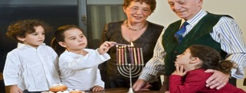
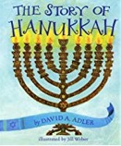
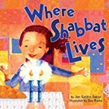
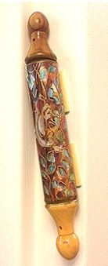
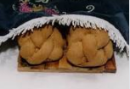
Being a Jew: KS1 Knowledge Mat (1.7 Y1)
Subject Specific Vocabulary |  |  | Exciting Books
Jew | A person who follows Judaism.
Judaism | A religion that believes in one God and faithfulness to the laws of the Torah.
Shema | A Jewish prayer
Shabbat | The name of the day of rest in Judaism. | Sticky Knowledge- Who is Jewish and how do they live?
Mezuzah | A piece of parchment (paper) with a prayer written on it. It is attached to the doorpost of Jewish homes.
 |  | Jews believe that God is one and cares for all people. They also believe that it is important to love God.
Tenakh | Jewish scriptures which are made up of many different smaller books. | Jewish people have special objects in their homes to help them praise God. Family and home are very important to Jewish people.
Sukkot | A Jewish festival , also know as the Feast of Tabernacles. |  | Mezuzah
Challah bread, challah board and challah cover | Challah bread is the Jewish Sabbath‑and‑holiday bread. It is laid on a challah board and covered with a challah cover. | Shabbat is the most important day of the week for Jews, because it is a day on which they remember that God created the world and everything in it. God created the world in six days, but on the seventh day, Shabbat.
Chanukah | Is a Jewish holiday that means dedication. It lasts for eight days. | Sukkot is a festival that remembers the time, many years ago, when the Jews spent time in the dessert. | Challah bread, challah board and challah cover
Kosher food | Jews have certain laws about the foods they can eat. Food has to follow these laws in order to be eaten by Jews. | Chanukah is a festival that remembers the re-dedication (giving back) of the temple in Jerusalem to God.
Jewish people celebrating Hanukah.

Slide 9

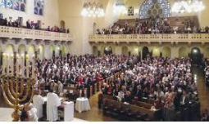
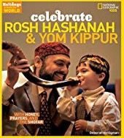
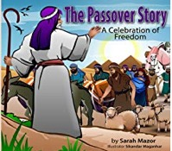
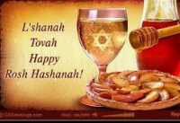
Being a Jew: LKS2 Knowledge Mat (L2.10 Y3)
Subject Specific Vocabulary |  |  | Exciting Books
Rosh Hashanah | The Jewish New Year festival.
Yom Kippur | Is the holiest day in the Jewish year’ also known as the Day of Atonement.
Pesach/ Passover | Is a major Jewish holiday . Its name comes from the miracle in which God “passed over” the houses of the Israelites during the tenth plague. | Sticky Knowledge – How do festivals and family life show what matters to Jewish people?(links to 1.7)
 |  | Rosh Hashanah commemorates the anniversary of creation and a time when Jews think about the year ahead. No work is permitted on this day. Jewish are reminded of their responsibilities as God’s chosen people. Most of the day is spent in the synagogue.
Seder meal | Jewish ritual feast that marks the beginning of the Jewish holiday of Passover.
Ten Commandments | The Ten Commandments are the fundamental laws of the Jews which tell the Jewish people how they should live. | Yom Kippur is celebrated ten days after Rosh Hashanah. This day is a very serious day for Jewish people. They must fast, meaning that they do not eat or drink. They are also not allowed to work. They spend a good deal of the day praying and attending services at the synagogue.
Synagogue | Jewish place of worship. | Pesach is celebrated every spring. The holiday lasts for 8 days and nights. On the first two nights a special meal is eaten – seder meal. Jews read the story of Moses leading the Jewish people out of Egypt.
Jewish people celebrating Yom Kippur

Slide 10
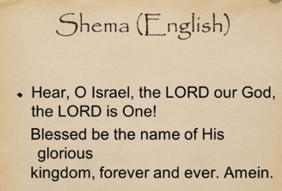
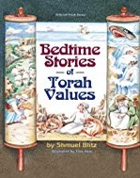
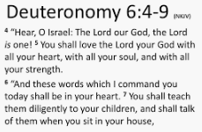
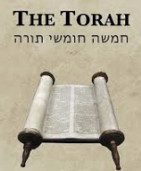
Being a Jew: UKS2 Knowledge Mat (U2.9 Y5)
Subject Specific Vocabulary |  |  | Exciting Books
Shema | A Jewish prayer. It is the first two words of a section of the Torah and is recited in daily prayer.
Tefflin | Leather black boxes that contain the Torah.
Torah | The law of God as revealed to Moses and recorded in the first five books of the Hebrew scriptures (the Pentateuch).
Sefer Torah | Is a handwritten copy of the Torah and must meet extremely strict standards of production. | Sticky Knowledge - Why is the Torah so important to Jewish people? (links to 1.7 and L2.10)
Progressive Jew | A Jew who believes in God, the Torah and Israel but also recognises the changing nature of the world in which they live. | Jews believe in one God and the command to love God with all their hearth, soul and might. This command is found the Torah – Deuteronomy 6:4-9.
Orthodox Jew | A Jew who adheres faithfully to the principles and practices of traditional Judaism. | It can take up to 18 months to complete a Sefer Torah. Great accuracy is needed when the sofer (scribe) writes the scroll. If he makes any mistakes it can make the whole scroll pasul (invalid). People stand when a Torah is lifted. It must be treated with the utmost respect at all times. A Sefer Torah is so sacred to Jews it is said that if one is accidentally dropped in the synagogue the whole congregation must fast for 40 days.

Slide 11

Being a Humanist: UKS2 Knowledge Mat (U2.10 Y5)
Subject Specific Vocabulary |  | Each symbol represents a letter or sound | Exciting Books
Humanism | A philosophy or way of thinking about the world. It is a set of ethics or ideas about how people should live and act.
Humanist | A person who follows the principles of Humanism.
Beliefs | A state of mind in which trust/confidence is placed in some one or some thing. | Sticky Knowledge- What matters most to Humanists and Christians?
 |  | Humanist are one group of non-religious people.
Atheism | Absence of/having no belief. | Most humanists would agree with the ideas below: There are no supernatural beings. The material universe is the only thing that exists. Science provides the only reliable source of knowledge about this universe. We only live this life - there is no after-life, and no such thing as reincarnation. Human beings can live ethical and fulfilling lives without religious beliefs. Human beings derive their moral code from the lessons of history, personal experience, and thought.
Morals | Standards of behaviour: knowing what is right and wrong.
Values | Beliefs of a person in which they have an emotional investment, for example: honesty.

Slide 12
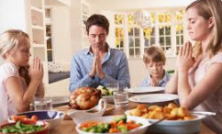
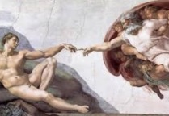
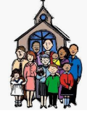
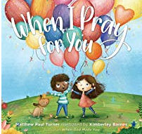


Being a Christian: KS1 Knowledge Mat (1.2 Y1)
Subject Specific Vocabulary
Creator | A person or thing that brings something into existence
Creation | The action or process of bringing something into existence.
Christian | A person who believes in Christ.
God | The creator and ruler of the universe.
 |  | Sticky Knowledge - Creation: Who do Christians say made the world?
Bible | The Christian Holy Book.
 |  | Jews, Christians and Muslims believe that there is a Creator of the world, God.
 |  | When Christians pray they thank God for creating the world. They also thank God for the food they eat as well as for their family and friends and health.
 |  | Creation is the beginning of the big story of the Bible.
The creation of Adam by Michelangelo.

Slide 13




Being a Christian: LKS2 Knowledge Mat (L2.1 Y3)
Subject Specific Vocabulary
God | Who Christians believe is the creator and ruler of the universe.
Creation | The action or process of bringing something into existence.
 |  |  | Exciting Books
Bible | The Christian Holy Book which contains the old and new testament. | Sticky Knowledge - Creation: What do Christians learn from the creation story? (links to 1.2)
Adam and Eve | Who Christians believe were the first people on earth to be created by God. | Jews and Christians believe that God created the world.
 |  | Christians believe that God wants people to look after the world he created, all of its animals and nature.
Sins The Fall | An action that is or is felt to be bad. This happened when Adam and Eve disobeyed God’s instructions.
 |  | Some people believe that the world wasn’t created by God.
 |  | Adam and Eve are believed by some Christians to be the first people on earth. They believe they were created by God.
 |  | Christians believe that Adam and Eve went against God’s wishes – The Fall. This is when Adam and Eve ‘fell’ from their close relationship with God. This was the first ‘sin’.

Slide 14
Being a Christian: UKS2 Knowledge Mat (U2.2 Y6)
Subject Specific Vocabulary
God | Who Christians believe is the creator and ruler of the universe and source of all moral authority; the supreme being.
Creation | The action or process of bringing something into existence.
Universe | All existing matter and space.
 |  |  | Exciting Books
Evolution | The process by which living things have developed from earlier forms during their time on earth. | Sticky Knowledge - Creation: Creation and Science: conflicting or complementary? (links to 1.2 and L2.1)
Interpret | To explain/understand the meaning of something.
Conflict | To be in disagreement with something. | Jews and Christians believe that God created the world.
 |  | Genesis 1:1-2:3 is an ancient text that was written over 2,500 years ago.
Complementary | An idea or thinking that enhances another.
 |  | Some Christians believe that the story of creation is a literal account whilst others believe that it is more of a description of what God and creation are like.
Scientists | A person who is studying or has expert knowledge of one or more of the natural or physical sciences.
 |  | Literal understanding can lead to conflict with science.
 |  | Some Christians believe that creation and science can be complementary.
Literally | The words mean exactly what they say.

Slide 15




Being a Christian: KS1 Knowledge Mat (1.1 Y1)
Subject Specific Vocabulary
Christian | A person who believes in Christ.
God | Who Christians believe to be the creator and ruler of the universe.
 |  |  | Exciting Books
 |  | Sticky Knowledge- God: What do Christians believe God is like?
Bible | The Christian Holy Book.
 |  | Christians believe that God is loving and forgiving.
 |  | Parable of ‘The Lost Son’ teaches people that God loves all people no matter what.
Parable | A simple story that Jesus used to get a message across.
 |  | Christians believe that there are four main types of prayer: Praise Saying sorry Saying thank you Asking for forgiveness
Forgiveness | The ability to allow someone else’s hurtful behaviour to be excused.

Slide 16




Being a Christian: UKS2 Knowledge Mat (U2.1 Y5)
Subject Specific Vocabulary
God | The creator and ruler of the universe and source of all moral authority; the supreme being.
Christian | A person who believes in Christ and his teachings.
Bible | The Christian holy book containing Christian scriptures, consisting of the Old and New Testaments.
 |  |  | Exciting Books
Psalm | A sacred song or hymn, in particular any of those contained in the biblical Book of Psalms and used in Christian and Jewish worship. | Sticky Knowledge - God: What does it mean for Christians to believe that God is holy and loving? (links to1.1)
Cathedral | The principal church of a diocese, with which the bishop is officially associated. | Christians believe in one God. . They believe that God is three persons in one: God the Father, Jesus the Son and the Holy Spirit.
 |  | Christians believe that God is loving, forgiving and holy.
Divine | Of or like God.
 |  | There are many Christian worship songs/hymns that emphasise the belief that God is holy and loving.
Prophet | A person regarded as an inspired teacher or proclaimer of the will of God
 |  | Cathedrals were built by medieval Christians and were dedicated to the glory of God.
 |  | In Christianity God can be depicted: this is prohibited in the Muslim and Jewish faiths.

Slide 17




Being a Christian: KS1 Knowledge Mat (1.3 Y2)
Subject Specific Vocabulary
Christian | A person who believes in Christ.
Bible | The Christian Holy Book.
Jesus | God’s son.
 |  |  | Exciting Books
 |  | Sticky Knowledge- Incarnation: Why does Christmas matter to Christians?
Tradition | Something that takes place that has been passed down from one generation to the next.
 |  | Christmas is a Christian festival celebrated on 25th December.
Incarnation | God becoming man (flesh).
 |  | Christmas celebrates the incarnation (God becoming flesh).
Christmas: Nativity Gabriel Bethlehem Advent | A Christian Festival. The birth of Jesus. The angel sent by God to tell Mary that she was going to have a baby. The town where Jesus was born. The time before Christmas when Christians get ready for his birth .
 |  | The Christmas story is told to Christians. Angel Gabriel visited Mary and told her that she was going to have a baby and she would call him Jesus. Jesus was born in a stable in Bethlehem. Shepherds and Kings visited Jesus and gave him gifts. Christians celebrate Christmas by going to church, sending cards and giving gifts.

Slide 18




Being a Christians: LKS2 Knowledge Mat (L2.3 Y4)
Subject Specific Vocabulary
God – The Father - Creator | The creator and ruler of the universe and source of all moral authority; the supreme being.
Jesus – The Son – The Saviour | Christians believe that Jesus is the son of God.
Christian | A person who believes in Christ and his teachings.
 |  |  | Exciting Books
Gospel | These are four biblical narratives (stories) about the life and death of Jesus. They were written by: St Matthew, St Mark, St Luke and St John. | Sticky Knowledge - Incarnation: What is the Trinity and why is it important for Christians? (links to 1.3)
 |  | Christians believe that Jesus is not just a good man but is God who came to earth to save all people.
 |  | Water is an important symbol in Christianity. Christians believe that water is cleansing and life-giving.
Baptism | A Christian sacrament that uses water to spiritually cleanse a person.
 |  | Baptism is a sacrament that usually takes place shortly after a child is born. It celebrates the child becoming part of God’s family.
Trinity | Three persons in one: the Father, the Son and the Holy Spirit.

Slide 19




Being a Christian: UKS2 Knowledge mat (U2.3 Y5)
Subject Specific Vocabulary
Messiah/ Saviour | Christians believe that Jesus is the Messiah/Saviour. They believe that he was sent by God to save all people.
Old Testament | This is the first part of the Christian bible and comprises of 39 books. It tells the story of God’s plan to save humanity.
 |  |  | Exciting Books
Gospel | These are four biblical narratives (stories) about the life and death of Jesus. They were written by: St Matthew, St Mark, St Luke and St John. | Sticky Knowledge - Incarnation: Why do Christians believe that Jesus is the Messiah? (links to 1.3 and L2.3)
 |  | Incarnation is the Christian belief that Jesus is God in the flesh; that God became man and came to earth.
Incarnation | God becoming man: God becoming flesh.
Christmas | This is a Christian festival which celebrates the incarnation; the birth of Jesus. Christians will go to church and receive communion (body and blood of Christ in the form of bread and wine). It is celebrated on 25th December. | Christians believe that God is three persons in one: God the father, Jesus the Son and the Holy Spirit.
 |  | Christians believe that Jesus – who was Jewish – was the promised Messiah. Most Jewish people were not convinced at the time and today still don’t think so.
 |  | Christians believe that the true meaning of Christmas is celebrating a time when God sent his son – Jesus – to be the Messiah/Saviour.

Slide 20





Being a Christian: LKS2 Knowledge mat (L2.6 Y4)
Subject Specific Vocabulary
Christian | A person who believes in Christ and his teachings.
Jesus | God’s son, who Christians believe came to earth.
God | The creator and ruler of the universe and source of all moral authority; the supreme being.
 |  |  | Exciting Books
 |  | Sticky Knowledge – Kingdom of God: For Christians, what was the impact of Pentecost? (link to L2.5 and L2.3)
Holy Spirit | The third person of the Trinity – this is God active in the world.
Resurrection | The time when Jesus rose form the dead. | Pentecost is a Christian festival. It is celebrated on the seventh Sunday after Easter. It marks the coming of the Holy Spirit to the disciples. They believed that the power they received from the Holy Spirit enables them to speak other languages and spread the word of God.
Disciples | These are 12 of Jesus’s friends who helped him spread the word of God.
Bible | The Christian Holy book which consists of the old and new testament.
Pentecost | A Christian festival that marks the coming of the Holy Spirit. | The Holy Spirit can be thought of as a battery: it powers Christians to do God’s work.
 |  | The Lord’s Prayer is recited by Christians and demonstrates they faith and belief they have in God.

Slide 21





Being a Christian: UKS2 Knowledge mat (U2.6 Y6)
Subject Specific Vocabulary
Jesus | God’s son, who Christians believe came to earth.
Incarnation | God becoming man: God becoming flesh.
Kingdom of God | A spiritual realm over which God reigns.
 |  |  | Exciting Books
Parables | A simple story used to illustrate a moral or spiritual lesson, as told by Jesus in the Gospels. | Sticky Knowledge – Kingdom of God: For Christians, what kind of King was Jesus?
Chief Priests | A person who has power of authority over others. | Jesus came to earth to save all people. Jesus wanted people to serve others especially those who are in need and vulnerable. Jesus has many names such as: Messiah, Son, King and Saviour.
 |  | Christians believe that incarnation happened so that people could enter heaven.
 |  | There are many parables that explain what the Kingdom of God is like: The Feast – Luke 14:12-24 and The Tenants in the Vineyard – Matthew 21: 35-46 In Luke 4:1-13, Jesus declined an offer from the devil to be King of all the nations of the earth.

Slide 22



Being a Christian: KS1 Knowledge mat (L2.2 Y3)
Subject Specific Vocabulary
Bible | The Christian Holy Book. It is made up of the Old Testament and the New Testament.
Old Testament | The first part of the Bible. It is made up of 39 books.
New Testament | The second part of the Bible. It tells Christians all about the life of Jesus.
 |  |  | Exciting Books
Noah | A man who was told by God to build an ark that would save his family and animals from the great flood. | Sticky Knowledge – People of God: What is it like for someone to follow God? (link to 1.10 and L2.1)
Pact/Promise or Covenant | An agreement to carry out certain rules. | The story of Noah (Genesis 6:5-9:17) tells Christians that God wanted to get rid of all the evil in the world to make it a better place. A rainbow is a sign of hope for the future within Christianity.
Christian wedding | A Christian sacrament where a man and woman make a promise to be with one another for the rest of their lives.
 |  | God made a covenant with Noah. These were rules that God wanted people to keep.
 |  | The Bible is made up of books, chapters and verses. Let’s look at how we can find certain stories.

Slide 23






Being a Christian: KS1 Knowledge mat (1.4 Y2)
Subject Specific Vocabulary
New Testament | The second part of the Bible. It tells Christians all about the life of Jesus.
Disciples | 12 friends of Jesus who helped spread the word of God.
Tax Collector | People who collected money from others. They were thought of as greedy and unkind.
 |  |  | Exciting Books
Gospel | This means ‘Good news.’ | Sticky Knowledge – Gospel: What is the ‘good news’ Christians say Jesus brings?
Confession | The action of being forgiven. | Tax Collectors worked for the Romans. Jesus teaches his followers that God will forgive them. Jesus teaches his followers to forgive each other. Jesus was a friend to ALL the people.
Forgiveness | Saying sorry to God and being forgiven for what you have done.
 |  | Confession is a sacrament for Christians. They speak to God and say that they are sorry.
Prayer | A way of asking God for help.
 |  | The story of Zacchaeus tells Christians that even though people do wrong and unkind things Jesus will still forgive them. This story tells people that Jesus came to help ALL people.

Slide 24




Being a Christian: LKS2 Knowledge mat (L2.4 Y3)
Subject Specific Vocabulary
Disciples | 12 friends of Jesus who helped spread the word of God.
Gospel | Means ‘good news’. There are 4 gospels written by Matthew, Mark, Luke and John.
Leper | Someone who has leprosy.
Leprosy | A skin disease. People who had leprosy were not allowed to live with others.
 |  |  | Exciting Books
Good News | The message that Jesus and his disciples told people about God. | Sticky Knowledge – Gospel: What kind of world did Jesus want?
Fisher of people | Jesus asked his disciples to become ‘fishers of people.’ Jesus wanted his disciples to tell people about God and for them to join him. | Jesus showed his followers how to behave by showing love to those who were most vulnerable. Jesus wanted the world to be one. Looking after the vulnerable is an important part of being a Christian. Churches offer many activities and groups to help bring people together. For example: toddler, youth and lunch groups. Giving to charity is another important part of being a Christian. Jesus asked people to join him and help him spread the good news.

Slide 25




Being a Christian: UKS2 Knowledge mat (U2.4 Y5)
Subject Specific Vocabulary
Commandments | God gave these rules to Moses. There are 10 of them. God wants Christians to follow these.
Gospel | Mean ‘good news’. There are 4 gospels written by Matthew, Mark, Luke and John.
Prayer | A way of asking God for help.
 |  |  | Exciting Books
Christian Aid | A Christian charity that people can donate to. The charity offers help and support when disasters happen | Sticky Knowledge – Gospel: How do Christians decide how to live?
Parables | Stories that Jesus told people that had a special message in them. | Jesus taught his followers many things. The two most important are: love God and love your neighbour. The Wise and Foolish Builders (Matthew 7:24-27) tells Christians about two men. One built his house on a rock the other on sand. When the bad weather came the house on the sand was washed away. Jesus told this story so that his followers could understand that when they build their life they need good foundations and they are believing in God.
Sermon on the Mount | This is a collection of teachings from Jesus where he tells people how they should live.

Slide 26




Being a Christian: KS1 Knowledge mat (1.5 Y2)
Subject Specific Vocabulary
Holy Week | An important week for Christians that leads up to Easter.
Nativity | Christians believe this is when Jesus was born. They celebrate this on 25th December.
Easter Sunday | Christians believe that this is the day when Jesus rose from the dead.
 |  |  | Exciting Books
Good Friday | Christians believe that this is the day when Jesus was crucified and died. | Sticky Knowledge –Salvation: Why does Easter matter to Christians?
Resurrection | Christians believe that this is when jesus rose from the dead. | Christians celebrate Holy Week. This is divided up in to several parts. Jesus enters Jerusalem on Palm Sunday. Jesus is betrayed by a friend and arrested. Jesus is crucified and dies. Jesus is placed in a tomb. Three days later the tomb is found empty. Christians believe that Jesus rose from the dead. This is called resurrection. Easter is celebrated by Christians and is the most important of all their festivals. During Easter, Christians feel sadness and joy.
Jerusalem | A holy city for Christians and Jews
Crucifixion | A way people were put to death many years ago.
Tomb | A place where people who have died are burried,

Slide 27



Being a Christian: LKS2 Knowledge mat (L2.5 Y4)
Subject Specific Vocabulary
Holy Week | A very important week for Christians precedes Easter.
Good Friday | Christians believe that this is the day when Jesus was crucified and died on the cross.
Mary | The mother of Jesus.
Easter Sunday | Christians believe that this is the day when Jesus rose from the dead. | Sticky Knowledge –Salvation: Why do Christians call the day Jesus died ‘Good Friday’? (Link to 1.5) | Exciting Books
Resurrection | Christians believe that this is when jesus rose from the dead. | Christians celebrate Holy Week. This is divided up in to several parts. Jesus enters Jerusalem on Palm Sunday. He is greeted as a hero. Jesus is betrayed by a friend, Judas, and arrested. On Good Friday, Jesus, along with two thieves, is crucified and dies. Jesus is placed in a tomb. Three days later on Easter Sunday, the tomb is found empty by Jesus’ friends. Christians believe that Jesus rose from the dead. This is called resurrection. Jesus shows his followers how to live a life that pleases God; he wants them to stay on the right path. During Easter, Christians feel sadness, hope and joy.
Jerusalem | A holy city for Christians and Jews
Crucifixion | A way people were put to death many years ago.
Salvation | Christian belief that Jesus died to save others.

Slide 28
Being a Christian: UKS2 Knowledge mat (U2.5 Y6)
Subject Specific Vocabulary
Holy Week | A very important week for Christians precedes Easter. | Sticky Knowledge –Salvation: What do Christians believe Jesus did to save people? (Link to 1.5 and L2.5)
Last Supper | The last meal that Jesus shared with his disciples. | Christians celebrate Holy Week. This is divided up in to several parts. Jesus enters Jerusalem on Palm Sunday. He is greeted as a hero. Jesus is betrayed by a friend, Judas, and arrested in the Garden of Gethsemane. On Good Friday, Jesus, along with two thieves, is crucified and dies. Jesus is placed in a tomb. Three days later, on Easter Sunday, the tomb is found empty by Jesus’ friends. Christians believe that Jesus rose from the dead. This is called resurrection. Many Christians believe that Jesus gave his life willingly to repair the damage done between humans and God. They believe it to be Jesus’ sacrifice; a price he was willing to pay. Christians believe that people deserve punishment if they sin. Jesus was punished for the sins of all. By dying he lifted sins from all people. Christians believe that Jesus’ death was not the end. Some Christians follow Jesus’ example even to the point of dying for what they believe in. Statues of such people can be found above the great west door in Westminster Abbey.
Garden of Gethsemane | The place where Jesus was betrayed by Judas.
Good Friday | The day Jesus was crucified and died on a cross.
Crucifixion | An ancient form of execution where people were bound or nailed to a cross.
Resurrection | Christians believe that this is when Jesus rose from the dead to everlasting life.
Salvation | Christian belief that Jesus died to save others. That he sacrificed himself.
Romans | The people in charge whilst Jesus was alive. They saw Jesus as a troublemaker.
Pilate | The Governor of Judea and the person who sentenced Jesus to death.
Martyr | A person who is killed because of their religious beliefs.

Slide 29





Thematic : KS1 Knowledge Mat (1.10 Y1)
Subject Specific Vocabulary
Christian | A person who believes in Christ.
Jews | A person who follows Judaism.
Muslim | A person who follows the religion of Islam.
Religious ceremonies | A special occasion that celebrates a special event.
 |  | Sticky Knowledge-What does it mean to belong to a faith community? | Exciting Books
Baptism (Christianity) | A Christian sacrament that uses water to spiritually cleanse a person.
 |  | Christians believe that all people are important to God. Jesus told his friends that they should all love one another.
Brit Bat (girls) Brit milah (boys) (naming ceremony- Judaism) | A Jewish celebration that welcomes a new child into the Jewish faith.
 |  | Jewish teaching tells people that they should love thy neighbour.
 |  | Muslim teachings say: ‘None of you is a good Muslim until you love for your brother and sister what you love for yourself.’
Aqiqah (naming ceremony – Islam) | A Muslim celebration that welcomes a new child into the Muslim faith.
 |  | Religions have special ceremonies that celebrate special times, For example birth and getting married.
 |  | All people of religion belong to a religious community. They come together in many ways and take part in many activities.
Baptism Brit Bat/Milah Aqiqah

Slide 30




Thematic : UKS2 Knowledge Mat (U2.11 Y6)
Subject Specific Vocabulary
Christian | A person who believes in Christ and his teachings.
Jew | A person who follows Judaism.
Muslim | A person who follows the religion of Islam.
 |  | Sticky Knowledge-Why do some people believe in God and some people not? (C/NR – link to U2.2) | Exciting Books
Agnostic | Someone who cannot say if God exists or not.
Theist | Someone who believes in God.
 |  | Christians believe in one God. That Jesus is his son who was sent to earth to save people.
Atheist | Someone who believes that there is no God.
 |  | Jews believe that there is a single God who created the universe. They also believe that God still works in the world and this affects all they do.
Creation | The action or process of bringing something into existence.
 |  | A Muslims believes in one true God – Allah. They believe that Islam was revealed to Muhammad over 1,400 years ago.
Science | The study of the physical and natural world.
 |  | Reasons people believe: family background, religious experiences, having prayers answered.
 |  | Reasons people do not believe: family background, terrible suffering, famine, illness and war,

Slide 31
















Thematic : KS1 Knowledge Mat (1.8 Y2)
Subject Specific Vocabulary
 |  | Sticky Knowledge-What makes some places sacred to believers?
Sacred/Holy | Something that is connected to God.
Church | A place where Christians worship. | KEY WORDS FOR CHRISTIANITY: Altar Cross Cruxifix Lectern Candles Vestments
Mosque | A place where Muslims worship.
Synagogue | A place where Jews worship.
KEY WORDS FOR JUDAISM Ark Kippah (skullcap) Tzizit (tassels)
 |  | KEY WORDS FOR ISLAM: Wudu Prayer mat Prayer beads Minbar (pulpit) Mihrab (shows Muslims he the direction to pray)

Slide 32





Thematic : KS1 Knowledge Mat (1.9 Y1)
Subject Specific Vocabulary
Unique | One of a kind – YOU are unique!
Friends | Someone you know well and you like and likes you.
Zakah (Islam) | Giving to charity.
 |  | Sticky Knowledge- How should we care for the world and for others, and why does it matter? | Exciting Books
Tzedaka (Judaism) | Giving to charity.
Golden Rule | Lots of religions follow this rule – Love God and love one another.
 |  | Christians and Jews believe that God values everyone. Christians and Jews believe that God created the earth and everything on it.
 |  | In the Bible there are lots of stories about friendship and caring for others, for example The Good Samaritan (Luke 10:25-37)
 |  | The Story of Creation tells Christians and Jews that they have a role to look after the earth and everything on. It is important to look after one another.

Slide 33





Thematic : LKS2 Knowledge Mat (L2.12 Y3)
Subject Specific Vocabulary
Christian | A person who believes in Christ and his teachings.
Jew | A person who follows Judaism.
Muslim | A person who follows the religion of Islam.
Ten Commandments | These are a set of rules that God gave Moses. God wants Christians to follow these.
 |  | Sticky Knowledge-How and why do people try to make the world a betters place? | Exciting Books
Jewish belief: Tikkun olam Tzedek | Doing acts of kindness to help repair the world. A charity that helps very poor people.
 |  | Christians believe that God helps them through the Holy Spirit.
 |  | Muslims believe people do good and bad deeds, and also need God’s mercy.
Muslim belief: Zakah | Muslims give 2.5% of their earnings to charity. | All religions suggest that people need help and guidance to live in the right way.
 |  | Use the Bible to find: Ten Commandments (Exodus 20:1-21) Two Commandments of Jesus (Mark 12:28-34) Golden Rule (Matthew 7:12)
Christian Aid | A Christian charity that helps very poor people.
Golden Rule | This is important for both religious and non-religious people.

Slide 34






Thematic : LKS2 Knowledge Mat (L2.11 Y4)
Subject Specific Vocabulary
Ceremony | An act carried out in a certain way according to certain rules.
Symbol | When something stands for something else.
Hindus: Sacred thread ceremony | A ceremony for boys to show that they are considered to be an adult.
Jews: Bar/bat mitzah | A ceremony for boys and girls to show that they are considered to be an adult.
 |  | Sticky Knowledge-How and why do people mark the significant events of life? | Exciting Books
Christians: Baptism First Confession First Communion | A ceremony: that welcomes children/adults to the Christian church. where children say sorry to God. where children receive the Eucharist for the first time.
 |  | Each religion has their own set of life events that they mark. People believe that their life is a journey where they mark various events
 |  | A variety of symbols are used to mark these special events. These special events are carried out in a certain way and follow certain rules. These ceremonies are regarded as being important milestones in people’s lives. They are celebrated with family, friends and the community.
Humanists: Naming Wedding Funeral | Ceremonies that mark a major life event.

Slide 35




Thematic : UKS2 Knowledge Mat (U2.10 Y5)
Subject Specific Vocabulary
Moral code | A consistent set of rules that explain how to be righteous.
Christian code | A set of rules defined by Jesus. These explain how he wants people to behave.
Humanist code | Humanists believe that they should live by the moral code.
 |  | Sticky Knowledge-What matters most to Humanists and Christians? | Exciting Books
The Fall | You can find this in the Bible, Genesis 3.
 |  | Christians believe that humans were made in the image of God and also sinful.
Good | Being morally right by following the rules.
 |  | Humanists believe that people should work out their own way of being good without reference to any divine being; they say people can be good without god.
Bad | Being morally wrong by not following the rules. | Thinking time: What matters the most? What would you include in your list? Is peace more valuable than money? Is love more important than freedom? Is thinking bad thoughts as bad as acting on them?

Slide 36




Thematic : UKS2 Knowledge Mat (U2.12 Y6)
Subject Specific Vocabulary
Jewish Scriptures | The Jewish Bible is made up of three books; Torah, Nevi’im and Ketuvim.
Christian Scriptures | The Christian Bible is made up of the Old and New Testament.
Hinduism: Karma Atman Samsara Moksha Brahman | Karma – the sum of a person’s actions throughout their lives. Atman – a person’s soul Samsara – the cycle of death and rebirh. Moksha – the release from this cycle of death and rebirth. Brahman – Hindi God/Ultimate reality
 |  | Sticky Knowledge-How does faith help people when life gets hard?
 |  | Most religious traditions teach about some form of life after death: this can bring comfort to people who face suffering.
Christianity: Resurrection Salvation Heaven | Resurrection – rising from the dead at the Last Judgement. Salvation – taking away sin and its consequences. Heaven - a place where God is and where good people go after death. | The Hindu Shruti teaches about: the law of Karma and how it effects reincarnation and the cycle of life, death and rebirth until the person can be taken back to Brahman.
 |  | The Christian Bible teaches about: Resurrection; Judgement by God and Salvation.
Humanism | Humanists believe that how humans live and what they experience provides knowledge and a moral code as how to live | Humanists believe that death if final: people are remembered in the memories of others.
 |  | Different religions have their own way of marking death.

