Slide 1

RE recommended reads
A useful picture book list to support the teaching of Religious Education and Worldviews.

Slide 2
CONTENTS
Acceptance
Belonging
Big Questions
Celebrations & Festivals
Community
Diversity/Respect
Joy
Light
Loss
Love
Our planet
Relationships
Rules
Sacrifice
Special People
(including key religious figures or inspirational figures in a community)
Special opportunities
Stories from holy texts

Slide 3

Acceptance

Slide 4




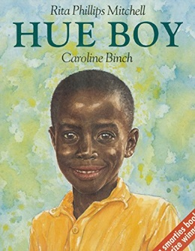
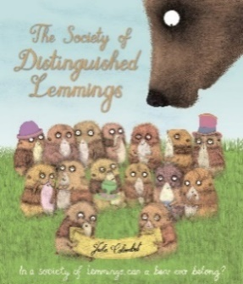






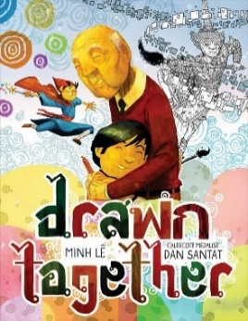
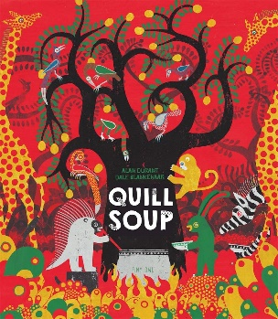





acceptance
Leaf by Sandra Dieckmann
War Game by Michael Foreman
Mixed by Arree Chung
The Smeds and The Smoos by Julia Donaldson & Axel Scheffler
Hue Boy by Rita Phillips Mitchell & Caroline Birch
The Society of Distinguished Lemmings: In a society of lemmings, can a bear ever belong? by Julie Colombet
One World Together by Catherine & Laurence Anholt
Green Lizards and Red Rectangles and the Blue Ball: A Story of Living in Harmony by Steve Antony
The Day You Begin by Jacqueline Woodson & Rafael Lopez (USA)
There’s Room for Everyone by Anahita Teymorian
Inch & Grub: A Story of Cavemen by Alastair Chisholm & David Roberts
Drawn Together by Minh Le & Dan Santat
Quill Soup by Alan Durant & Dale Blankenaar
All Are Welcome by Alexandra Penfold & Suzanne Kaufman
Amazing Grace by Mary Hoffman & Caroline Binch
The Day War Came by Nicole Davies & Rebecca Cobb
Julian is a Mermaid by Jessica Love
The New Girl by Nicola Davies & Cathy Fisher

Slide 5


acceptance
Giraffes Can’t Dance by Giles Andreae & Guy Parker-Rees
The Tale of Gilbert Alexander Pig by Gael Cresp & David Cox

Slide 6
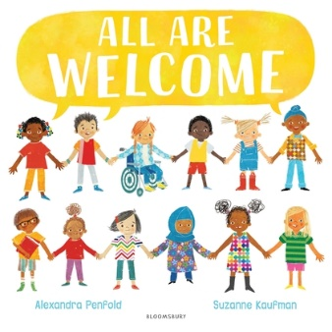
BELONGING

Slide 7

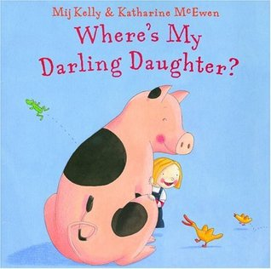

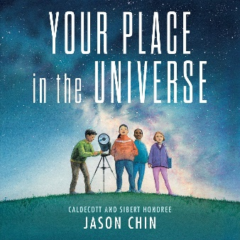



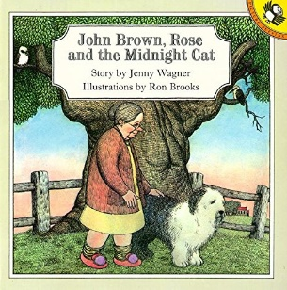






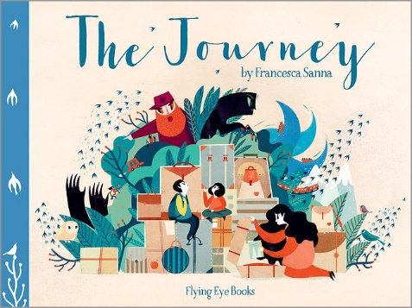

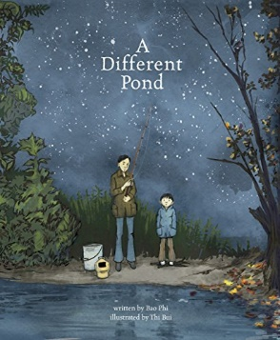

belonging
All Are Welcome by Alexandra Penfold & Suzanne Kaufman
Where’s My Darling Daughter? by Mij Kelly & Katherine McEwan
The Name Jar by Yangsook Choi
One World Together by Catherine & Laurence Anholt
Your Place in the Universe by Jason Chin
Migrations: Open Hearts Open Borders by numerous
Flock by Gemma Koomen
No Matter What by Debi Gliori
John Brown, Rose and the Midnight Cat by Jenny Wagner & Ron Brooks
Amazing Grace by Mary Hoffman & Caroline Birch
Stepping Stones: A Refugee Family’s Journey by Margriet Ruurs & Nizar Ali Badr
Refugees by Brian Bilston & Jose Sanabria
My Name Is Not Refugee by Kate Milner
Wisp: A Story of Hope by Zana Fraillon & Grahame Baker-Smith
What is a Refugee? By Elise Gravel
The Journey by Francesca Sanna
The Little Refugee by Anh Do, Suzanne Do & Bruce Whatley
A Different Pond by Bao Phi & Thi Bui
The Day War Came by Nicola Davies & Rebecca Cobb

Slide 8
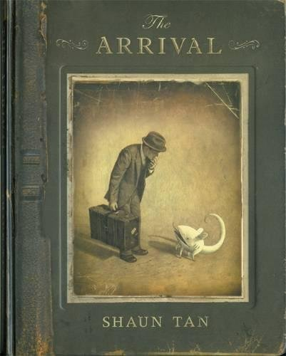


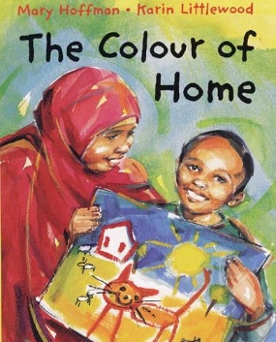

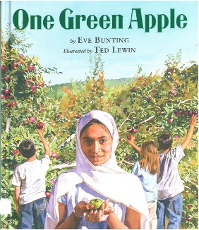
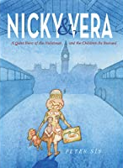


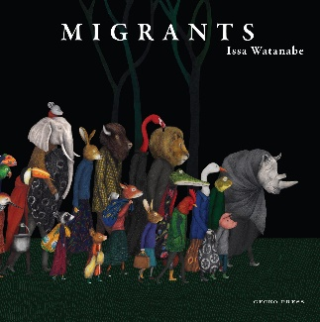
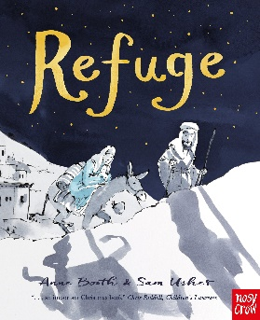


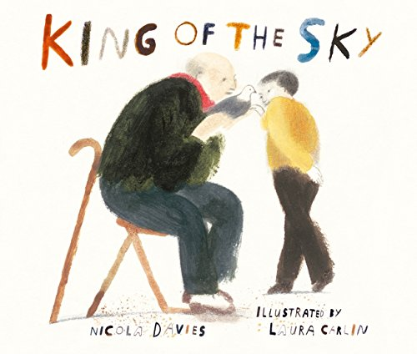


belonging
The Arrival by Shaun Tan
Carmela Full of Wishes by Matt De La Pena & Christian Robinson
Azzi In Between by Sarah Garland
The Colour of Home by Mary Hoffman & Karin Littlewood
The Suitcase by Chris Naylor-Ballesteros
One Green Apple by Eve Bunting & Ted Lewin
Nicky and Vera by Peter Sis
Coming to England by Floella Benjamin & Diane Ewen
Island Born by Junot Diaz & Leo Espinosa
Migrants by Issa Watanabe
Refuge by Anne Booth & Sam Usher
Welcome to Our World by Moira Butterfield & Harriet Lynas
Migrant by Maxine Trottier & Isabelle Arsenault
King of the Sky by Nicola Davies & Laura Carlin
There’s A Boy Just Like Me by Frasier Cox & Alison Brown
The Bear and the Piano by David Litchfield

Slide 9

Big questions

Slide 10




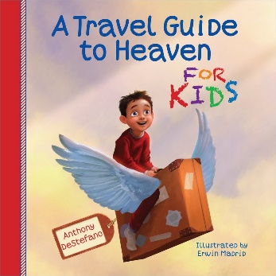

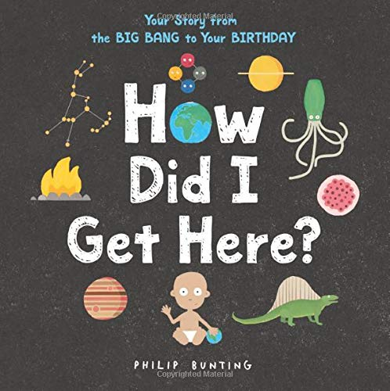
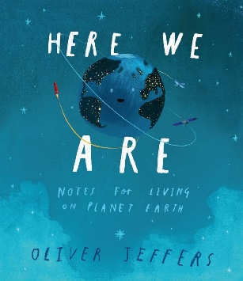
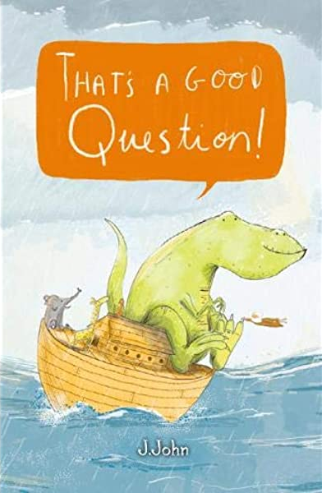


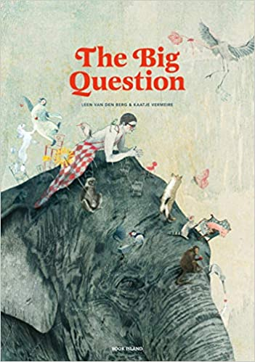


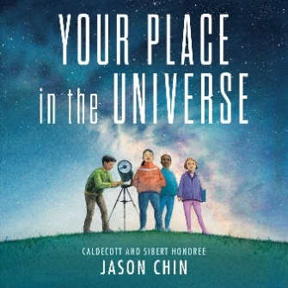
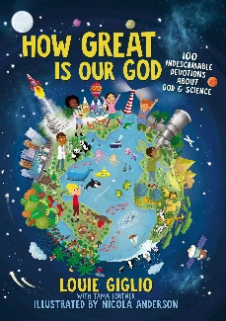

Big questions
Really Really Big Questions about God, Faith and Religion by Julian Baggini & Nishant Choksi
Big Ideas for Young Thinkers by Jamia Wilson & Andrea Pippins
The Three Questions by Jon J Muth
A Travel Guide to Heaven for Kids by Anthony DeStefano & Erwin Madrid
Dear God, I Have a Question by Kathryn Slattery
How Did I Get Here? by Philip Bunting
Here We Are by Oliver Jeffers
That’s a Good Question by J. John
The Little Book of Big Questions by Jackie French & Martha Newbigging
What Makes Me A Me? By Ben Faulks & David Tazzyman
The Big Question by Leen Van Den Berg & Kaatje Vermeire
Blue by Britta Teckentrup
Maia and What Matters by Tine Mortier & Kaatje Vermeire
Your Place in the Universe by Jason Chin
How Great Is Our God? by Louie Giglio, Tama Fortner & Nicola Anderson
Thoughts to Make Your Heart Sing by Sally Lloyd-Jones & Jago

Slide 11

Celebrations & Festivals

Slide 12





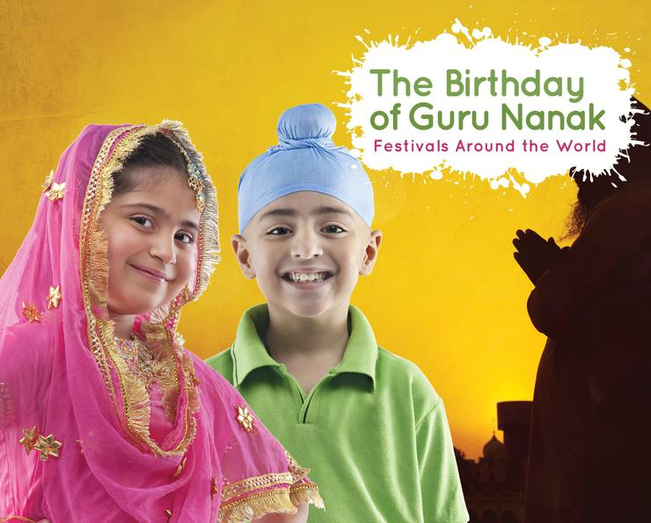

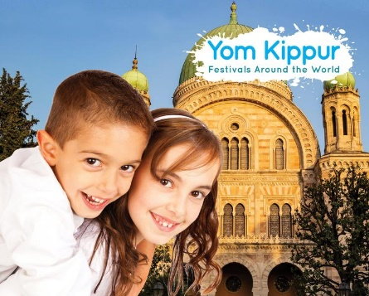


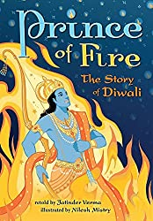

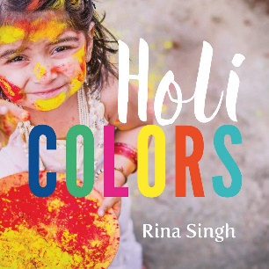
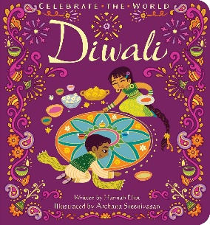

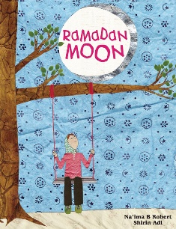
Celebrations & Festivals
A Year Full of Celebrations and Festivals by Christopher Corr
Festivals and Celebrations by Sandra Lawrence & Jane Newland
Ramadan: Festivals Around the World by Grace Jones
Eid al-Adha: Festivals Around the World Grace Jones
Rosh Hashanah: Festivals Around the World by Grace Jones
Easter: Festivals Around the World by Grace Jones
The Birthday of Guru Nanak: Festivals Around the World by Grace Jones
The Big Book of Festivals by Marita Bullock, Joan-Marie Hargreaves & Liz Rowland
Yom Kippur: Festivals Around the World by Grace Jones
Chinese New Year: Festivals Around the World by Grace Jones
Christmas: Festivals Around the World by Grace Jones
Prince of Fire: The Story of Diwali by Jatinder Verma & Nilesh Mishry
Festival of Colors by Kabir Sehgal, Surishtha Sehgal & Vashti Harrison
Holi Colours by Rina Singh
Diwali by Hannah Elliot & Archana Sreenivasan
Holi: Festivals Around the World by Grace Jones
Ramadan Moon by Na’ima B Robert & Shirin Adi

Slide 13


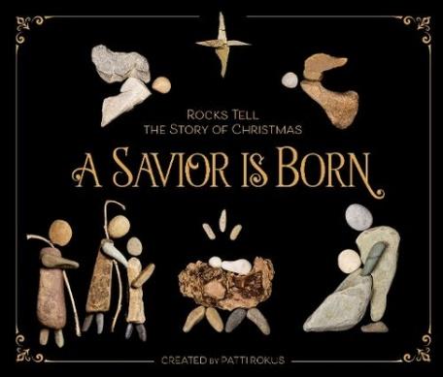
Celebrations & Festivals
Dogger by Shirley Hughes (Easter)
He is Risen by Patti Rokus
A Saviour is Born by Patti Rokus

Slide 14

Community

Slide 15













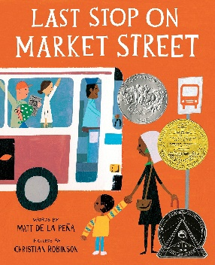





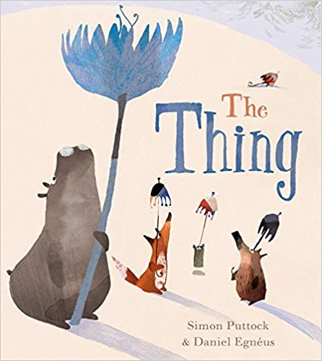
community
Hey, Wall: A Story of Art and Community by Susan Verde & John Parra
It Takes a Village by Hillary Rodham Clinton & Marla Frazee
The Invisible by Tom Percival
Stick and Stone by Beth Ferry & Tom Lichtenfield
All Are Welcome by Alexandra Penfold & Suzanne Kaufman
Quill Soup by Alan Durant & Dale Blankenaar
If You Come to Earth by Sophie Blackall
The Society of Distinguished Lemmings: In a society of lemmings, can a bear ever belong? by Julie Colombet
The Giving Tree by Shel Silverstein
Elmer by David McKee
The Invisible Boy by Trudy Ludwig & Patrice Barton
The Whispering Town by Jennifer Elvgren & Fabio Santomauro
Mr Gumpy’s Outing by John Burningham
Last Stop on Market Street by Matt De La Pena & Christian Robinson
If the World Were a Village by David J Smith & Shelagh Armstrong
Island Born by Junot Diaz & Leo Espinosa (Dominican Republic/USA)
The Marvellous Fluffy, Squishy, Itty Bitty by Beatrice Alemagna (France)
Child of St Kilda by Beth Waters
Love the World by Todd Parr
The Thing by Simon Puttock & Daniel Egneus

Slide 16










community
Here We Are by Oliver Jeffers
My Very Own Space by Pippa Goodhart & Rebecca Crane
We Are Britain! by Benjamin Zephaniah by Prodeepta Das
There Is a Tribe of Kids by Lane Smith
Footpath of Flowers by Jon Arno Lawson & Sydney Smith
The Only Way is Badger by Stella J Jones & Carmen Saldana
Who Will I Be? By Abby Huntsman & Joanne Lew-Vriethoff
Mama Panya’s Pancakes by Mary & Rich Chamberlin & Julia Cairns
Varmints by Helen Ward & Marc Craste
The Lumberjack’s Beard by Duncan Beedie

Slide 17

Diversity/RESPECT

Slide 18


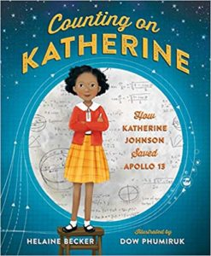




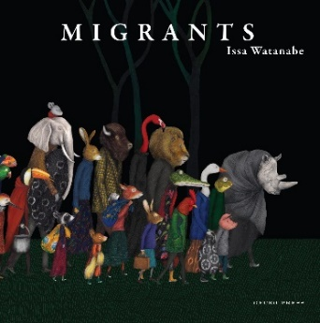


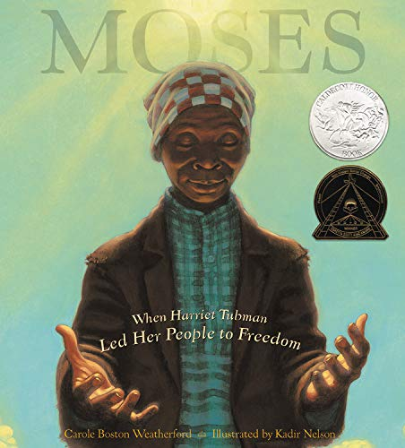






Diversity/respect
Freedom, We Sing by Amyra Leon & Molly Mendoza
Every Child a Song by Nicola Davies & Marc Martin
Counting on Katherine by Helaine Becker & Dow Phumiruk
I Have the Right to be a Child by Alain Serres, Aurelia Fronty & Sarah Ardizzone
Henry’s Freedom Box by Ellen Levine & Kadir Nelson
If a Bus Could Talk: The Story of Rosa Parks by Faith Ringgold
Kamala Harries: Rooted in Justice by Nikki Grimes & Laura Freeman
Migrants by Issa Watanabe
Mary Wears What She Wants by Keith Negley
Julian at the Wedding by Jessica Love
Moses: When Harriet Tubman Led Her People to Freedom by Carole Boston Weatherford & Kadir Nelson
Box: Henry Brown Mails Himself to Freedom by Carole Boston Weatherford & Michele Wood
The Undefeated by Kwame Alexander & Kadir Nelson
Muslim Girls Rise by Saira Mir & Aaliya Jaleel
Flight for Freedom by Kristen Fulton & Torben Kuhlmann
Minty: A Story of Young Harriet Tubman by Alan Schroeder & Jerry Pinkney
For the Right to Learn: Malala Yousafzai’s Story by Rebecca Langston-George & Janna Bock

Slide 19


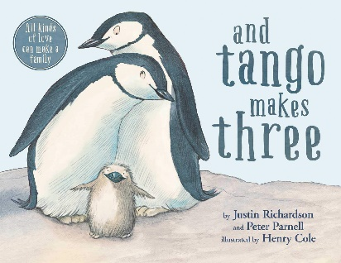




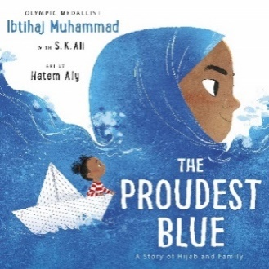
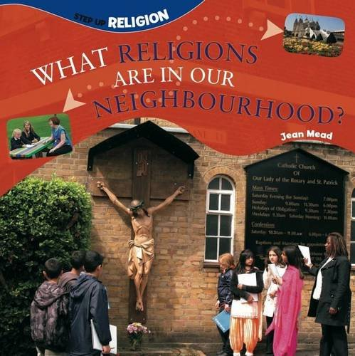


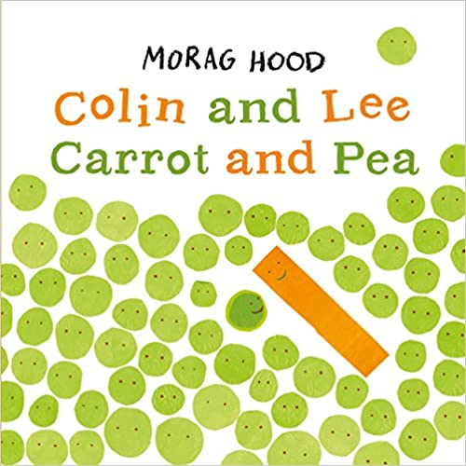

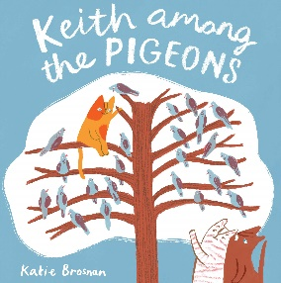

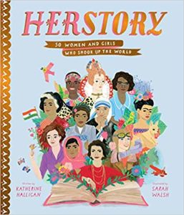
Diversity/respect
Pride: The Story of Harvey Milk and the Rainbow Flag by Rob Sanders & Steven Salerno
We Are Family by Patricia Hegarty & Ryan Wheatcroft
And Tango Makes Three by Justin Richardson, Peter Parnell & Henry Cole
Julian is a Mermaid by Jessica Love
Introducing Teddy by Jessica Walton & Dougal MacPherson
Pies from Nowhere: How Georgia Gilmore Sustained the Mixed by Arree Chung
The Proudest Blue: A Story of Hijab and Family by Ibtihaj Muhammad, S K Ali & Hatem Aly
One World Together by Catherine & Laurence Anholt
What Religions are in our Neighbourhood? by Jean Mead
The Day You Begin by Jacqueline Woodson & Rafael Lopez
The Girl with Two Dads by Mel Elliott
Colin and Lee Carrot and Pea by Morag Hood
Pink by Lynne Rickards & Margaret Chamberlain
Keith Among the Pigeons by Katie Brosnan
Little Dreamers: Visionary Women Around the World by Vashti Harrison
HerStory by Katherine Halligan & Sarah Walsh

Slide 20
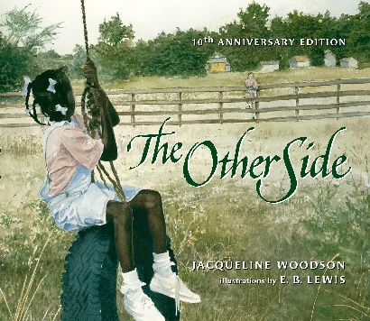



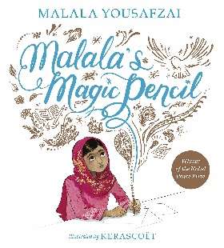
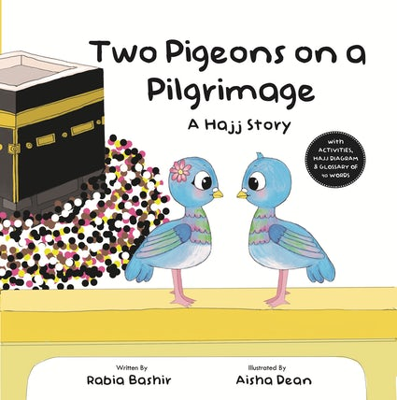
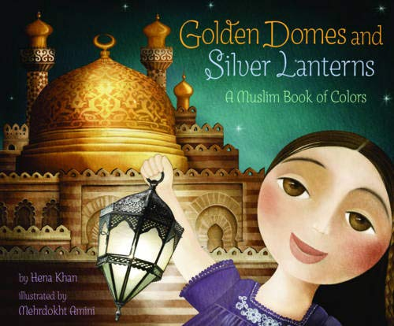


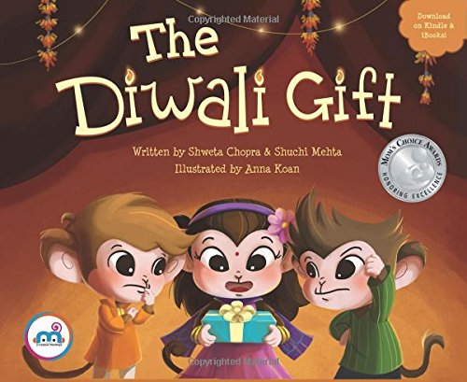

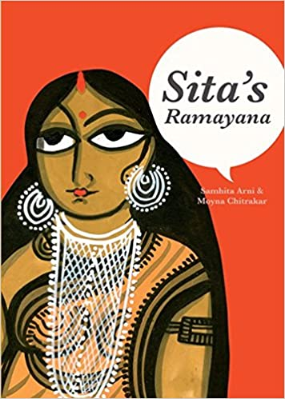
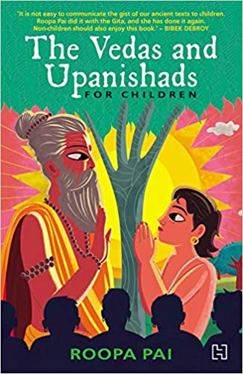
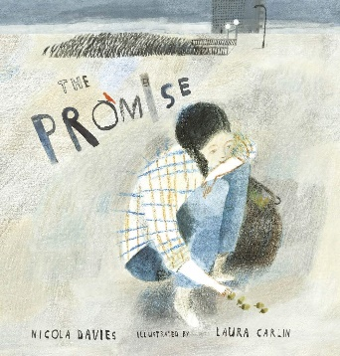


Diversity/respect
The Other Side by Jacqueline Woodson & E B Lewis
Unspeakable: The Tulsa Race Massacre by Carole Boston Weatherford & Floyd Cooper
My Place by Nadia Wheatley & Donna Rawlins
Amazing Muslims Who Changed the World by Burhana Islam
Malala’s Magic Pencil by Malala Yousafzai & Kerascoet
Two Pigeons on a Pilgrimage: A Hajj Story by Rabia Bashir & Aisha Dean
Golden Domes & Silver Lanterns by Hena Khan & Mehrdokht Amini
The Hanukkah Mice by Steven Kroll & Michelle Shapiro
Ganesha’s Sweet Tooth by Sanjay Patel & Emily Hughes
The Diwali Gift by Shweta Chopra, Shuchi Mehta & Anna Koan
Festival of Colors by Kabir Sehgal & Surishtha Sehgal
Sita’s Ramayana by Sambita Arni & Moyna Chitrakar
The Vedas and Upanishads for Children by Roopa Pai
The Promise by Nicola Davies & Laura Carlin
The Silence Seeker by Ben Morley & Carl Pearce
What We’ll Build by Oliver Jeffers

Slide 21







Diversity/respect
Desmond and the Very Mean World by Archbishop Desmond Tutu and Douglas Carlton Abrams & AG Ford
Coming to England by Floella Benjamin & Diane Ewen
Yaffa and Fatima Shalom, Salaam by Fawzia Gilani-Williams & Chiara Fedele
Jerome by Heart by Thomas Scotto & Olivier Tallec
Steamboat School by Deborah Hopkinson & Ron Husband
Two Monsters by David McKee
Shine by Sarah Asuouo & Florelle Bohi

Slide 22

joy

Slide 23


















Joy
Freedom, We Sing by Amyra Leon & Molly Mendoza
Augustus and his Smile by Catherine Rayner
Joy by Corinne Averis & Isabelle Follath
Happy Dreamer by Peter H Reynolds
Nothing Can Separate You From God’s Love! By Natalee Creech & Joseph Cowman
Lights on Cotton Rock by David Litchfield
Tom’s Magnificent Machine by Linda Sarah & Ben Mantle
Would You Rather by John Burningham
Happy by Nicola Edwards & Katie Hickey
Once Upon An Eid: Stories of Hope and Joy by 15 Muslim Voices by SK Ali & Aisha Saeed
Giraffes Can’t Dance by Giles Andreae & Guy Parker-Rees
The Dancing Tiger by Malachy Doyle, Steve Johnson and Lou Fancher
What a Wonderful World by Bob Thiele, George David Weiss & Tim Hopgood
After the Fall by Dan Santat
When I Coloured in the World by Ahmadreza Ahmadi & Ehsan Abdollahi
Singing in the Rain by Arthur Freed & Tim Hopgood
Olivia Dances for Joy by Natalie Shaw
The World Made a Rainbow by Michelle Robinson & Emily Hamilton

Slide 24

Light

Slide 25













light
You Are Light by Aaron Becker
My Favorite Color by Aaron Becker
When God Made Light by Matthew Paul Turner & David Catrow
Light the Candles by Joan Holub & Lynne Cravath
Hanukkah: The Festival of Lights by Bonnie Baker & Joanie Stone
Let There Be Light by Archbishop Desmond Tutu & Nancy Tillman
Chandra’s Magic Light by Theresa Heine & Judith Gueyfier
Nature’s Light Spectacular by Katy Flint & Cornelia Li
The Light in the Night by Marie Voigt
She Caught the Light: Williamina Stevens Fleming – Astronomer by Kathryn Lasky & Julianna Swaney
Can’t You Sleep, Little Bear? By Martin Waddell & Barbara Firth
Rain Before Rainbows by Smriti Halls & David Litchfield

