Slide 1

RE recommended reads
Part 2
A useful picture book list to support the teaching of Religious Education and Worldviews.

Slide 2

Loss

Slide 3













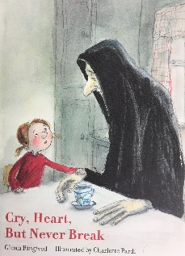




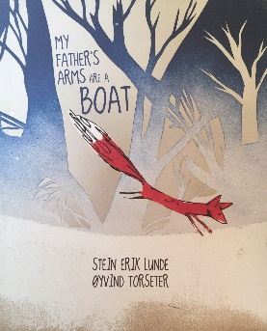
Loss, grief and sadness
The Day War Came by Nicola Davies and Rebecca Cobb
The Sea Saw by Tom Percival
The Dam by David Almond & Levi Pinfold
The Heart in the Bottle by Oliver Jeffers
The Tear Thief by Carol Ann Duffy & Nicoletta Ciccoli
Small in the City by Sydney Smith
The Red Tree by Shaun Tan
Erika’s Story by Ruth Vander-Zee & Roberto Innocenti
Up the Mountain by Marianne Dubuc
Ocean Meets the Sky by The Fan Brothers
Snook Alone by Marilyn Nelson & Timothy Basil Ering
Duck, Death and the Tulip by Wolf Erlbruch
Cry Heart but Never Break by Glenn Ringtved & Charlotte Pardi
The Flat Rabbit by Bardur Oskarsson
Fox and the Goldfish by Nils Pieters
Life and I: A Story about Death by Elisabeth Helland Larsen & Marine Schneider
Maia and What Matters by Tine Mortier & Kantje Vermeire
Mum’s Jumper by Jayde Perkin
My Father’s Arms are a Boat by Stein Erik Lunde & Oyvjnd Torseter

Slide 4




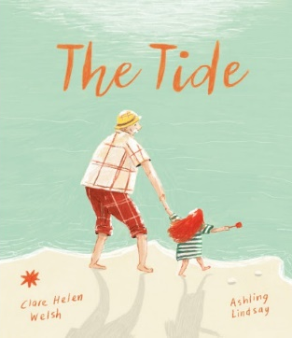
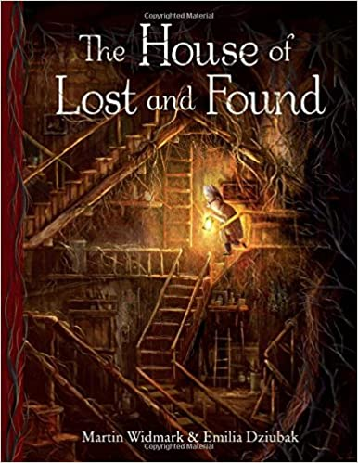

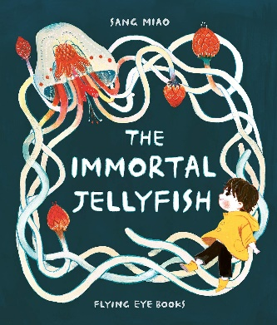
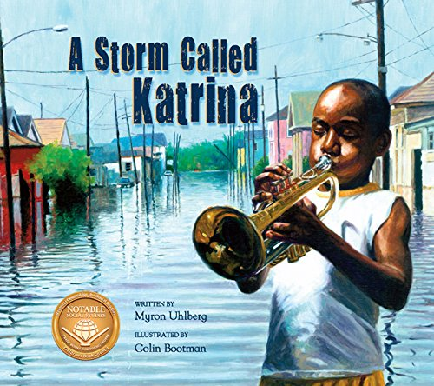






Loss, grief and sadness
A Grandfather’s Heart by Irena Trevisan
Tom’s Magnificent Machines by Linda Sarah & Ben Mantle
The Memory Tree by Breta Teckentrup
The Garden of Hope by Isabel Otter & Katie Rewse
The Tide by Clare Helen Walsh & Ashling Lindsay
The House of Lost and Found by Martin Widmark & Emilia Dziubak
Finn’s Feather by Rachel Noble & Zoey Abbott
The Immortal Jellyfish by Sang Miao
A Storm Called Katrina by Myron Uhlberg & Colin Bootman
Tree: A Little Story about Big Things by Danny Parker & Matt Ottley
The Colour Thief by Andrew Fusek Peters, Polly Peters & Karin Littlewood
If All the World Were… by Joseph Coelho & Allison Colpojs
The Scar by Charlotte Moundlic & Olivier Tallec
One Wave at a Time by Holly Thompson & Ashley Crowley
A Map into the World by Kao Kalia Yang & Seo Kim

Slide 5










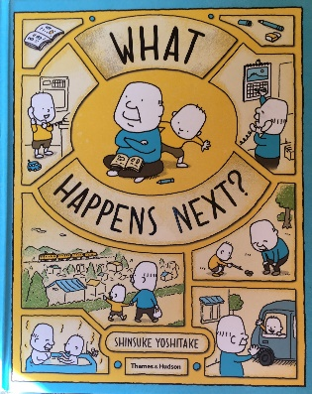




Loss, grief and sadness
The Lonely Tree by Nicholas Halliday
The Visitor by Antje Damm
Michael Rosen’s Sad Book by Michael Rosen
Footpath of Flowers by Jon Arne Lawson and Sydney Smith
Grandpa’s Island by Benji Davies
Where the Poppies Now Grow by Hilary Robinson and Martin Impey
The Rough Patch by Brian Lies
Big Cat Little Cat by Elisha Cooper
Rabbityness by Jo Empson
Grandpa’s Angel by Jutta Bauer
What Happens Next? By Shinsuke Yositake
The Dead Bird by Margaret Wise Brown & Christian Robinson
No Matter What by Debi Gliori
Funeral by Matt James
Badger’s Parting Gifts by Susan Varley

Slide 6




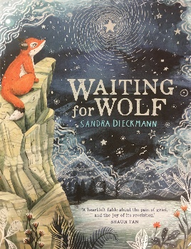







Loss, grief and sadness
Bug in a Vacuum by Melanie Watt
Rabbit and the Motorbike by Kate Hoefler & Sarah Jocoby
Grandpa by John Burningham
Missing Mummy by Rebecca Cobb
Waiting for Wolf by Sandra Dieckmann
The Gift by Carol Ann Duffy and Rob Ryan
The End of Something Wonderful by Stephanie V. W. Lucianovic & George Ermos
Grandpa’s Angel by Jutta Bauer
Fox: A Circle of Life Story by Isabel Thomas & Daniel Egneus
The Survivor Tree by Cheryl Somers Aubin & Sheila Harrington
Girl from the Sea by Margaret Wild & Jane Tanner
I’ll Always Love You by Hans Wilhelm
Always and Forever by Debi Gliori & Alan Durant

Slide 7

Love

Slide 8



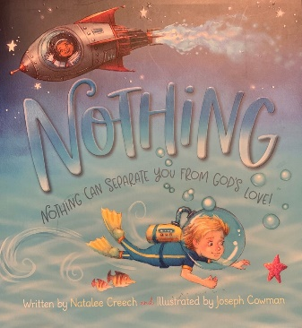










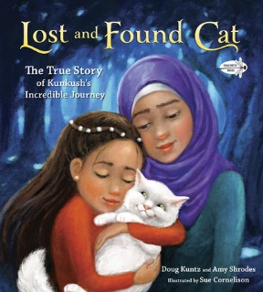


love
Love by Matt De La Pena & Loren Long
Hug by Jez Alborough
Nothing Can Separate You From God’s Love! By Natalee Creech & Joseph Cowman
The Heart and the Bottle by Oliver Jeffers
And Tango Makes Three by Justin Richardson, Peter Parnell & Henry Cole
Finn’s Feather by Rache Noble & Zoey Abbott
How Do Dinosaurs Say I Love You? by Jane Yolen & Mark Teague
One Love by Bob Marley, Cedella Marley & Vanessa Brantley-Newton
Owl Babies by Martin Waddell & Patrick Benson
Julian at the Wedding by Jessica Love
The Garden of Hope by Isabel Otter & Katie Rewse
The Perfect Shelter by Clare Helen Welsh & Asa Gilland
I Am Love: A Book of Compassion by Susan Verde & Peter H Reynolds
Lost and Found Cat by Doug Kuntz, Amy Shrodes & Sue Cornelison
Guess How Much I Love You by Sam McBratney & Anita Jeram
No Matter What by Debi Gliori
I’ll Always Love You by Hans Wilhelm

Slide 9









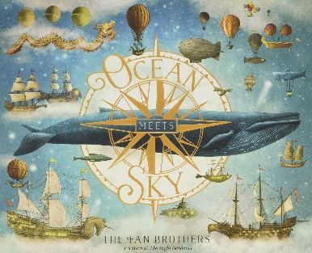





love
Why Do You Love Me? by Martin Baynton
I Forgot to Say I Love You by Miriam Moss & Anna Currey
Little Baa by Kim Lewis
Where’s My Darling Daughter? By Mij Kelly & Katherine McEwan
So Much by Trish Cooke & Helen Oxenbury
The Emperor’s Egg by Martin Jenkins & Jane Chapman
The Ferry Birds by Helen Dunmore & Rebecca Cobb
A Grandfather’s Heart by Irena Trevisan & Enrico Lorenzi
Under the Love Umbrella by Davina Bell & Allison Colpoys
Ocean Meets the Sky by The Fan Brothers
The Sea Saw by Tom Percival
If All the World Were by Joseph Coelho & Allison Colpoys
The Tide by Clare Helen Welsh & Ashling Lindsay
The Building Boy by Ross Montgomery & David Litchfield
A Chair for My Mother by Vera B Williams

Slide 10

Our planet

Slide 11

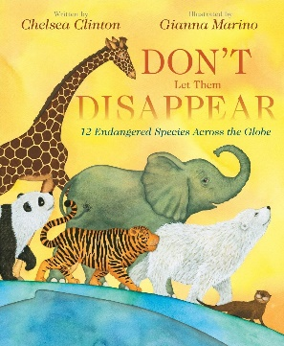

















Our planet
It’s Your World Now by Barry Falls
Don’t Let Them Disappear by Chelsea Clinton & Gianna Marino
Somebody Swallowed Stanley by Sarah Roberts & Hannah Peck
The Last Tree by Ingrid Chabbert & Guridi
Fox and the Deep Sea Quest by Benjamin Flouw
A Planet Full of Plastic by Neal Layton
Duffy’s Lucky Escape by Ellie Jackson & Liz Oldmeadow
One Plastic Bag by Miranda Paul & Elizabeth Zunon
Fantastically Great Women Who Saved the Planet by Kate Pankhurst
Old Enough to Save the Planet by Adelina Lirius & Loll Kirby
My Friend Earth by Patricia MacLachlan & Francesca Sanna
Red Alert by Catherine Barr & Anne Wilson
Here We Are by Oliver Jeffers
We Are Water Protectors by Carole Lindstrom & Michaela Goade
Dear Earth by Isabel Otter & Clara Anganuzzi
Rocket Says Clean Up by Nathan Bryon & Dapa Adeola
How too Help a Hedgehog and Protect a Polar Bear by Jess French & Angela Keoghan
What a Waste by Jess French
Last: The Story of a White Rhino by Nicola Davies
Endangered Animals and How You Can Help by Sam Hutchinson & Sarah Dennis

Slide 12










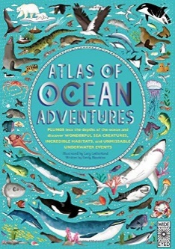










Our planet
Coral Reefs by Jason Chin
Aquarium by Cynthia Alonso
Extraordinary by Penny Harrison & Katie Wilson
Whale in a Fishbowl by Troy Howell & Richard Jones
The Song of the Nightingale by Tanya Landman & Laura Carlin
The Last Tree by Emily Haworth-Booth
The Last Tree by Maria Quintana Silva & Silvia Alvarez
The Hike by Alison Farrell
Wild City by Ben Hoare & Lucy Rose (worldwide)
Wombat Goes Walkabout by Michael Morpurgo & Christian Birmingham
Atlas of Ocean Adventures by Lucy Letherland & Emily Hawkins
The Boy Who Grew A Forest by Sophia Gholz & Kayla Harren
The Book of Bees by Piotr Socha
The Big Book of Birds by Yuval Zommer
The Big Book of Bugs by Yuval Zommer
Tiger, Tiger, Burning Bright by Fiona Waters & Britta Teckentrup
Florette by Anna Walker
Fish by Brendan Kearney
I Am the Seed That Grew That Tree by Frann Preston-Gannon & Fiona Waters
Window by Jeannie Baker
Giant by Juliet & Charles Snape

Slide 13





Our planet
Five Little Fiends by Sarah Dyer
The Snail and the Whale by Julia Donaldson & Axel Scheffler
The Gigantic Turnip by Aleksei Tolstoy & Niamh Sharkey
Wangari’s Trees of Peace by Jeanette Winter
In the Forest by Anouk Boisrobert & Louis Rigaud

Slide 14

Relationships

Slide 15





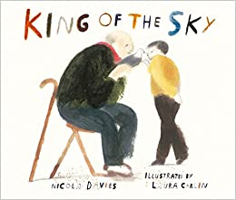











Relationships
All Are Welcome by Alexandra Penfold & Suzanne Kaufman
My Two Grannies by Floella Benjamin & Margaret Chamberlain
Drawn Together by Minh Le & Dan Santat
A Different Pond by Bao Phi & Thi Bui
Hike by Pete Oswald
King of the Sky by Nicola Davies & Laura Carlin
Finding Francoise by Gus Gordon (France)
The Scarecrow’s Wedding by Julia Donaldson & Axel Scheffler
Guess How Much I Love You by Sam McBratney & Anita Jeram
Can’t You Sleep Little Bear? by Martin Waddell & Barbara Firth
John Brown, Rose and the Midnight Cat by Jenny Wagner & Ron Brooks
Dogger by Shirley Hughes
Tusk Tusk by David McKee
I’m Not Your Friend by Sam BcBratney & Kim Lewis
Bear by Ben Queen & Joe Todd-Stanton
The Visitor by Antje Damm
The House of Lost and Found by Martin Widmark & Emilia Dziubak

Slide 16

RUles

Slide 17







RULEs
The Red Flag: Josh Learns About Rules by Deborah Chancellor & Elif Balta Parks
How to Build Your Own Country by Valerie Wyatt & Fred Rix
You Must Bring a Hat by Simon Philip & Kate Hindley
Rules of the House by Mac Barnett & Matt Myers
While We Can’t Hug by Eoin McLaughlin & Polly Dunbar
Don’t Cross the Line by Isabel Minhos Martins & Bernardo P Carvalho
The Society of Distinguished Lemmings by Julie Colombet

Slide 18

Sacrifice

Slide 19










Sacrifice
Angelo by David Macaulay
The Giving Tree by Shel Silverstein
The Quilt Maker’s Gift by Jeff Brumbeau & Gail de Marcken
The Very Cranky Bear by Nick Bland
The Legend of the Bluebonnet by Tomie DePaola
Dogger by Shirley Hughes
Erika’s Story by Ruth Vander Zee & Roberto Innocenti
The Very Hungry Caterpillar by Eric Carle
The Rainbow Fish by Marcus Pfister

Slide 20

Special People

Slide 21




















Special People
Women of the Bible by Margaret MacAllister & Alida Massari
HerStory by Katherine Halligan & Sarah Walsh
A Voice Named Aretha by Katheryn Russell-Brown & Laura Freeman
Skyward: The Story of Female Pilots in WW11 by Sally Deng
Suffragette The Battle for Equality by David Roberts
Emmeline Pankhurst: Votes for Women by Kay Barnham
Desmond and the Very Mean Word by Archbishop Desmond Tutu, Douglas Carlton Abrams & A G Ford (Sth Africa)
Thunder Rose by Jerdine Nolen & Kadir Nelson
Sisters and Champions by Howard Bryant & Floyd Cooper
The Bluest of Blues: Anna Atkins and the First Book of Photographs by Fiona Robinson
Stories for South Asian Super Girls by Raj Kaur Khaira
Miep and the Most Famous Diary by Meef Pincus & Jordi Solano
Nature’s Friend: The Gwen Frostic Story by Lindsey McDivitt & Eileen Ryan Ewen
Rosa’s Bus by Jo S Kittinger & Steven Walker
Muslim Girls Rise by Saira Mir & Aaliya Jaleel
Lighter than Air: Sophie Blanchard The First Female Pilot by Matthew Clark Smith & Matt Tavares
Instructions Not Included by Tami Lewis Brown, Debbie Loren Dunn & Chelsea Beck
Born to Ride by Larissa Theule
Counting on Katherine by Helaine Becker & Dow Phumiruk
How to Solve A Problem: The Rise (and Falls) of a Rock-Climbing Champion by Ashima Shiraishi & Yao Xiao

Slide 22




















Special People
Moses: When Harriet Tubman Led Her People to Freedom by Carole Boston Weatherford & Kadir Nelson
Little People Big Dreams: Amelia Earhart
Women in Sports by Rachel Ignotofsky
Hidden Figures by Margot Lee Shetterly & Laura Freeman
Rosa Parks by Lisbeth Kaiser & Marta Antelo (see the whole of this series)
Rise Maya Angelou: From Caged Bird to Poet of the People by Bethany Hegedus & Tonya Engel
Nina: Jazz Legend and Civil Rights Activist Nina Simone by Alice Briere-Haquet & Bruno Llance
Greta and the Giants by Zoe Tucker & Zoe Persico
Great Women Who Changed the World by Kate Pankhurst
Flying High: The Story of Gymnastic Champion Simone Biles by Michelle Meadows & Ebony Glenn
Amelia and Eleanor Go For a Ride by Pam Munoz Ryan & Brian Selznick
The Watcher by Jeanette Winter
For the Right to Learn: Malala Yousafzai’s Story by Rebecca Langston-George & Janna Bock
Black Music Greats: 40 Inspiring Icons by Olivier Cachin & Jerome Masi
Women in Science by Rachel Ignotofsky
Little Leaders: Bold Women in Black History by Vashti Harrison
Little Leaders: Visionary Women Around the World by Vashti Harrison
Minty: A Story of a Young Harriet Tubman by Alan Schroeder & Jerry Pinkney
If a Bus Could Talk: The Story of Rosa Parks by Fauth Ringgold
Fantastically Great Women Who Saved the Planet by Kate Pankhurst

Slide 23



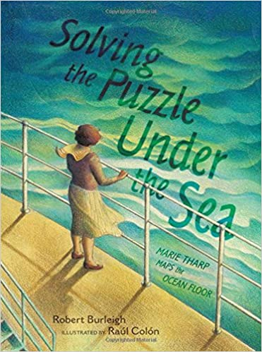


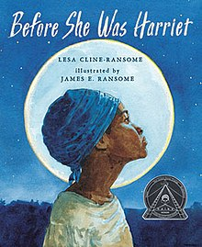









SPECIAL PEOPLE
Wilma Unlimited by Katherine Krull & David Diaz (USA)
Super Scientists by Anne Blanchard & Tino
Of Thee I Sing: A Letter to my Daughters by Barack Obama & Loren Long
People of Peace by Sandrine Murza & Le Duo
Solving the Puzzle Under the Sea by Robert Burleigh & Raul Colon
Brilliant Ideas From Wonderful Women by Aitziber Lopez & Luciano Lozano
Nelson Mandela: Long Walk to Freedom by Chris Van Wyk & Paddy Bouma
Before She Was Harriet by Lesa Cline-Ransome & James E Ransome
A Band of Angels by Deborah Hopkinson & Raul Colon
A Picture Book of Martin Luther King by David A Adler & Robert Casilla
Hidden Figures by Margot Lee Shetterly & Laura Freeman
Grandad Mandela by Zaz, Ziwelene and Zindzi Mandela & Sean Qualls
Mandela by Floyd Cooper
Box Henry Brown Mails Himself to Freedom by Carole Boston Weatherford & Michele Wood
The Seed of Compassion by Dalai Lama & Bao
The Life of the Buddha by Heather Sanche & Tara Di Gesu
The Brave Cyclist by Amelia Hoffman & Chiars Fedele

Slide 24




Special People
Grandfather Gandhi by Arun Gandhi, Bethany Hegedus & Evan Turk
Little People Big Dreams: Mahatma Gandhi by Isabel Sanchez Vegara & Albert Arraya
Nadia The Girl Who Couldn’t Sit Still by Karlin Gray & Christine Davenier
Wilma Unlimited by Katherine Krull & David Diaz (USA)

Slide 25
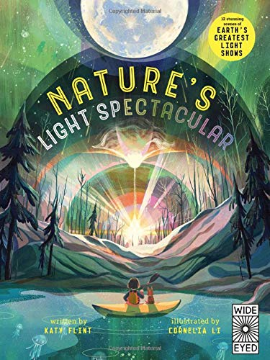
Special opportunities

Slide 26
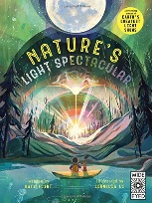

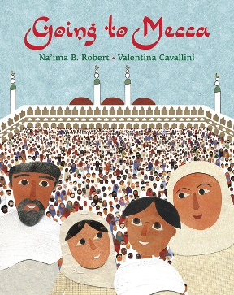




Special opportunities
Nature’s Light Spectacular by Katy Flint & Cornelia Li
Yan’s Hajj: The Journey of a Lifetime by Fawzia Gilani & Sophie Burrows
Going to Mecca by Na’ima B Robert & Valentina Cavallini
Two Pigeons on a Pilgrimage: A Hajj Story by Rabia Bashir & Aisha Dean
Atlas of Adventures: Wonders of the World by Lucy Letherland & Ben Handicott
Atlas of Adventures by Lucy Letherland
Dear Pope Francis by Pope Francis

Slide 27

Stories from holy texts

Slide 28






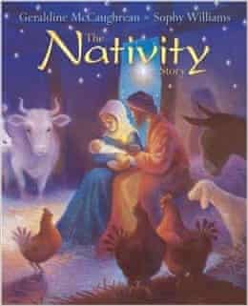





Stories of holy texts
Refuge by Anne Booth & Sam Usher
A Christmas Story by Brian Wildsmith
And God Said by Andrew Wilson & Rosie Dexter
Women of the Bible by Margaret McAllister & Alida Massari
The First Christmas by Jan Pienkowski
B is for Bethlehem by Isabel Wilner & Elisa Kleven
The Nativity Story by Gerladine McCaughrean & Sophy Williams
The Gita for Children by Roopa Pai
The Biggest Story by Kevin DeYoung & Don Clark
Bible Infographics Volume 1 and 2
Exodus by Brian Wildsmith

